Slide 1
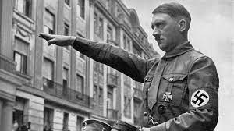
Adolf Hitler
Nazi leader of Germany

Slide 2
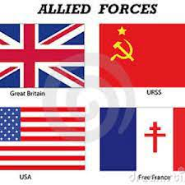
Allied Powers
Alliance of Great Britain, France, Russia, and the U.S.

Slide 3
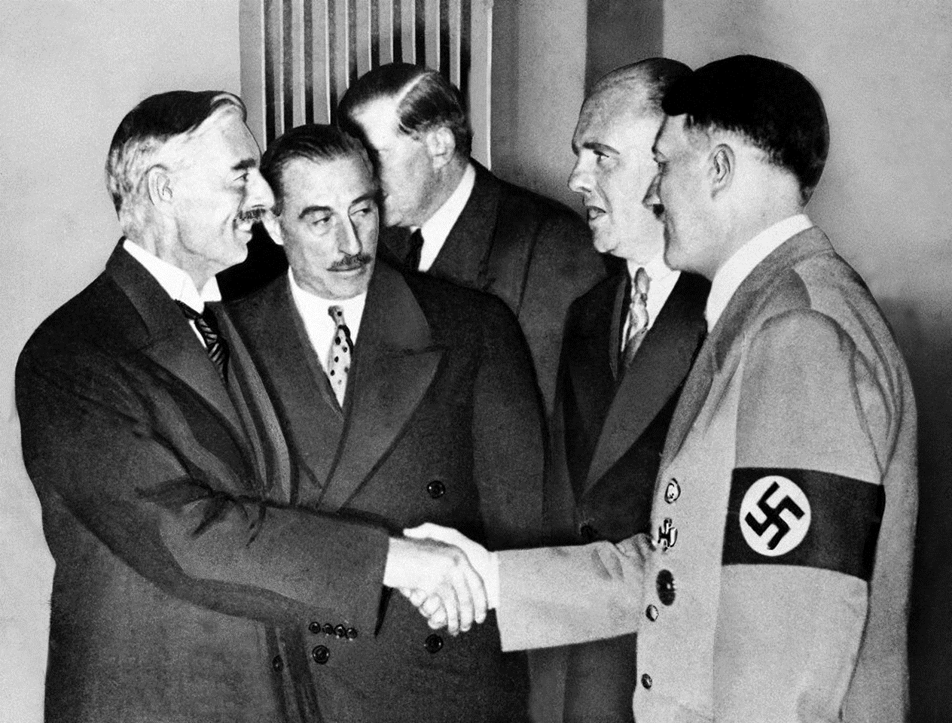
Appeasement
The policy of giving in to satisfy the demands of a potential enemy

Slide 4
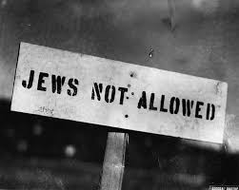
Anti-Semitism
Hostility or prejudice against Jews

Slide 5
Axis Powers
Alliance between Germany, Italy, and Japan

Slide 6
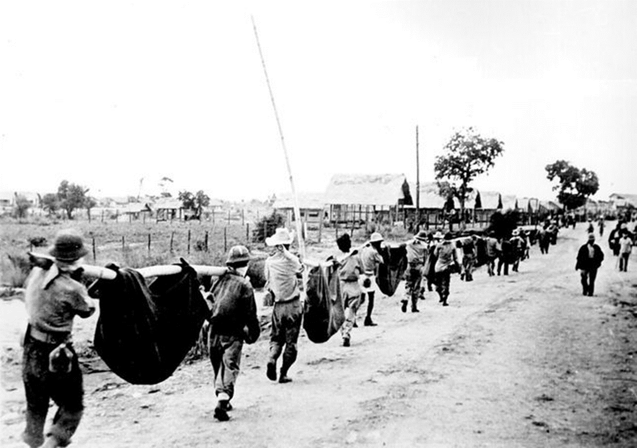
Bataan Death March
Prisoners of war were forced by the Japanese to march 60 miles; many died

Slide 7
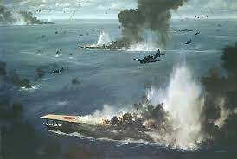
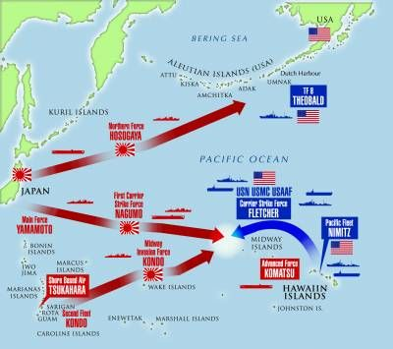
Battle of Midway
Naval battle and turning point for the Allies in the Pacific

Slide 8
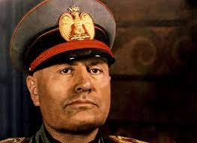
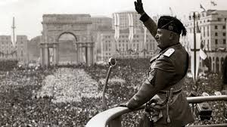
Benito Mussolini
Fascist dictator of Italy

Slide 9
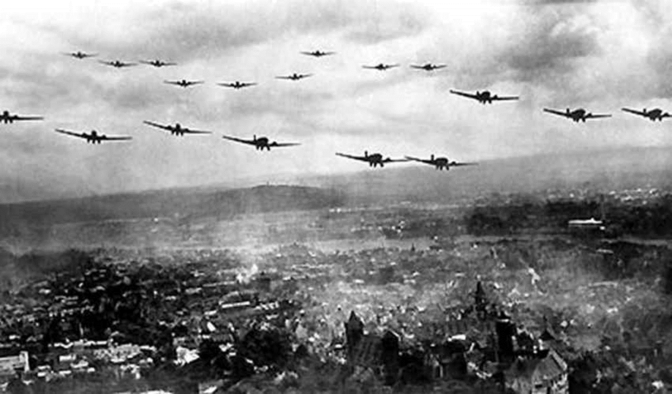
Blitzkrieg
Germany’s new type of warfare - rapid, coordinated movements by airplanes, tanks, troop carriers, and infantry

Slide 10
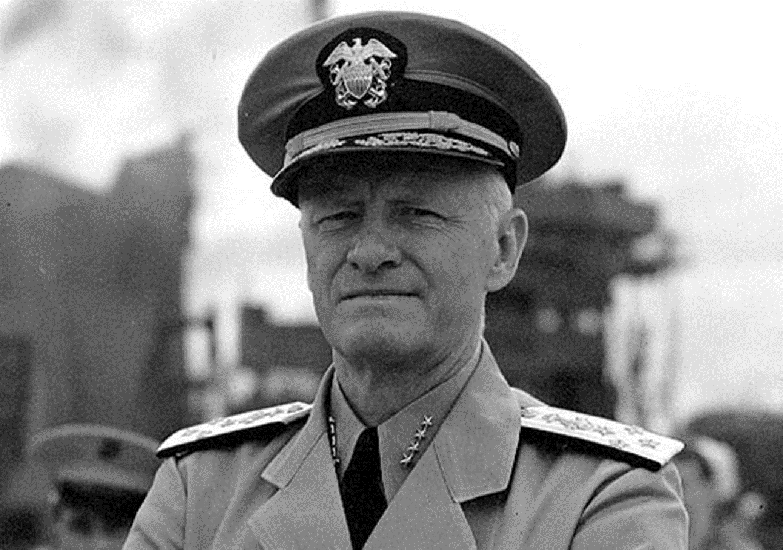
Chester Nimitz
Naval Admiral; appointed Commander-in-Chief of the U.S. Pacific Fleet just after Pearl Harbor, crippled Japanese Navy

Slide 11
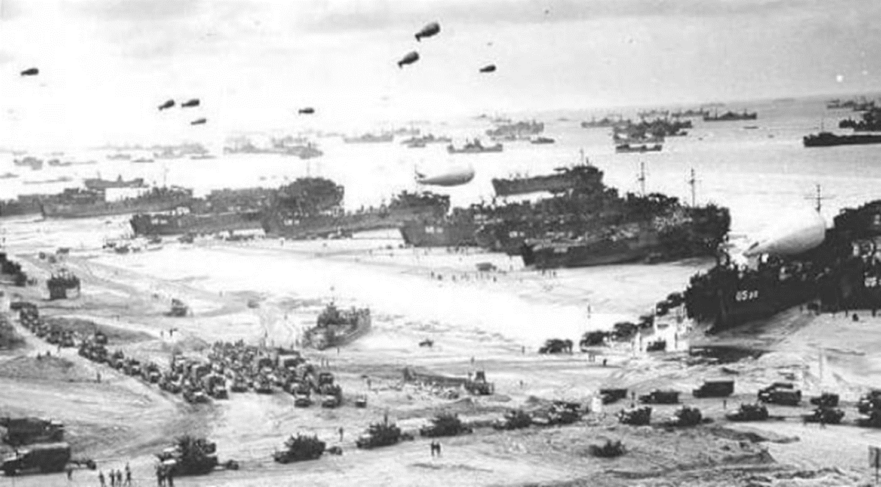
D-Day (Omaha Beach)
June 6, 1944, Allies launched a massive invasion of France to reclaim from Germany (Battle of Normandy); the largest amphibious operation

Slide 12
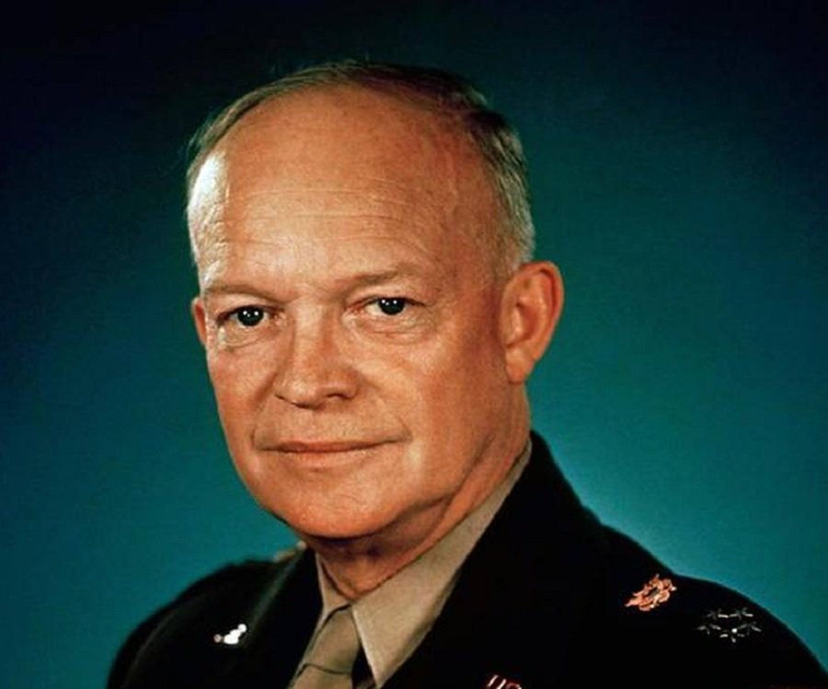
Dwight Eisenhower
Supreme Commander of D-Day and Allied invasion of Europe

Slide 13
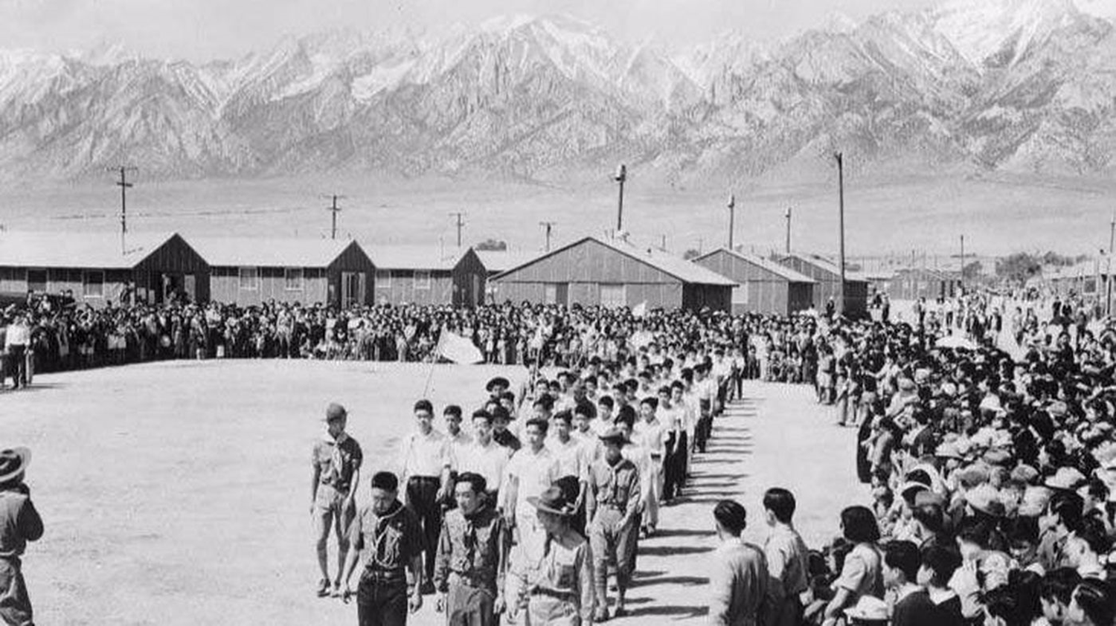
Executive Order 9066
Relocation of Japanese Americans to internment camps after Pearl Harbor; fear of everything Japanese

Slide 14
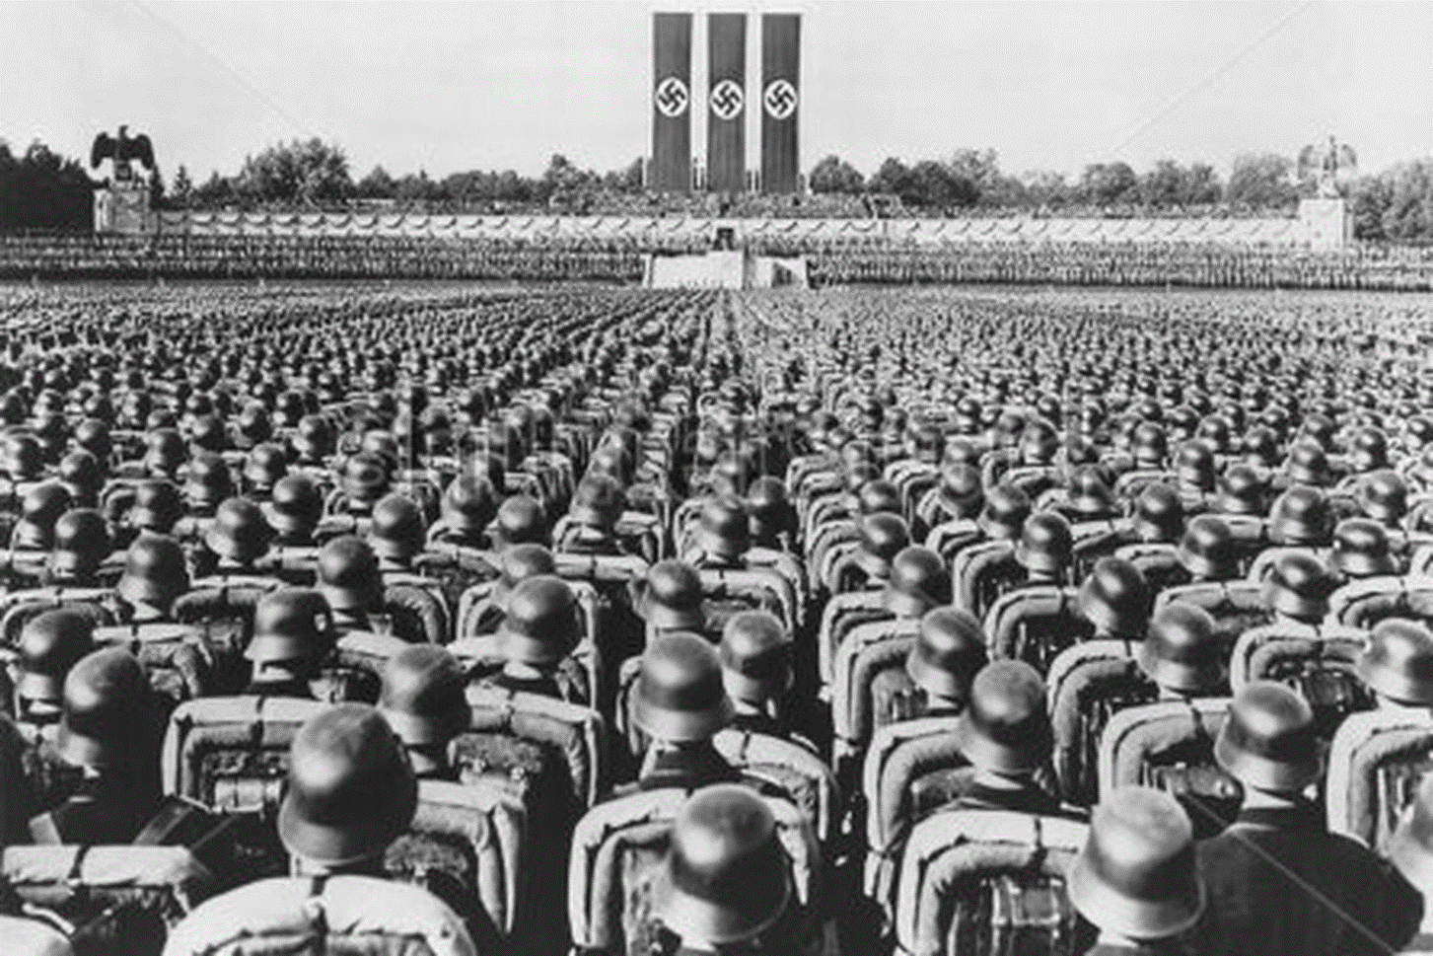
Fascism
Totalitarian government, one leader; controlled every aspect of citizens lives

Slide 15
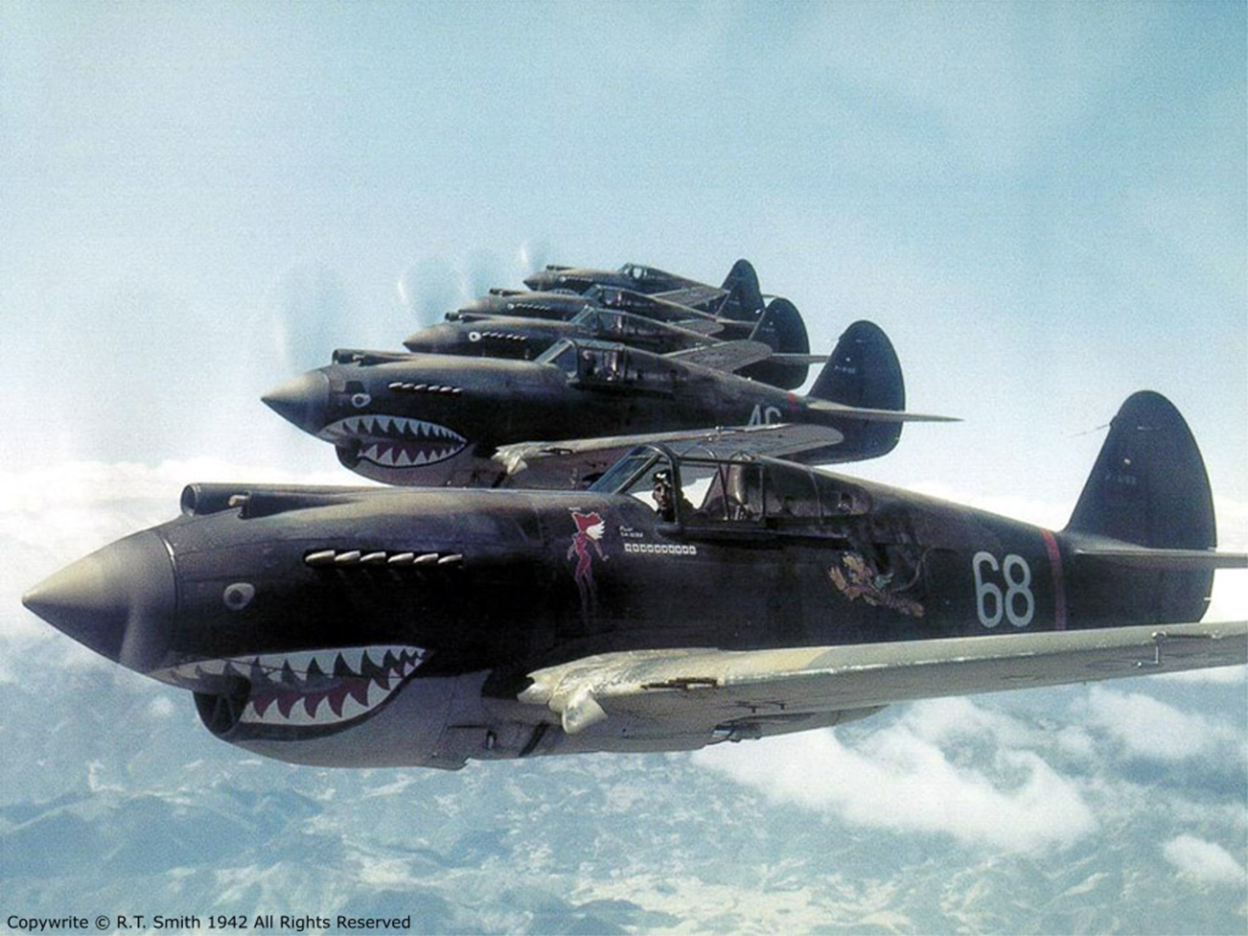
Flying Tigers
Volunteer airmen who trained Chinese fliers prior to U.S. entering WWII (secret)

Slide 16
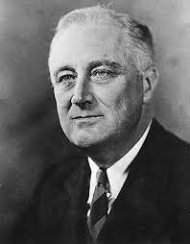
Franklin D. Roosevelt
U.S. President during most of WWII

Slide 17
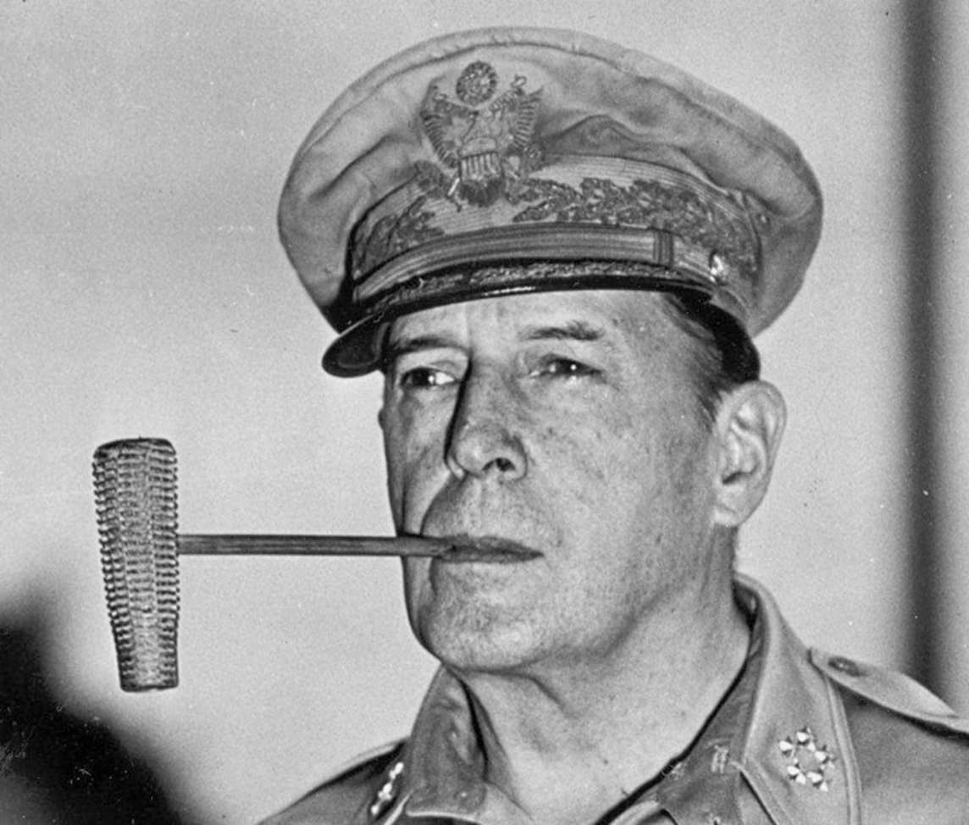
General Douglas MacArthur
Forced to retreat from Philippines, vowed to return, after the war he became military governor of Japan

Slide 18
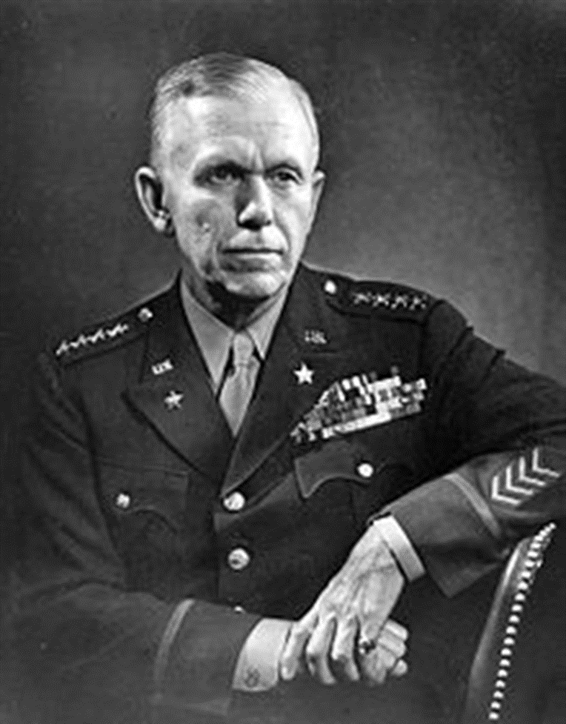
General George Marshall
Acted as a Chief of Staff, worked closely with President Roosevelt to help form and equip U.S. Army

Slide 19
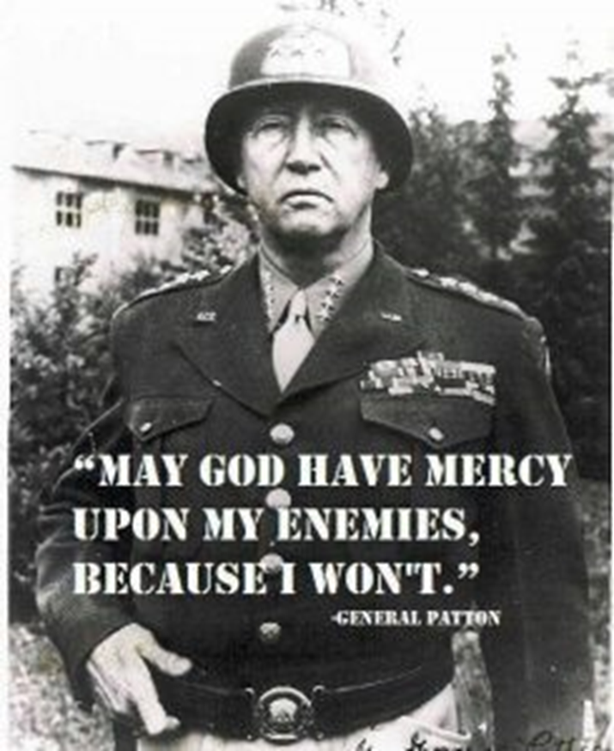
General George Patton
Commander of the U.S. Third Army; expert in tank warfare

Slide 20
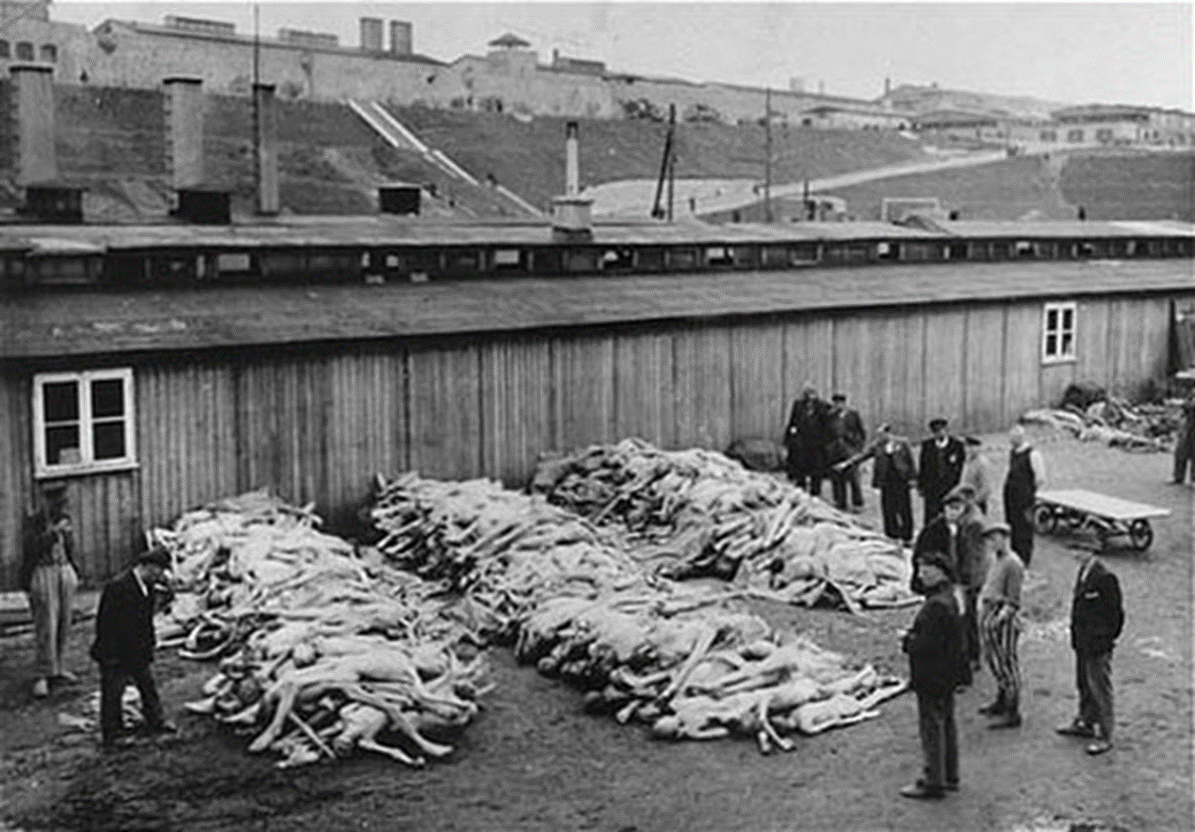
Genocide
An effort to murder an entire people or nationality

Slide 21
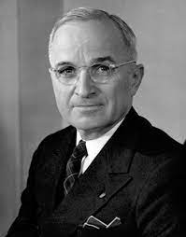
Harry Truman
U.S. President (33rd) at the end of WWII; ordered the atomic bomb be dropped

Slide 22
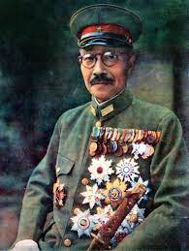
Hideki Tojo
Dictator of Japan; bombed Pearl Harbor

Slide 23
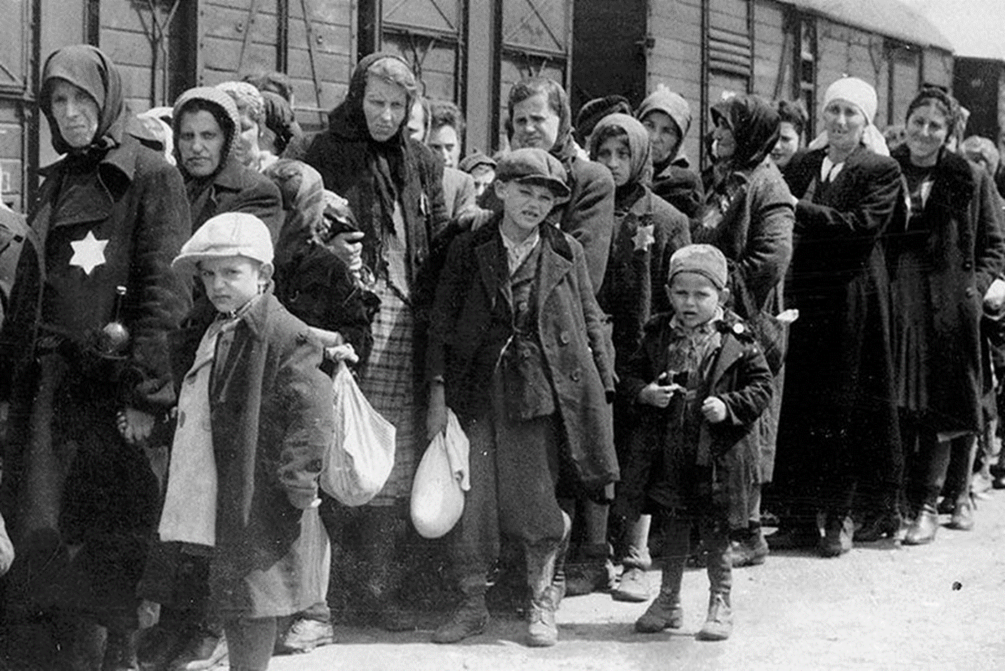
Holocaust
Mass extermination of Jews and selected other non-Aryan groups

Slide 24
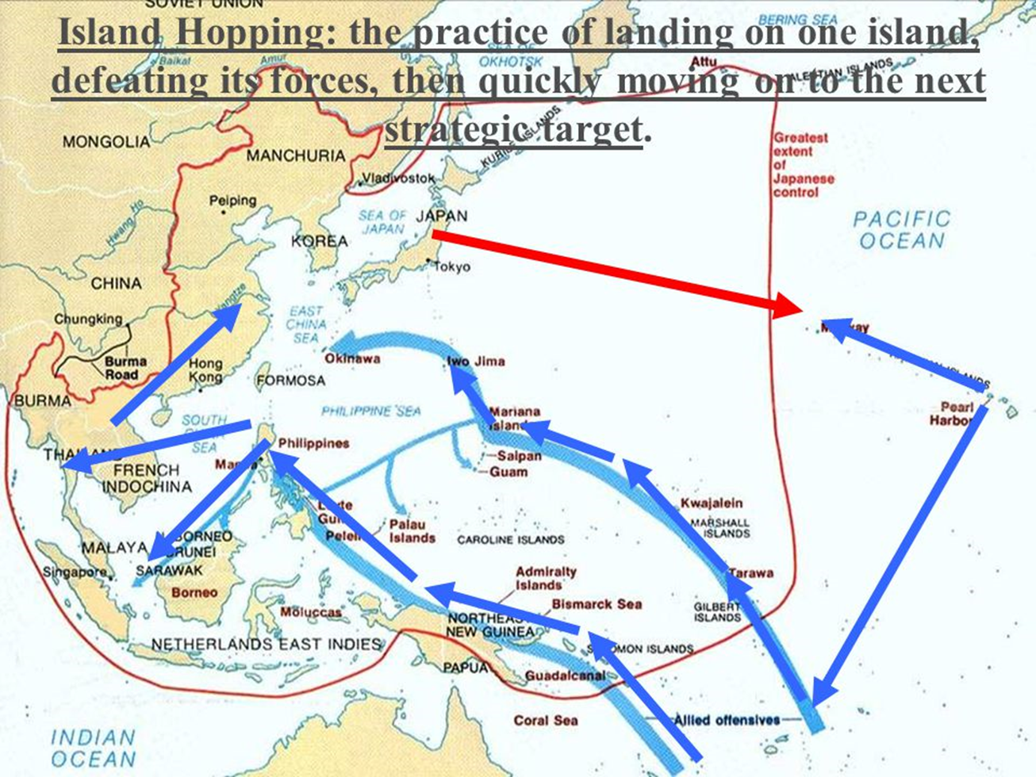
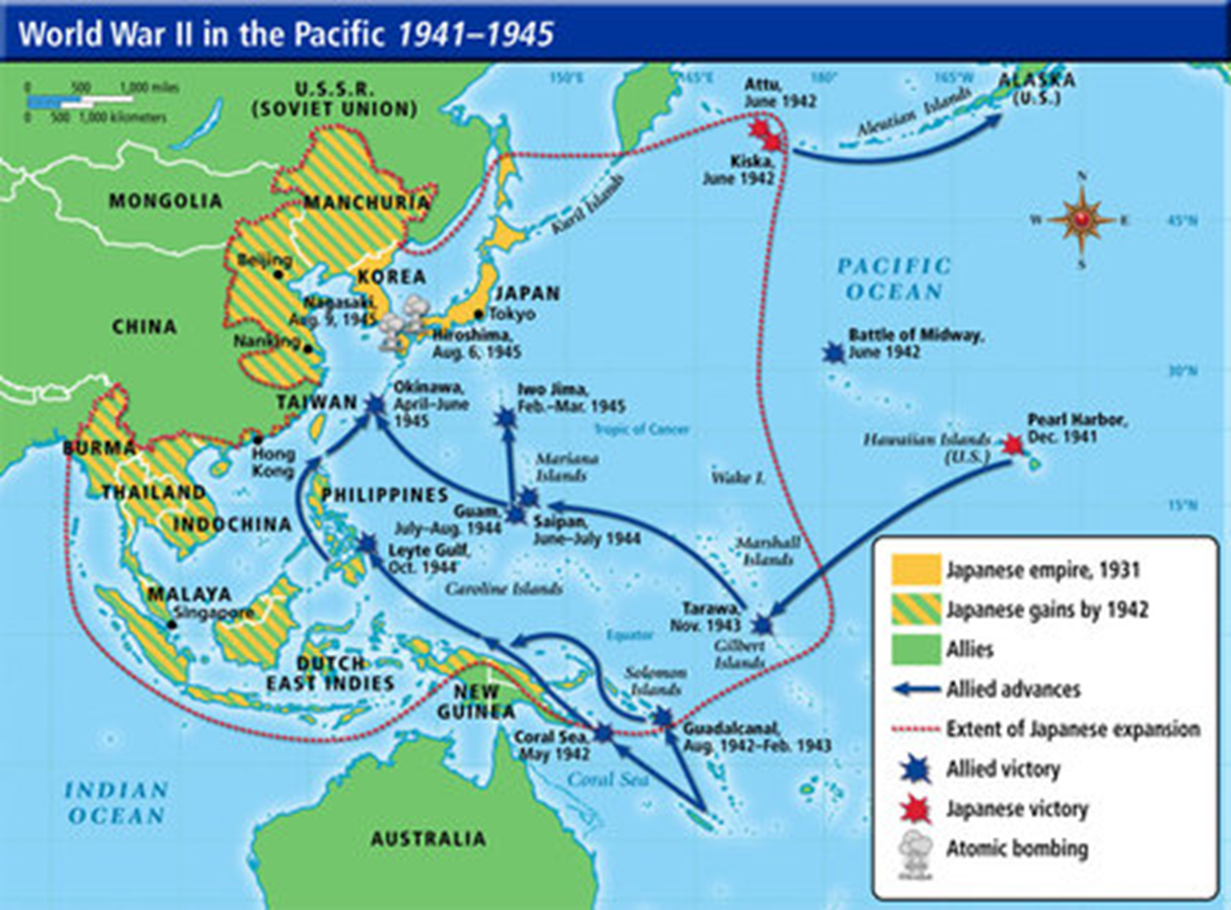
Island Hopping
U.S. strategy of taking over islands one by one all the way to Japan

Slide 25
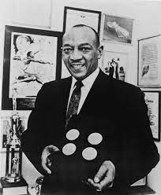
Jesse Owens
1936 African American U.S. Olympic Track Medalist (4 golds)

Slide 26
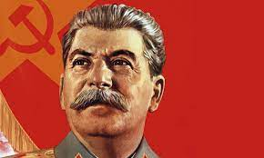
Josef Stalin
Communist dictator of the Soviet Union

Slide 27
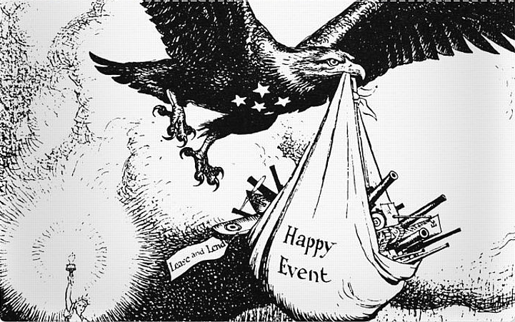
Lend-Lease Act
U.S. allowed Allies to rent or borrow crucial supplies

Slide 28
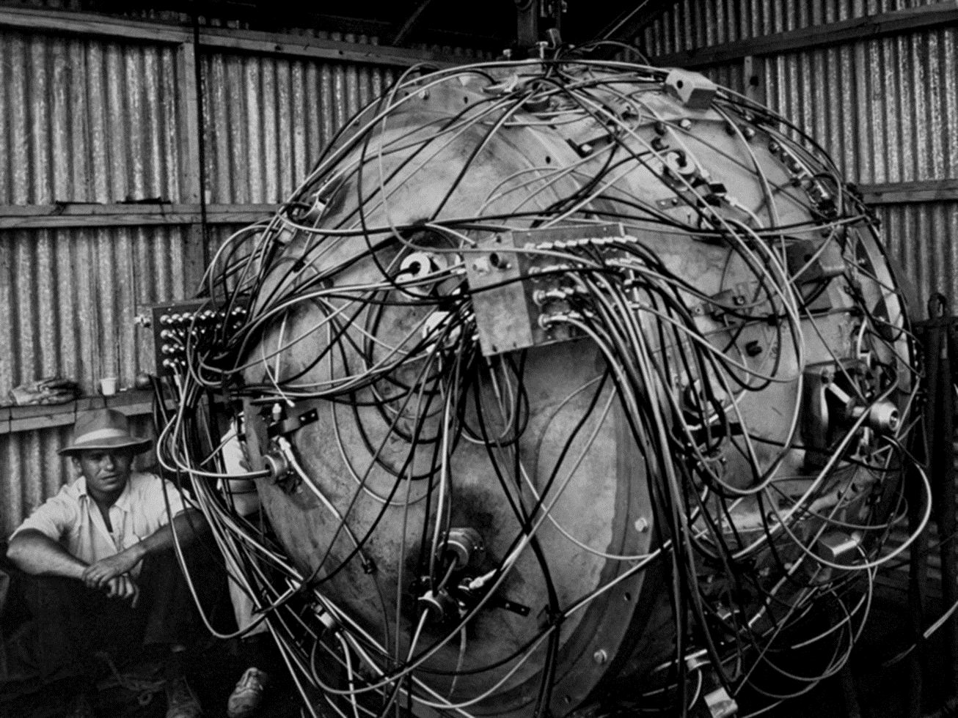
Manhattan Project
Project to create an atomic bomb

Slide 29
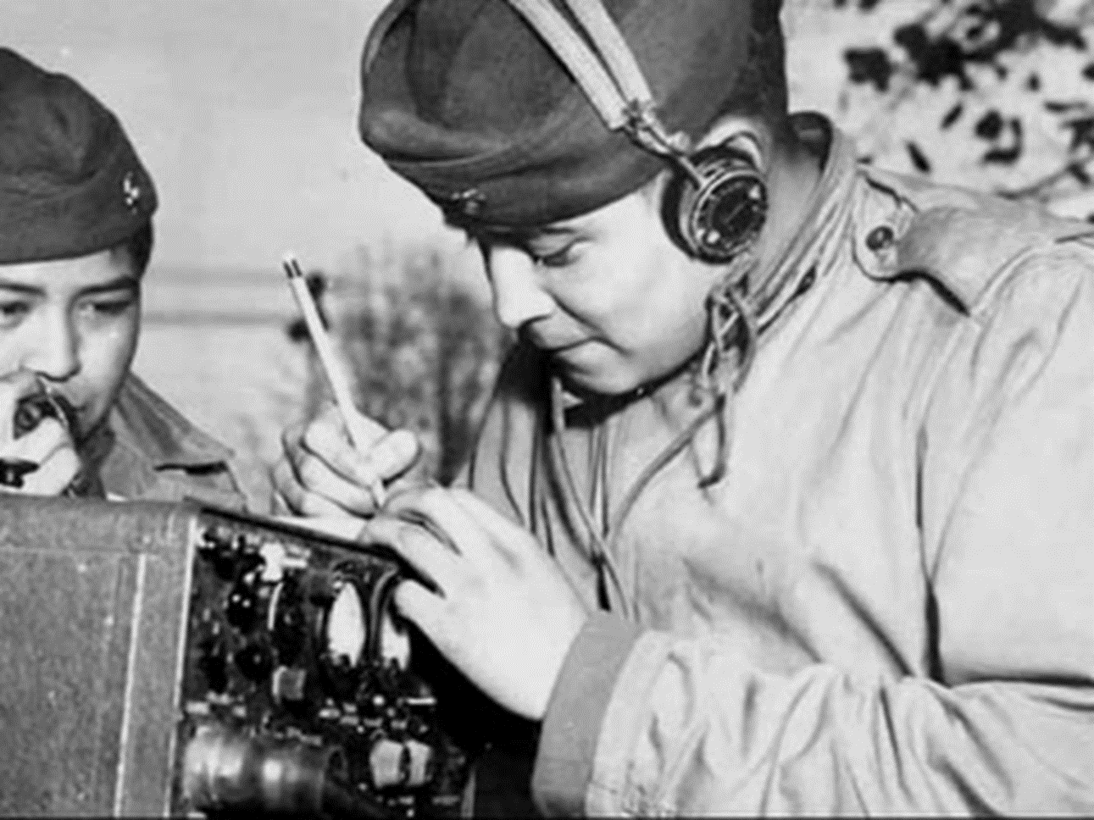
Navajo Code Talkers
Navajo Indians served as code talkers for U.S. Marines; Japanese never broke codes

Slide 30
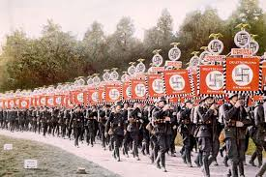
Nazism
German political movement led by Hitler; extreme nationalism/anti-Semitism

Slide 31
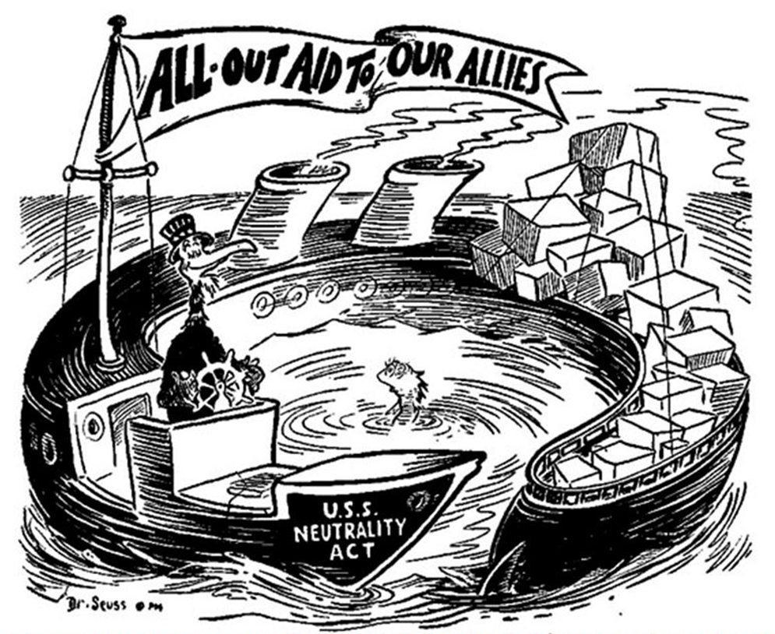
Neutrality Acts
Congress passed a series of laws (1935-1937) to keep the country out of war; prohibited Americans from traveling on ships of nations at war and prohibited from selling arms to countries at war

Slide 32
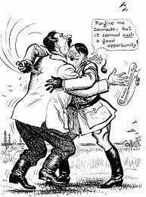
Non-Aggression Pact
Agreement between Germany and Soviet Union neither would attack the other prior to WWII; Hitler broke the agreement

Slide 33
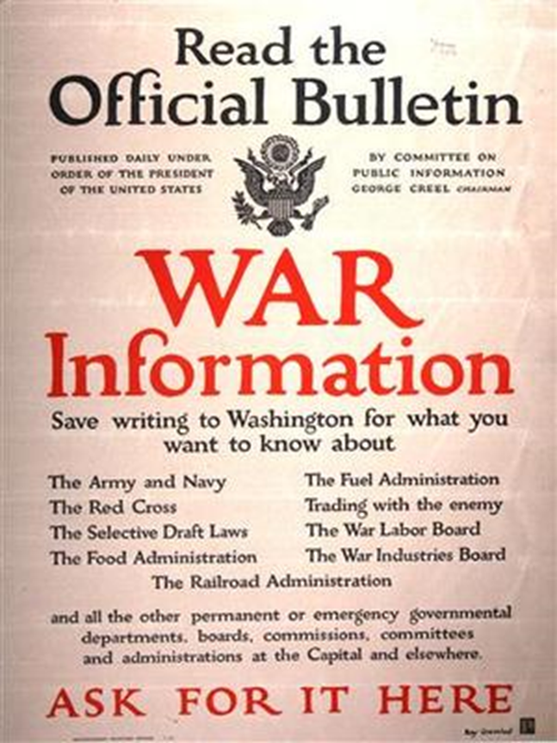
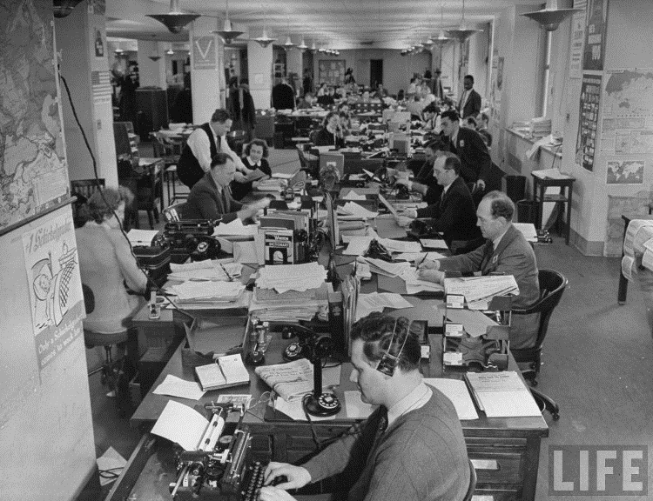
Office of War Information
Created in 1942 by FDR; pro-Ally & anti-Axis propaganda to influence Americans to support the war

Slide 34
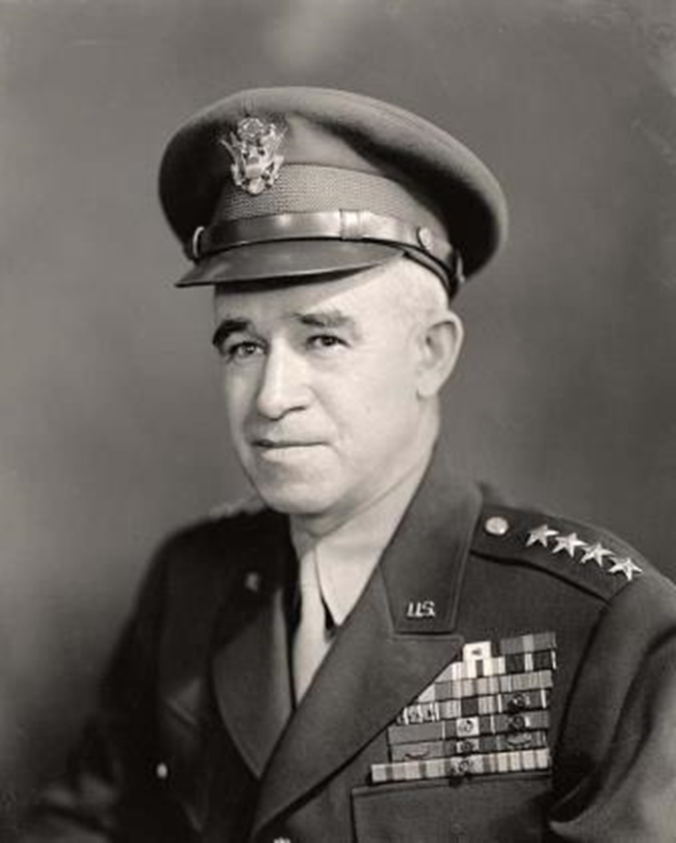
Omar Bradley
Commanded an army that landed in Normandy invasion

Slide 35
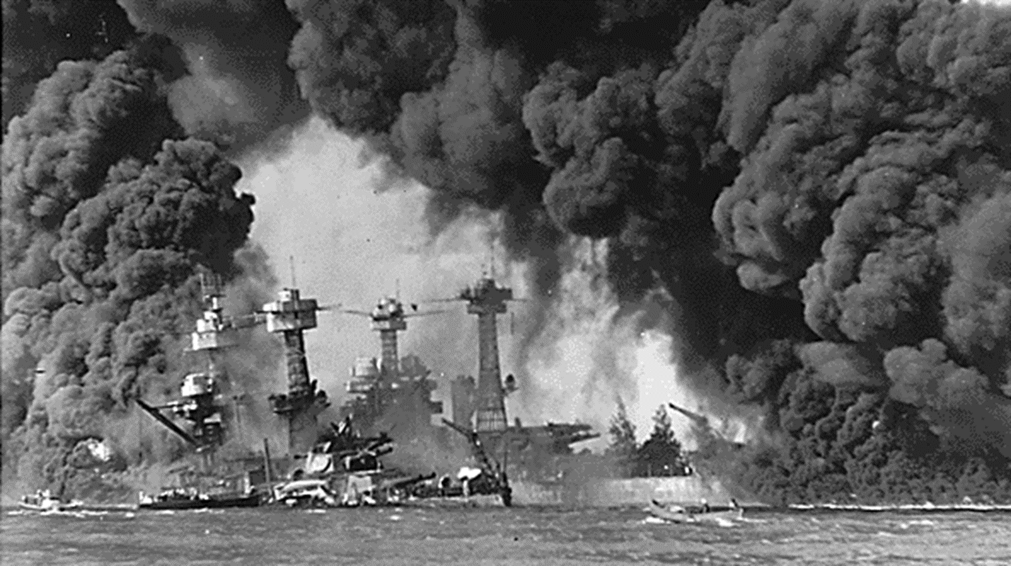
Pearl Harbor
On the morning of December 7, 1941, surprise military strike by Japanese Navy against the U.S. naval base at Pearl Harbor

Slide 36
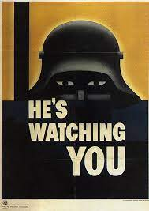
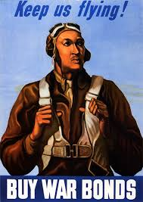
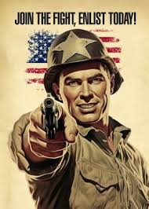
Propaganda
Attempt to influence through media, billboards, advertisement, etc…

Slide 37
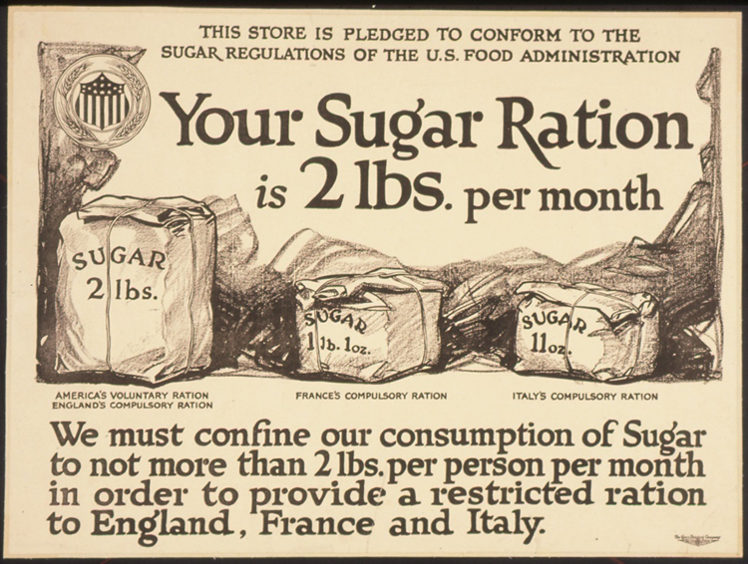
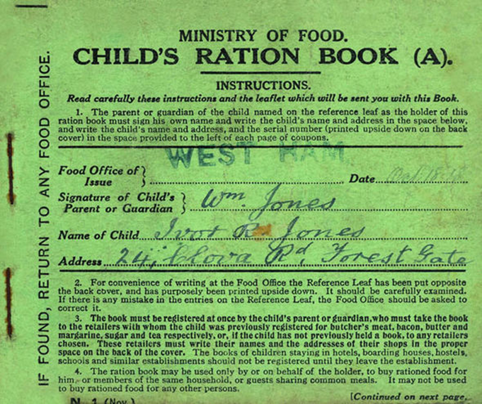
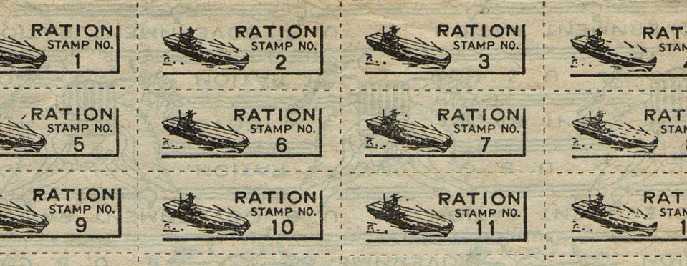
Rationing
Limits of product to support the war effort

Slide 38
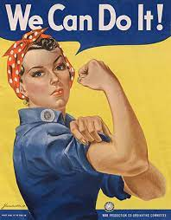
Rosie the Riveter
Symbol of women in the workplace while men were fighting in WWII

Slide 39
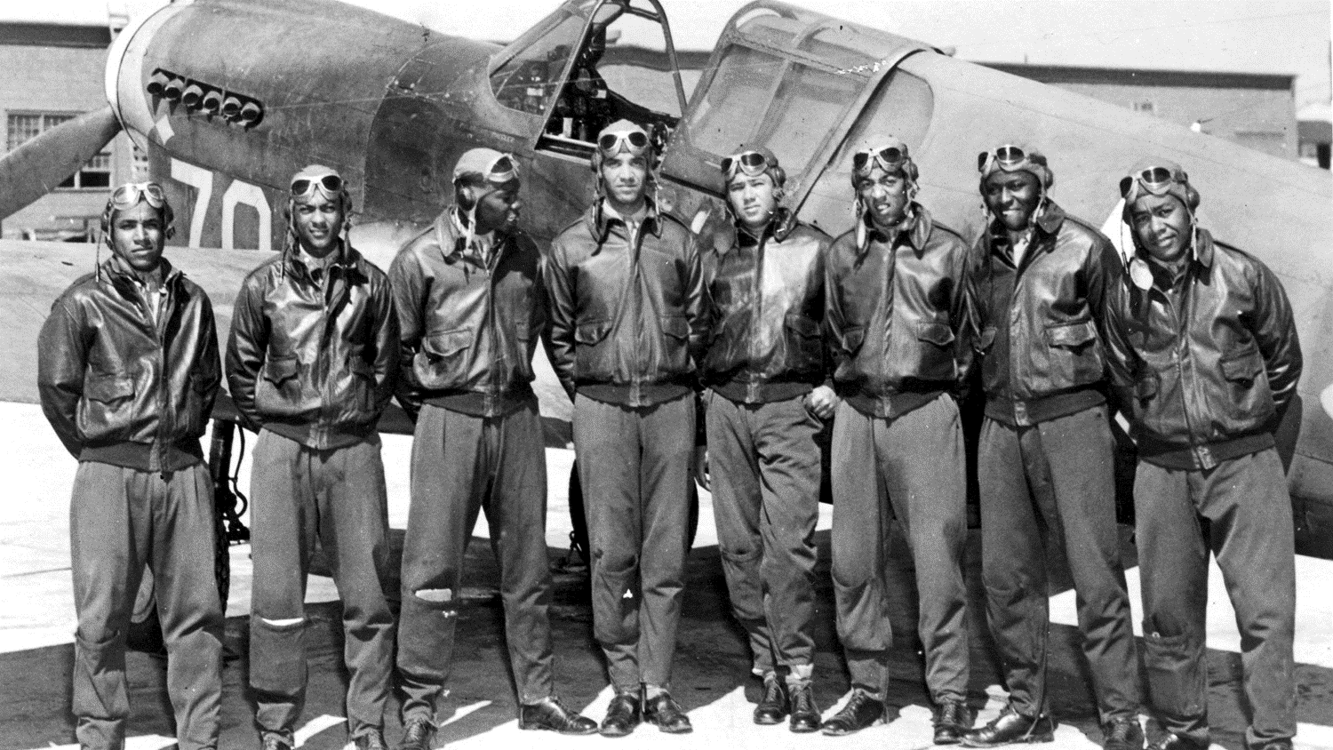
Tuskegee Airmen
The first black U.S. airmen squadron noted for their skill & bravery

Slide 40
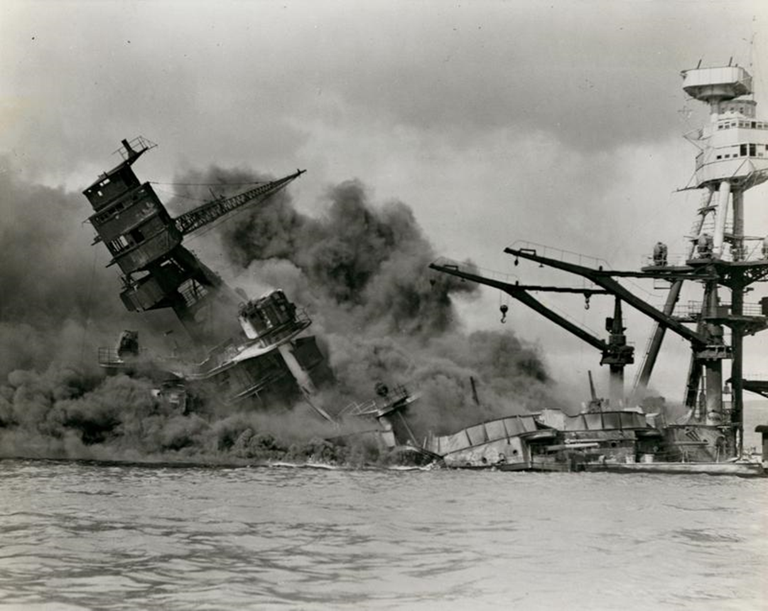
USS Arizona at Pearl Harbor
Cash payments for food from the government to the poor

Slide 41
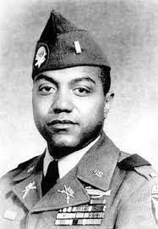
Vernon Baker
African American Army Lt.; Medal of Honor for wiping out German machine-gun nests

Slide 42
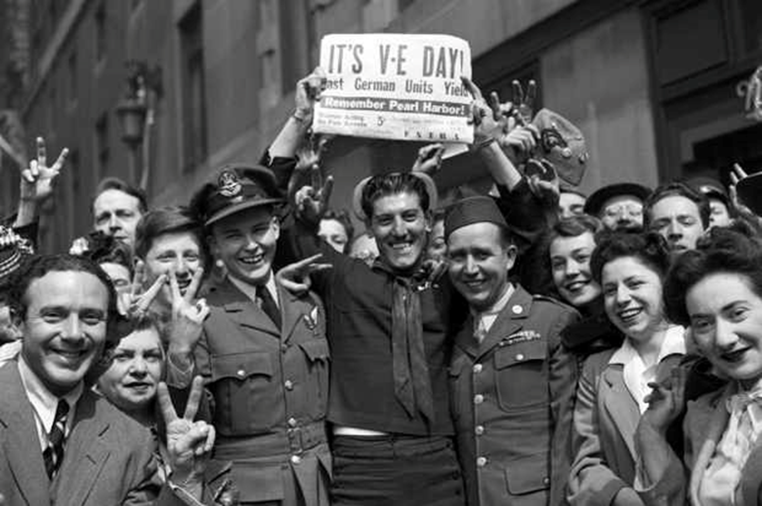
V-E Day
May 8, 1945, Victory in Europe Day; Germany unconditionally surrendered its military forces to the Allies; marked end of World War II in Europe

Slide 43
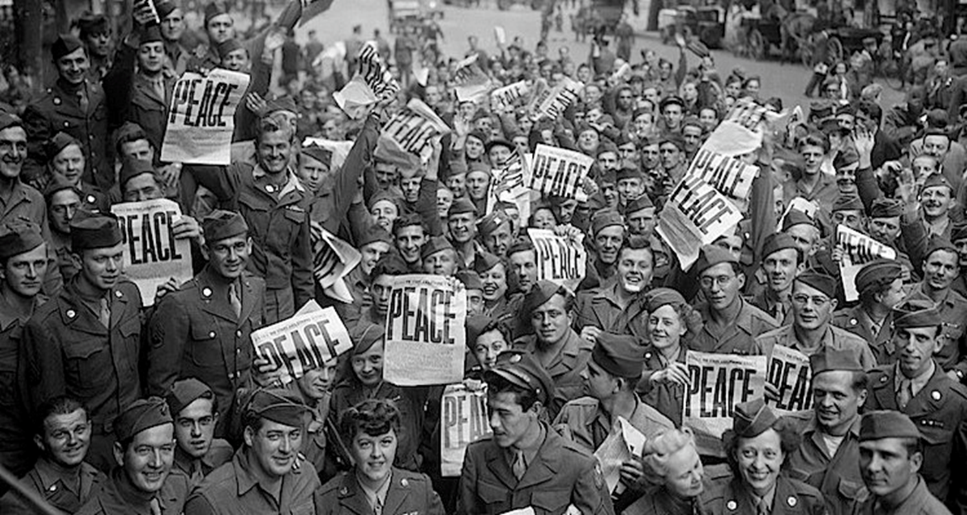
V-J Day
August 14, 1945, Victory over Japan Day; President Truman announced that Japan had surrendered unconditionally; celebrations erupted all over the world

Slide 44
Victory (War) Gardens
Gardens, especially home gardens, planted to increase food production during a war

Slide 45
WACs
Women’s Army Corp

Slide 46
War Bonds
Issued by government to finance military operations & expenditures in times of war

Slide 47
War Production Board
U.S. Agency that supervised war production during WWII

Slide 48
Winston Churchill
Prime Minister of Great Britain; said Allies needed to be more aggressive with Hitler

Slide 49
Yalta Conference
“Big Three” discussed what to do with Europe after the war was over
(“Big Three” (seated L to R): Winston Churchill, Franklin D. Roosevelt, Joseph Stalin)

