Slide 1
Ways of the World: A Brief Global History First Edition
Robert W. Strayer
CHAPTER XIV
Empires and Encounters
1450–1750
Asian Empires

Slide 2
Asian Empires
A. Asian empires were regional, not global.
1. Creation of Asian empires did not include massive epidemics
2. Did not fundamentally transform their homelands like interaction with the Americas and Siberia did for European powers

Slide 3
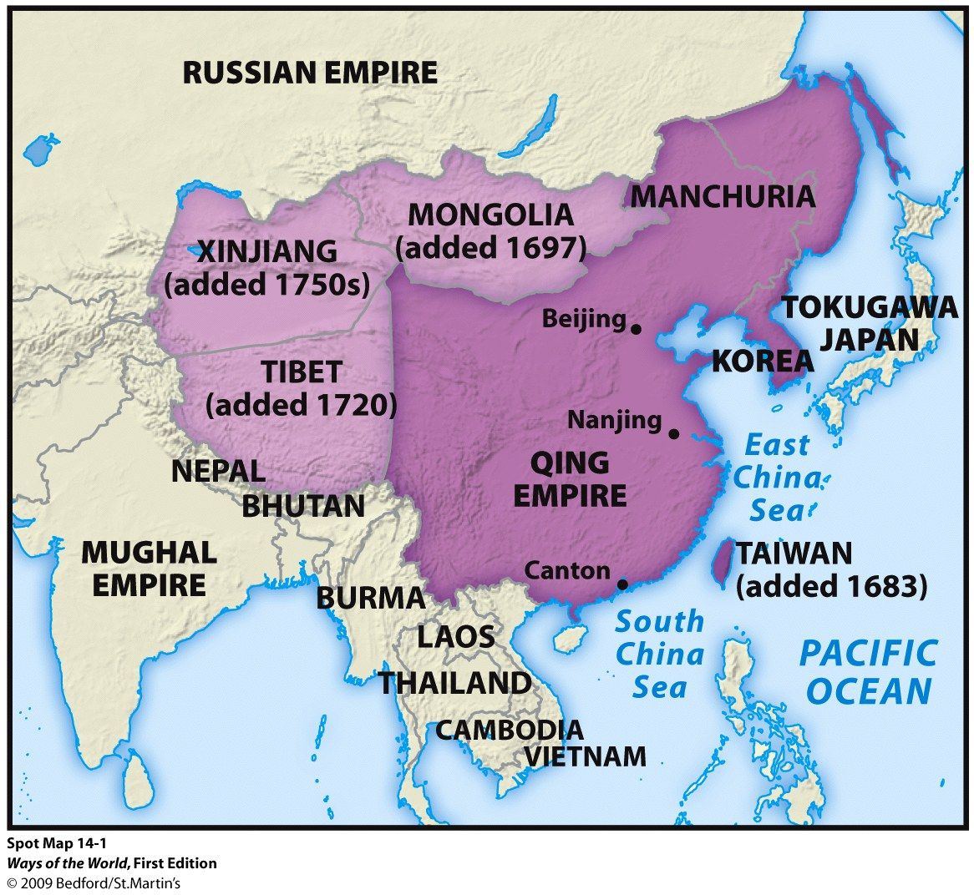

Slide 4
Asian Empires
Making China an Empire
The Chinese vastly enlarged the
territorial size of the country and
incorporated a number of non-
Chinese people
A great military effort was undertaken to
provide security for the huge region.

Slide 5
Asian Empires
Making China an Empire
Conquered regions were ruled separately from
the rest of China through a new office
called the Court of Colonial Affairs
Chinese or Qing officials didn’t seek to assimilate
local people into Chinese culture and showed
considerable respect for the Mongolian,
Tibetan, and Muslim cultures of the region. However, Political independence and economic
prosperity came to an end.

Slide 6
B. Making China an Empire
1. Qing dynasty (1644–1912) launched enormous imperial expansion to the north and west
2. Nomads of the north and west were very familiar
to the Chinese
a. 80-year-long Chinese conquest (1680–1760)
b. Motivated by security fears; reaction to Zunghar
state

Slide 7
Muslims and Hindus in the Mughal Empire
1. Mughals united much of India between 1526 and
1707
2. The Mughal Empire’s most important divide was
religious: 20 percent of the population were
Muslims, while most of the rest were Hindus

Slide 8
Muslims and Hindus in the Mughal Empire
3. Emperor Akbar (r. 1556–1605) attempted
serious accommodation of the Hindu majority
4. Mughal toleration provoked reaction among
some Muslims
5. Aurangzeb’s policy provoked Hindu reaction
Notes:
a. brought many Hindus into the political-military elite
b. imposed a policy of toleration
c. abolished payment of jizya by non-Muslims
d. created a state cult that stressed loyalty to the emperor
e. Akbar and his successors encouraged a hybrid Indian-Persian-Turkic culture
4. a. Emperor Aurangzeb (r. 1658–1707) reversed Mughal policy, tried to impose Islamic supremacy
b. Aurangzeb banned sati (widow burning), music and dance at court, various vices
c. destruction of some Hindu temples
d. reimposition of jizya

Slide 9
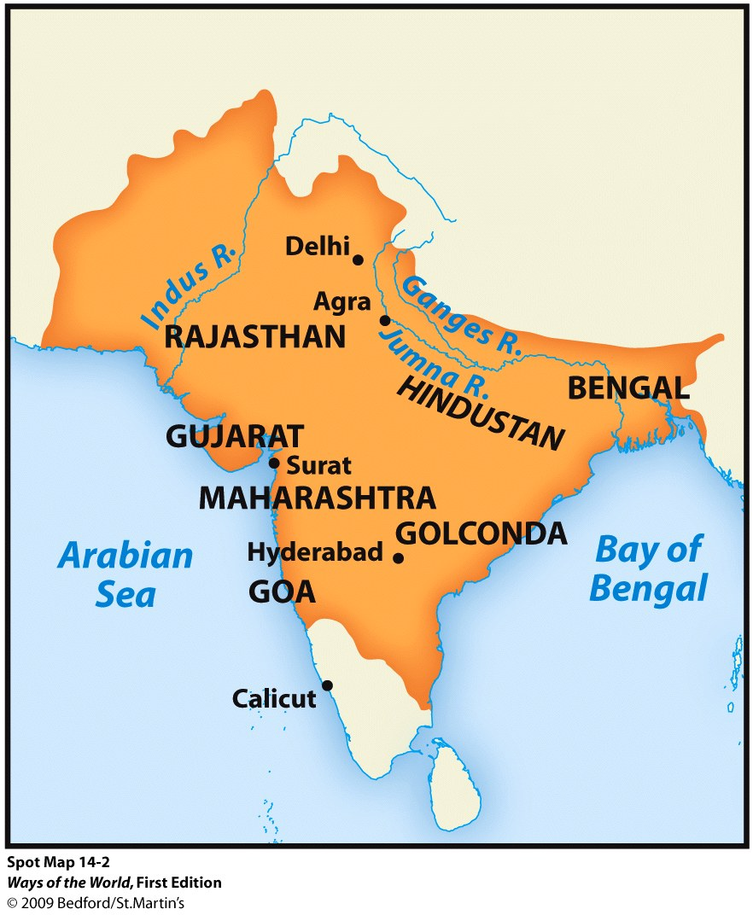

Slide 10
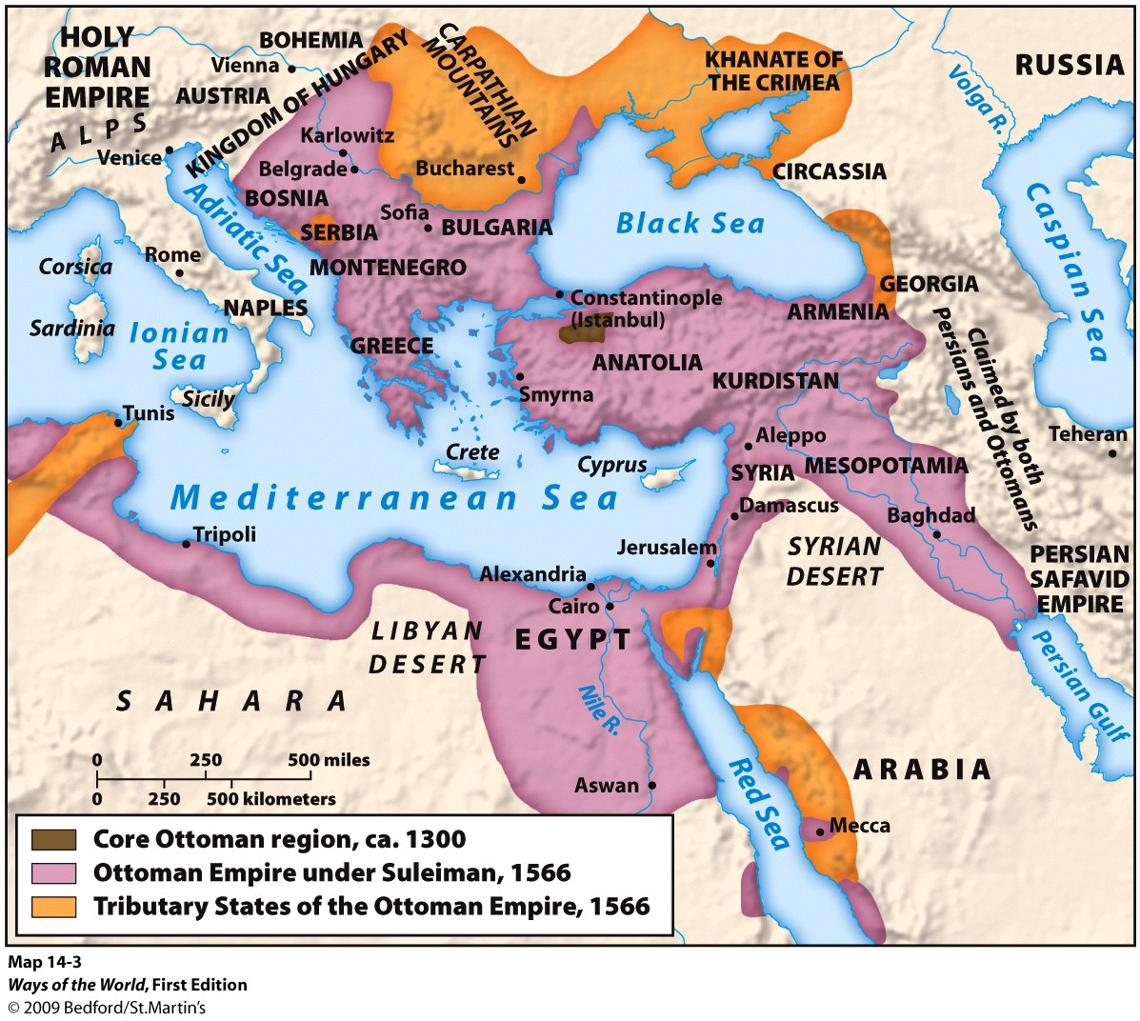
Muslims, Christians, and the Ottoman Empire

Slide 11
Muslims, Christians, and the Ottoman Empire
The Ottoman Empire was the Islamic world’s most important empire in the early modern period
Long conflict (1534–1639) between Sunni Ottomans and Shia Safavids
The Ottoman Empire was the site of a significant cross-cultural encounter
Notes:
a. in Anatolia, most of the conquered Christians converted to Islam
b. in the Balkans, Christian subjects mostly remained Christian
4. in the Balkans, many Christians welcomed Ottoman conquest
a. Ottoman taxed less and were less oppressive
b. Christian churches received considerable autonomy
c. Balkan elites were accepted among the Ottoman elite without conversion

Slide 12
Muslims, Christians, and the Ottoman Empire
5. Jewish refugees from Spain had more opportunities in the Ottoman Empire
6. Devshirme: tribute of boys paid by Christian Balkan communities
7. The Ottoman state threatened Christendom
8. Some Europeans admired Ottoman rule
Notes:
6. devshirme: tribute of boys paid by Christian Balkan communities
a. boys were converted to Islam, trained to serve the state
b. the devshirme was a means of upward social mobility
7. the Ottoman state threatened Christendom 20% CONVERTED TO iSLAM
8. some Europeans admired Ottoman rule
a. philosopher Jean Bodin (sixteenth century) praised Ottoman religious tolerance
b. European merchants evaded papal bans on selling firearms to the Turks
c. Ottoman women enjoyed relative freedom

Slide 13
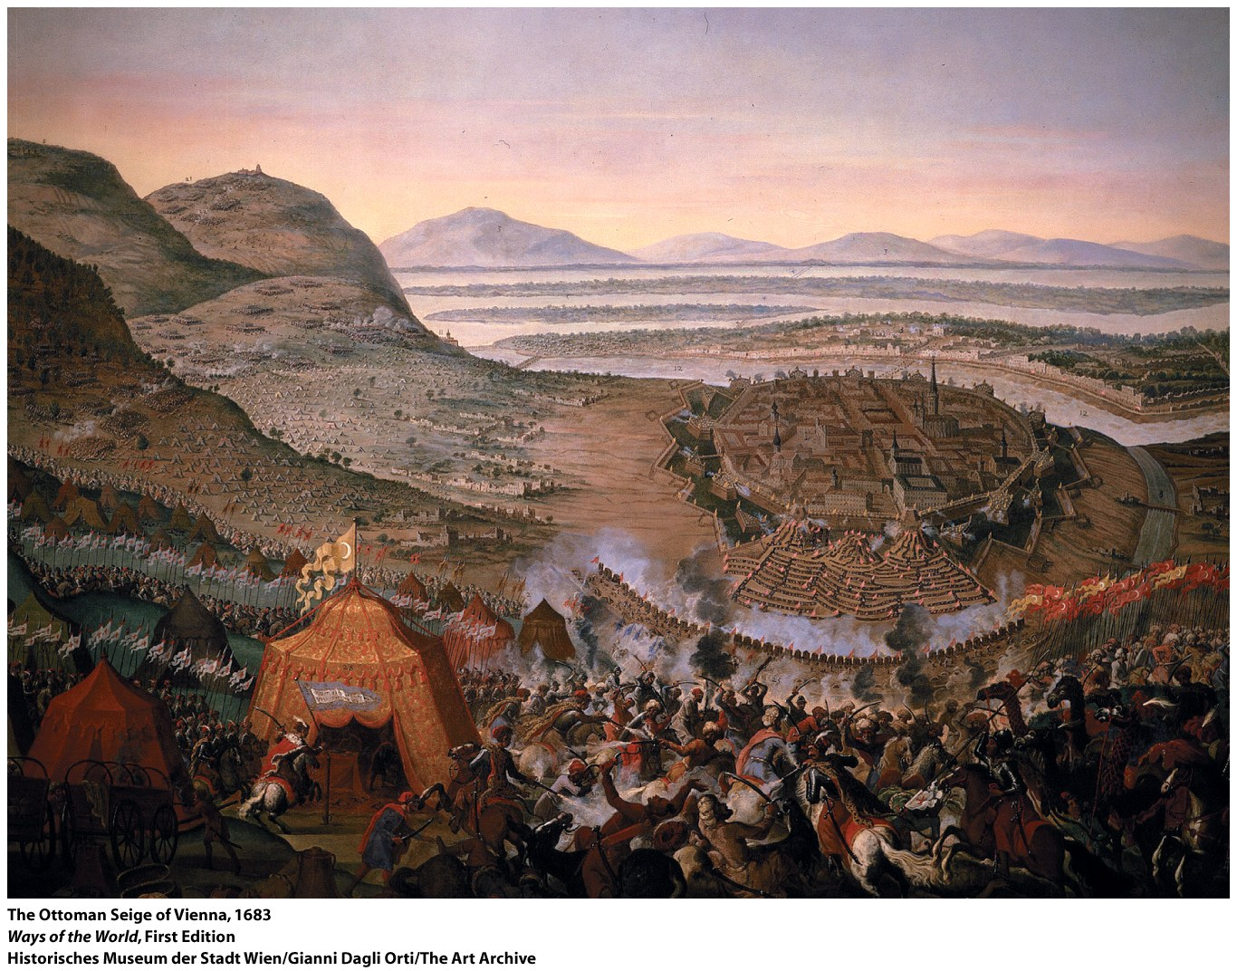
Ottoman Empire
Balkan Christian communities were required to hand over a quota of young boys, who were then removed from their families, required to learn Turkish, usually converted to Islam, and trained for either civil administration or military service in elite Janissary units.

Slide 14
Ottoman Empire
The empire itself represented an enormous threat to
Christendom in general.
-The seizure of Constantinople,
-The conquest of the Balkans,
-Ottoman naval power in the Mediterranean
-Siege of Vienna in 1529 and Battle of Vienna in 1683
Raised anew “the specter of a Muslim takeover of all of Europe.”
The last Ottoman incursion into the Austrian Empire was
pushed back with French and Polish help, marking the end of
a serious Muslim threat to Christian Europe.

Slide 15
How did Western European empires in the Americas differ from empires elsewhere in the world during the early modern era?
Comparison
Only Western European empire building in the Americas produced empires that that featured the mixing of diverse peoples.
b. Only Western European empire building in the Americas was facilitated by collapse or displacement of indigenous populations.
c. Only Western European empires in the Americas conquered substantial new lands instead of increasing their effective control over lands already under their control.
d. Only Western European empires in the Americas were initiated by maritime expansion.

Slide 16
Colonies of Sugar V. Settler Colonies in North America
Brazil/Caribbean | British North America
Sugar plantation economy | Plantation economy- tobacco, cotton, rice, indigo
Slave labor/harsh | Slave labor/less harsh
Racial mixing took place; In Brazil, a person of African or non-African ancestry was not considered “black,” but some other mixed-race category. The perception of color in Brazil changed with the educational or economic standing of individuals. | A sharply defined racial system (with Black Africans, red Native Americans, and white Europeans) In North America, any African ancestry, no matter how small or distant, made a person “black.”
Notes:
Handout KEY

Slide 17
Chinese conquests, together with the expansion of the Russian Empire, transformed Central Asia.
Eurasia Before | After under Russian or Chinese Rule
The region had been the cosmopolitan crossroads, hosting the Silk Road trade network. Welcomed all of the major world religions. Generated an enduring encounter between the nomads of the steppes and farmers of settled agricultural regions. | Became the backward and impoverished region known to 19th and 20th century observers. Land-based commerce took a backseat to oceanic trade. Indebted Mongolian nobles lost their land to Chinese merchants. Nomads no longer were able to herd their animals freely and fled to urban areas where many were reduced to begging. The incorporation of the heartland of Eurasian nomads into the Russian and Chinese empires eliminated the nomadic pastoralists who had been the strongest alternative to settled agricultural society since 200 B.C.E.
Notes:
Handout- KEY

