Slide 1
Ways of the World: A Brief Global History First Edition
Robert W. Strayer
CHAPTER XIV
Empires and Encounters
1450–1750
Columbian Exchange

Slide 2
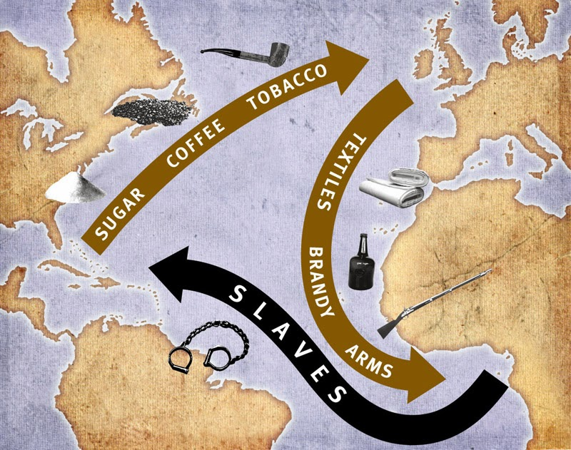
The Columbian Exchange
It was the enormous network of communication, migration, trade, the spread of disease, and the transfer of plants and animals between the Old and New Worlds. This was an interacting Atlantic world connecting four continents

Slide 3
The Columbian Exchange
Massive native mortality created labor shortage.
Migrant Europeans and African slaves created entirely new societies.
American food crops (corn, potatoes and cassava)
spread widely in the Eastern Hemisphere.
Potatoes allowed enormous population growth
Corn & sweet potatoes were important in China and Africa

Slide 5
Comparing Colonial Societies in the Americas
Europeans did not just conquer and govern established societies they created wholly new societies.
All were shaped by mercantilism
Colonies should provide closed markets for the mother country’s manufactured goods.
But colonies differed widely, depending on native cultures and the sort of economy that was established
Three types of economies
settler-dominated agriculture
slave-based plantations
ranching or mining
Notes:
Europeans did not just conquer and govern established societies they created wholly new societies.
All were shaped by mercantilism-This view held that European countries’ economic interests were best served by encouraging exports and accumulating silver and gold which represented prosperity. Colonies provided their mother countries with great quantities of bullion.
Colonies should provide closed markets for the mother country’s manufactured goods.
But colonies differed widely, depending on native cultures and the sort of economy that was established
Three types of economies
settler-dominated agriculture
slave-based plantations
ranching or mining

Slide 6
Comparing Colonial Societies in the Americas
In the Lands of the Aztecs and the Incas
Spanish conquest
The mostly wealthy, urbanized, and populous regions of the Western Hemisphere.
Within a century, the Spaniards established major cities, universities, and religious and bureaucratic infrastructure.
A distinctive social order grew up
Notes:
Spanish conquest
replicating the Spanish hierarchy while accommodating the racially and culturally different Indians and Africans, as well as growing numbers of racially mixed people. The society was dominated by Europeans.

Slide 7
Rise of a distinctive social order
replicated some of the Spanish class hierarchy
b. accommodated Indians, Africans, and racially mixed
people
Spaniards were at the top, increasingly wanted a large
measure of self-government from the Spanish Crown
d. emergence of mestizo (mixed-race) population
e. gross abuse and exploitation of the Indians
f. more racial fluidity than in North America

Slide 8
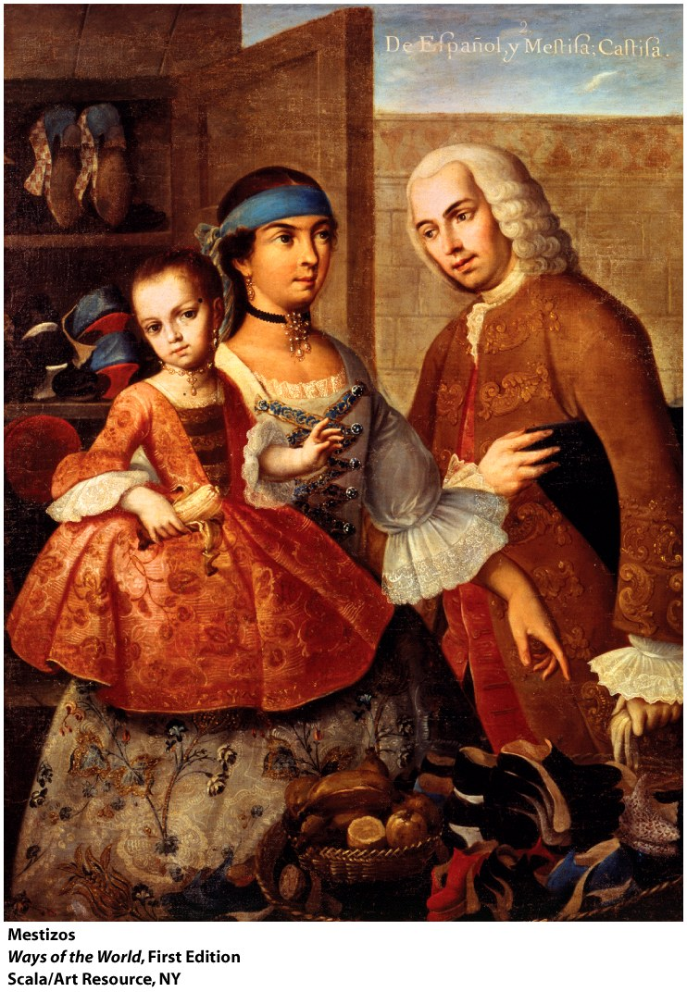
Rise of a distinctive social order
Peninsulares—Spanish born peoples
Creoles-Spainards born in the Americas_
Mestizo—mixed race populations
(the product of unions between Spanish men and Indian women
Mulattoes—the product of Portuguese-African unions_
Indians-indigenous peoples

