Slide 1
Ways of the World: A Brief Global History First Edition
Robert W. Strayer
CHAPTER XIV
Empires and Encounters
1450–1750
The Great Dying

Slide 2
European Empires in the Americas
Western European Empires were marked by maritime expansion
Spaniards
Portuguese
British, French, and Dutch colonies
Europeans controlled most of the Americas by the mid-nineteenth century
Notes:
Western European Empires were marked by maritime expansion
Spaniards in Caribbean, then on to the Aztec and Inca empires
Portuguese in Brazil
British, French, and Dutch colonies in North America
Europeans controlled most of the Americas by the mid-nineteenth century

Slide 3
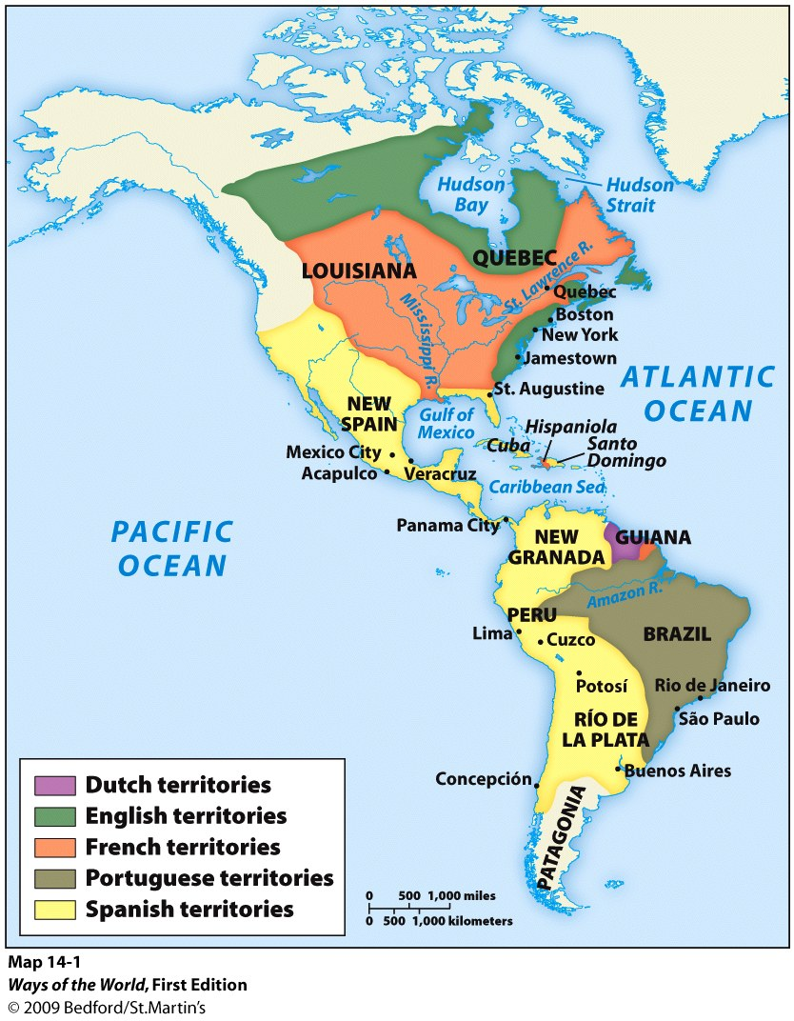
European Empires in the Americas
The European Advantage
Geography
Countries on the Atlantic rim of Europe (Portugal, Spain, Britain, and France)
Notes:
were simply closer to the Americas than was any possible Asian competitor.
They also understood winds and currents much different from monsoon winds in the Indian Ocean.

Slide 4
The European Advantage
Need:
Chinese and Indians markets
Marginality
Rivalry
Merchants
Wealth
Religion
.
Notes:
Chinese and Indians markets had such a rich markets in the Indian Ocean that there wasn’t much incentive to go beyond.
Marginality-Europeans were aware of their marginal position in Eurasian commerce and wanted to change it.
Rivalry - Interstate rivalry drove rulers to compete.
Merchants – 1) Seeking access to Asian Wealth 2) The merchant class wanted to avoid the reliance on Muslim middlemen that they found so distasteful.
Wealth – 1) Colonies were an opportunity for impoverished nobles and commoners. 2) The silver mines in Mexico and Peru allowed the Spanish conquerors and other Europeans to buy massive amounts highly valuable commodities such as Chinese tea, silk, and porcelain
Religion- 1) Crusade Zeal 2) Persecuted minorities looking for more freedom. 3) Christian saints in many places blended easily with specialized indigenous gods, while belief in magic, folk medicine, and communion with the dead remained strong. Many gravitated toward the world of their conqueror, learned Spanish, and converted to Christianity.

Slide 5
The Great Dying
Europeans brought European and African diseases.
Native American populations
Caribbean
Central Mexico
Notes:
90% mortality rate among Native American populations
Native population nearly vanished in the Caribbean
Central Mexico: population drops from 10-20 million to around 1 million by 1650. Similar mortality in North America

Slide 6
The Great Dying
Europeans brought European and African diseases.
Native American populations
Caribbean
Central Mexico
Notes:
90% mortality rate among Native American populations
Native population nearly vanished in the Caribbean
Central Mexico: population drops from 10-20 million to around 1 million by 1650. Similar mortality in North America

Slide 7
The Great Dying
Pre-Columbian Western Hemisphere had 60-80 million
No immunity to Old World Diseases
Created an acute labor shortage
Made room for immigrant newcomers— colonizers
enslaved Africans
Notes:
Had no large animals, thus no domesticated animals which would have exposed them to diseases.

