Slide 1
Ways of the World: A Brief Global History First Edition
Robert W. Strayer
CHAPTER XV
Global Commerce
1450–1750
Fur in Global Commerce

Slide 2
A. Europe’s supply of fur-bearing animals was
sharply diminished by 1500.
B. There was intense competition for the furs
of North America .
- French
- British
- Dutch
Notes:
B
1. French were prominent in St. Lawrence valley, Great Lakes, and along the Mississippi
2. British traders moved into Hudson Bay region
3. Dutch moved into what is now New York City.

Slide 3
North American fur trade
1. Europeans usually traded with Indians for furs or skins,
rather than hunting or trapping animals themselves
2.
3.
Notes:
Negotiated for furs in North America
2. Beaver and other furry animals were driven to near extinction
3. By the 1760s, hunters in the southeastern British colonies took around 500,000 deer every year

Slide 4
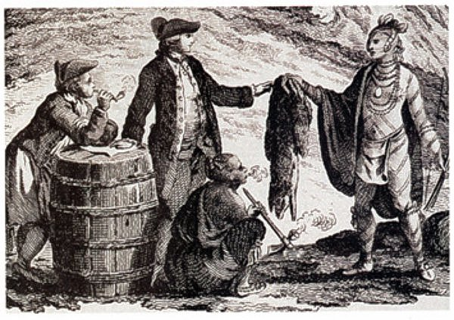
4. Trade was profitable for the Indians
a. Received many goods of real value
b. Huron chiefs enhanced their authority
c.
d.
Notes:
a. Received many goods of real value
b. Huron chiefs enhanced their authority with control of European goods
c. Indians fell prey to European diseases
d. Fur trade generated much higher levels of inter-Indian warfare
Native Americans sometimes based decisions of which side to support in times of war in relation to which people had provided them with the best trade goods in an honest manner. Because trade was so politically important, the Europeans tried to regulate it in hopes (often futile) of preventing abuse. Unscrupulous traders sometimes cheated natives by plying them with alcohol during the transaction, which subsequently aroused resentment and often resulted in violence.

Slide 5
5. Native Americans became dependent on
European trade goods.
a. Iron tools and cooking pots
b. Gunpowder weapons
c. European textiles
d. Result, many traditional crafts were lost
e. Many animal species were depleted
through overhunting
f. Alcohol’s deeply destructive effect on
Indian societies

Slide 6
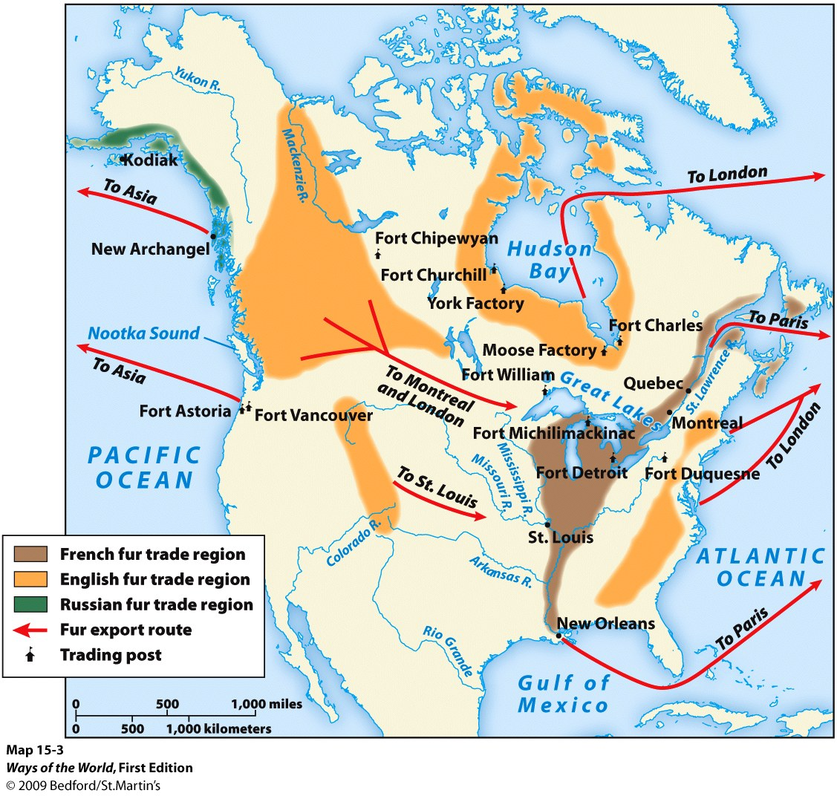

Slide 7
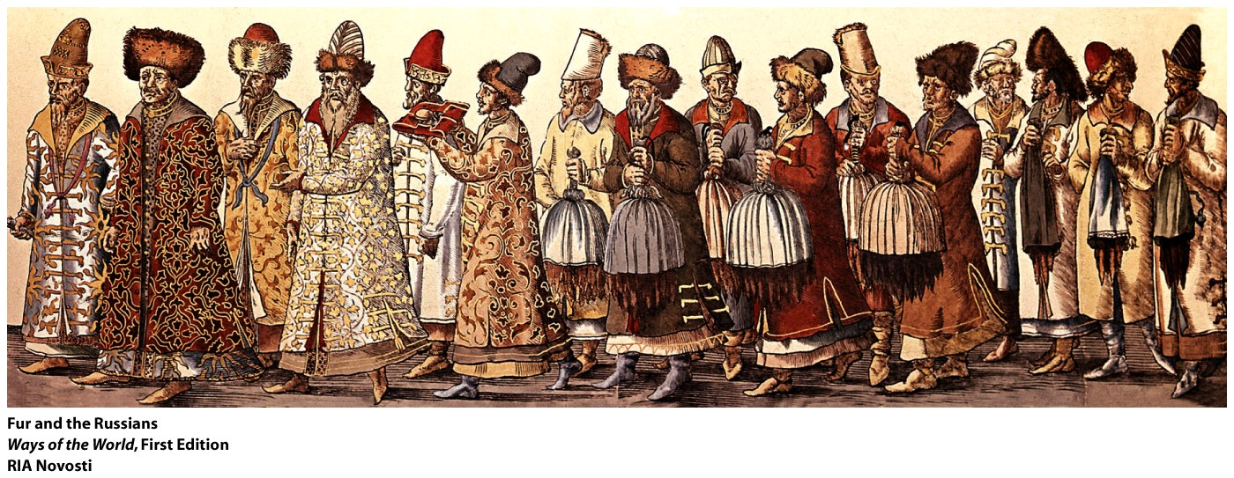
Russian fur trade
1. Profits
2. Had a similar toll on native Siberians as it had on Indians
a.
b.
Notes:
1. profits of fur trade were the chief incentive for Russian expansion
2. had a similar toll on native Siberians as it had on Indians
a. dependence on Russian goods
b. depletion of fur-bearing animal populations

Slide 8
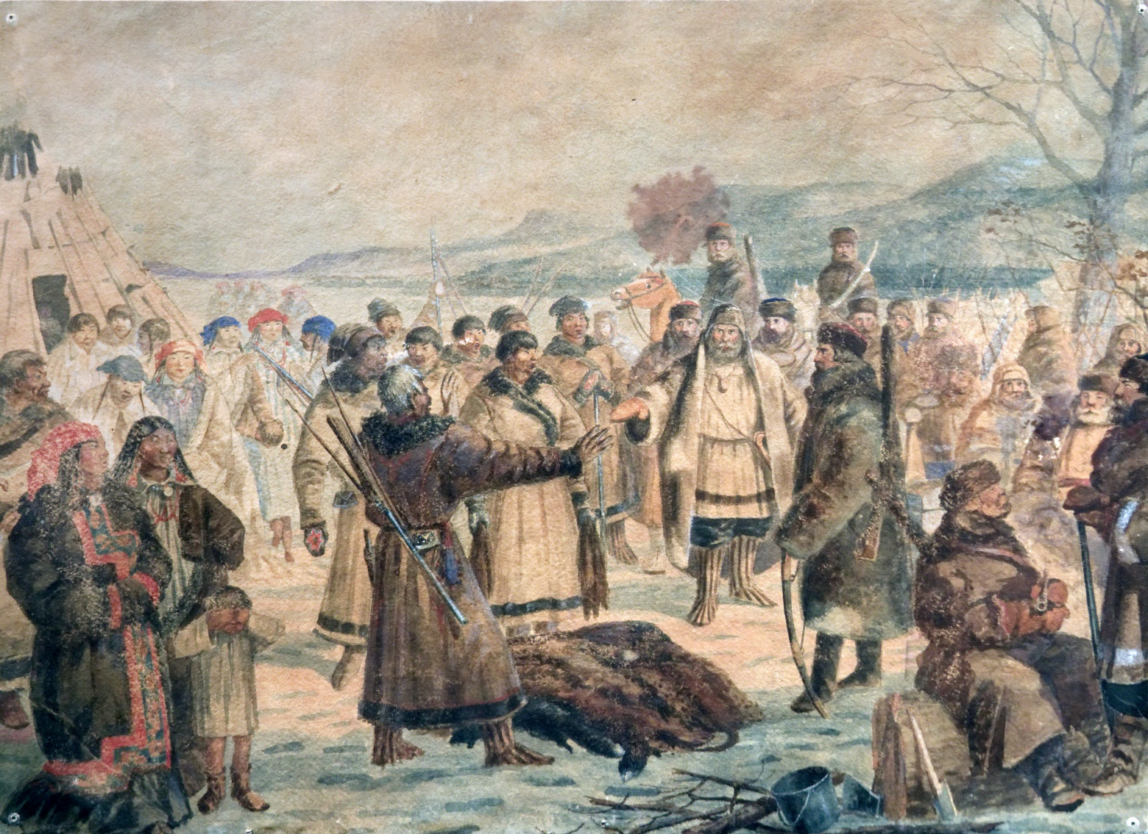
3. Russians didn’t have competition
4. Private Russian hunters and trappers
competed with Siberians
Notes:
3. Russians didn’t have competition, so they forced Siberians to provide furs instead of negotiating commercial agreements
4. Private Russian hunters and trappers competed with Siberians

Slide 9
Positive Impact | Negative Impact
Notes:
Handout

Slide 10
Positive Impact | Negative Impact
The fur trade did bring some benefits, including the trade of pelts for goods of real value. It enhanced influence and authority for some Native American leaders. It ensured the protection of Native Americans involved in the fur trade, for a time, from the kind of extermination, enslavement, or displacement that was the fate of some native peoples elsewhere in the Americas. | It exposed Native Americans to European diseases and generated warfare. It left Native Americans dependent on European goods without a corresponding ability to manufacture the goods themselves. It brought alcohol into Indian societies, often with destructive effects.
Notes:
Handout - KEY

