Slide 1
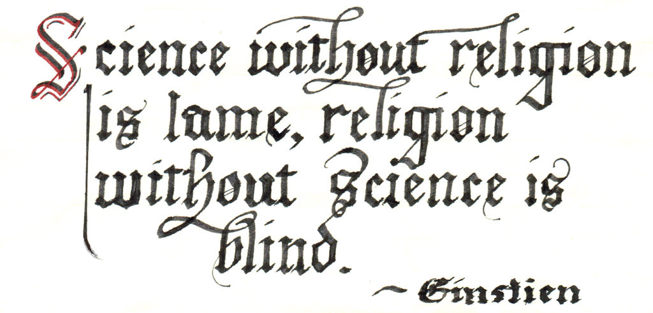
Ways of the World: A Brief Global History First Edition
Robert W. Strayer
CHAPTER XVI
Religion and Science
1450–1750
Scientific Revolution

Slide 3
A New Way of Thinking: The Birth of Modern Science
The Scientific Revolution was an intellectual and cultural transformation that occurred between the mid-sixteenth century and the early eighteenth century.
1.
2.
Notes:
1. Based on careful observations, controlled experiments, and formulation of general laws to explain the world
2. Creators of the movement saw themselves as making a radical departure

Slide 4
A New Way of Thinking: The Birth of Modern Science
3. Scientific Revolution was vastly significant
a.
b.
Notes:
a. fundamentally altered ideas about the place of humankind within the cosmos
b. challenged the teachings and authority of the Church

Slide 5
A New Way of Thinking: The Birth of Modern Science
c. Challenged ancient social hierarchies and
political systems
d. Used to legitimize racial and gender inequality
e. By the twentieth century, science had become the
chief symbol of modernity around the world
Notes:
c. Challenged ancient social hierarchies and political systems
d. Used to legitimize racial and gender inequality
e. By the twentieth century, science had become the chief symbol of modernity around the world

Slide 6
The Question of Origins: Why Europe?
1. The Islamic world was the most scientifically advanced realm in period 800–1400
2. China’s technological accomplishments and
economic growth were unmatched for several centuries after the millennium

Slide 7
The Question of Origins: Why Europe?
3. But European conditions were uniquely favorable
to rise of science
a.
b.
c.
Notes:
a. evolution of a legal system that guaranteed some independence for a variety of institutions by twelfth/thirteenth centuries
b. idea of the “corporation”—collective group treated as a legal unit with certain rights
c. universities became zones of intellectual autonomy

Slide 8
The Question of Origins: Why Europe?
4. In the Islamic world, science remained mostly
outside of the system of higher education
5. Chinese authorities did not permit independent
institutions of higher learning
a. Chinese education focused on preparing for
civil service exams
b. Emphasis was on classical Confucian texts

Slide 9
The Question of Origins: Why Europe?
6. Western Europe could draw on the knowledge of
other cultures, especially that of the Arab world
7. 16th–18th centuries: Europeans were at
the center of a massive new information
exchange
a.
b.
Notes:
7. 16th–18th centuries: Europeans were at the center of a massive new information exchange
a. Tidal wave of knowledge shook up old ways of thinking
b. Explosion of uncertainty and skepticism allowed modern science to emerge

Slide 10
Science as Cultural Revolution
1. Dominant educated-European view of the world
before the Scientific Revolution, derived from
Aristotle and Ptolemy:
a.
b.
Notes:
a. The earth is stationary and at the center of the universe, with sun, moon, and stars revolving around it
b. A universe of divine purpose

Slide 11
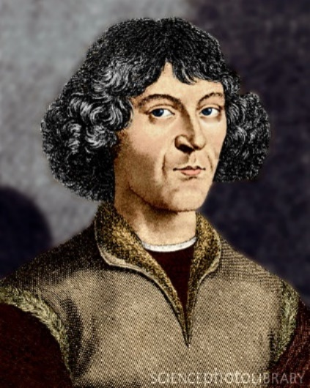
Science as Cultural Revolution
2. Initial breakthrough was by Nicolaus Copernicus
a.
b.
Notes:
a. On the Revolutions of the Heavenly Spheres (1543)
b. Promoted the view that the earth and the planets revolved around the sun

Slide 12
Science as Cultural Revolution
3. Other scientists built on Copernicus’s insight
a. Some argued that there were other inhabited
worlds
b. Johannes Kepler demonstrated elliptical orbits of
the planets
c. Galileo Galilei developed an improved telescope
Notes:
a. Some argued that there were other inhabited worlds
b. Johannes Kepler demonstrated elliptical orbits of the planets
c. Galileo Galilei developed an improved telescope

Slide 13
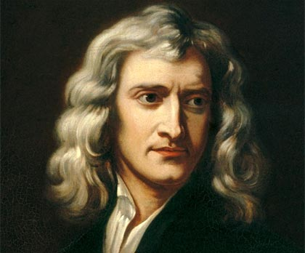
Science as Cultural Revolution
4. Sir Isaac Newton was the apogee of the Scientific
Revolution
a.
b.
c.
Notes:
a. Formulated laws of motion and mechanics
b. Central concept: universal gravitation
c. Natural laws govern both the micro- and the macrocosm
Apogee: the highest point in the development of something; the climax or culmination

Slide 14
Science as Cultural Revolution
5. By Newton’s death, educated Europeans had a
fundamentally different view of the physical
universe
a. Not propelled by angels and spirits but
functioned according to mathematical principles
b.
c.
6. The human body also became less mysterious
Notes:
a. Not propelled by angels and spirits but functioned according to mathematical principles
b. The “machine of the universe” is self-regulating
c. Knowledge of the universe can be obtained through reason

Slide 15
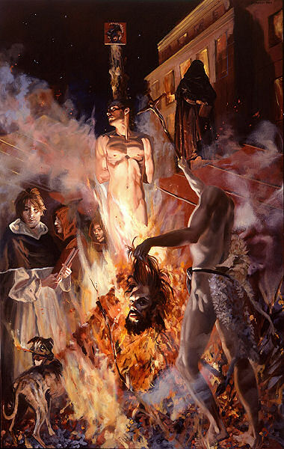
Science as Cultural Revolution
7. Catholic Church strenuously
opposed much of this
thinking
a. Burning of Giordano Bruno
in 1600 for proclaiming an
infinite universe

Slide 16
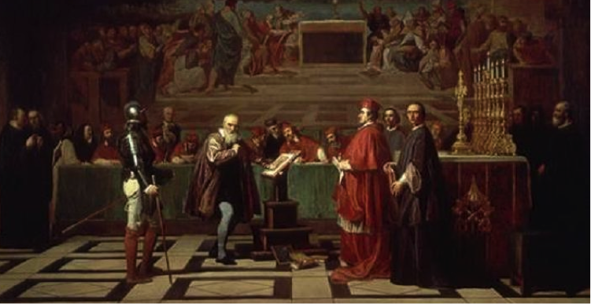
Science as Cultural Revolution
b. Galileo was forced to renounce his belief that the
earth moved around an orbit and rotated on its axis
c. But no early scientists rejected Christianity

Slide 17
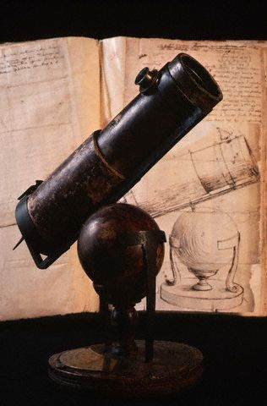
Science as Cultural Revolution
Copernicus – heliocentric theory.
Kepler – mathematically proved Copernicus’ theory of planetary motion.
Galileo – suffered at hands of Catholic Church for preaching the theory.
Leeuwenhoek – Microscope/ discovered bacteria
Hooke – cell theory
Boyle – Father of Modern Chemistry.
Priestly – discovered oxygen as an element
Newton – laws of physics and gravity.

Slide 18
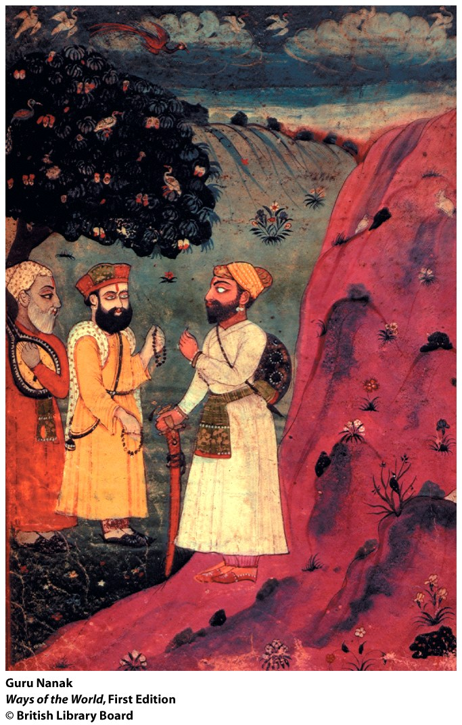

Slide 19
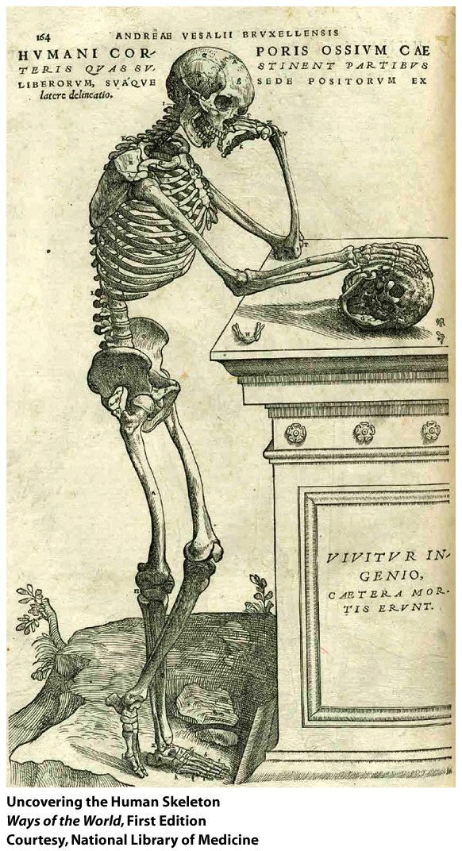

Slide 20
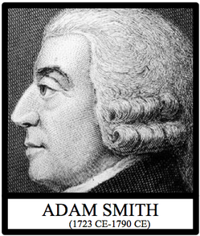
Science and Enlightenment
1. Ideas of the Scientific Revolution gradually
reached a wider European audience
2. Scientific approach to knowledge
was applied to human affairs
a. Adam Smith (1723–1790)
formulated economic laws
b. People believed that scientific
development would bring
“enlightenment” to humankind

Slide 21
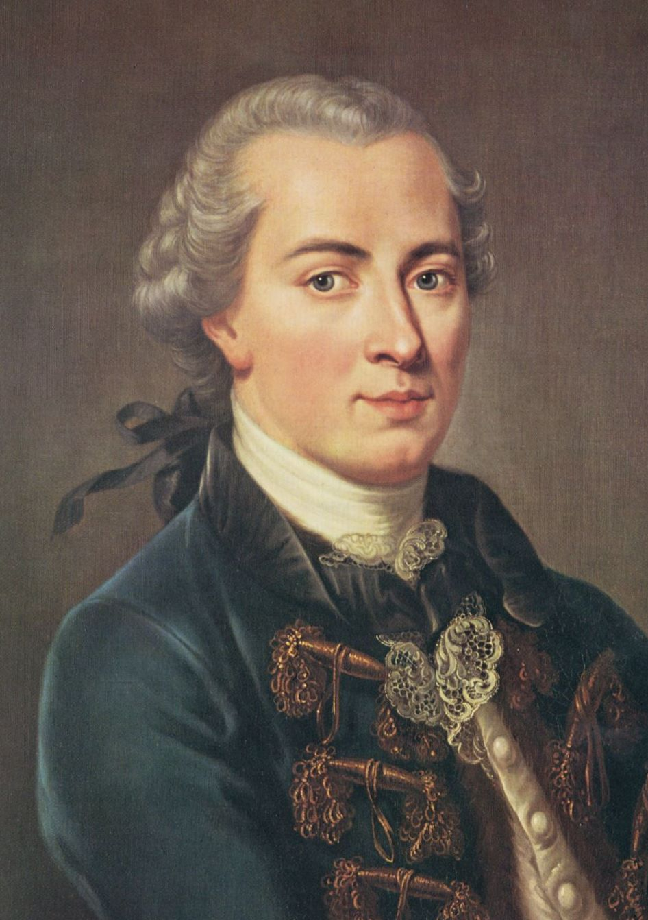
Science and Enlightenment
3. Immanuel Kant (1724–1804)
defined Enlightenment as a
“daring to know”

Slide 22
Science and Enlightenment
4. Enlightenment thinkers believed that knowledge
could transform human society
a.
b.
Notes:
a. Tended to be satirical, critical, and hostile to established authorities
b. Attacked arbitrary government, divine right, and aristocratic privilege

Slide 23
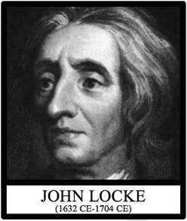
Science and Enlightenment
c. John Locke (1632–1704)
articulated ideas of
constitutional government
d. Many writers advocated
education for women

Slide 24
Science and Enlightenment
5. Much Enlightenment thought
attacked established religion
a. In his Treatise on Toleration,
Voltaire (1694–1778) attacked
the narrow particularism of
organized religion

Slide 25
Science and Enlightenment
b. Many Enlightenment thinkers were deists, believing in
a remote deity who created the world but doesn’t
intervene
c. Some were pantheists
d.
e. Example of Confucianism—supposedly secular,
moral, rational and tolerant—encouraged
Enlightenment thinkers to imagine a future for
European civilization without the kind of
supernatural religion they found so offensive in
the Christian West
Notes:
c. Some were pantheists—equated God and nature
d. Some even regarded religion as a fraud

Slide 26
Science and Enlightenment
6. Enlightenment thought was influenced by growing
global awareness
7. Central theme of Enlightenment:
the idea of progress

Slide 27
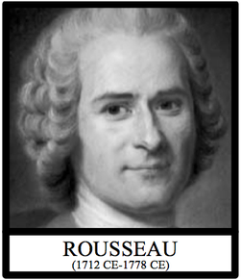
Science and Enlightenment
8. Some thinkers reacted against
too much reliance on human
reason
a. Jean-Jacques Rousseau (1712–
1778) argued for immersion in
nature rather than book learning

Slide 28
Science and Enlightenment
b. The Romantic movement appealed to emotion and
imagination
c. Religious awakenings made an immense emotional
appeal

Slide 29
Looking Ahead: Science in the Nineteenth Century
1. Science became the most widely desired product of
European culture
2. Chinese had selective interest in Jesuits’ teaching
a.
b.
Notes:
2. Chinese had selective interest in Jesuits’ teaching
a. most interested in astronomy and mathematics
b. European science had substantial impact on the Chinese kaozheng movement

Slide 30
Looking Ahead: Science in the Nineteenth Century
3. Japan kept up some European contact via trade with
the Dutch
a. Import of Western books allowed
b.
Notes:
a. Import of Western books allowed, starting in 1720
b. A small group of Japanese scholars was interested in Western texts, anatomical studies in particular

Slide 31
Looking Ahead: Science in the Nineteenth Century
4. Ottoman Empire chose not to translate major
European scientific works
a. Ottoman scholars were only interested in ideas of
practical utility (e.g., maps, calendars)
b. Islamic educational system was conservative,
made it hard for theoretical science to do well

Slide 32
European Science beyond the West
1. Modern science was cumulative and self-critical
2. In the nineteenth century, science was applied to
new sorts of inquiry; in some ways, it
undermined Enlightenment assumptions

Slide 33
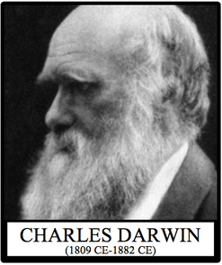
European Science beyond the West
3. Charles Darwin (1809–1882) argued that all of life
was in flux

Slide 34
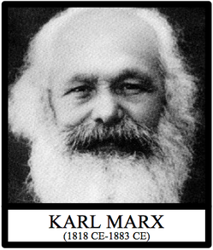
European Science beyond the West
4. Karl Marx (1818–1883) presented human history as
a process of change and struggle

Slide 35
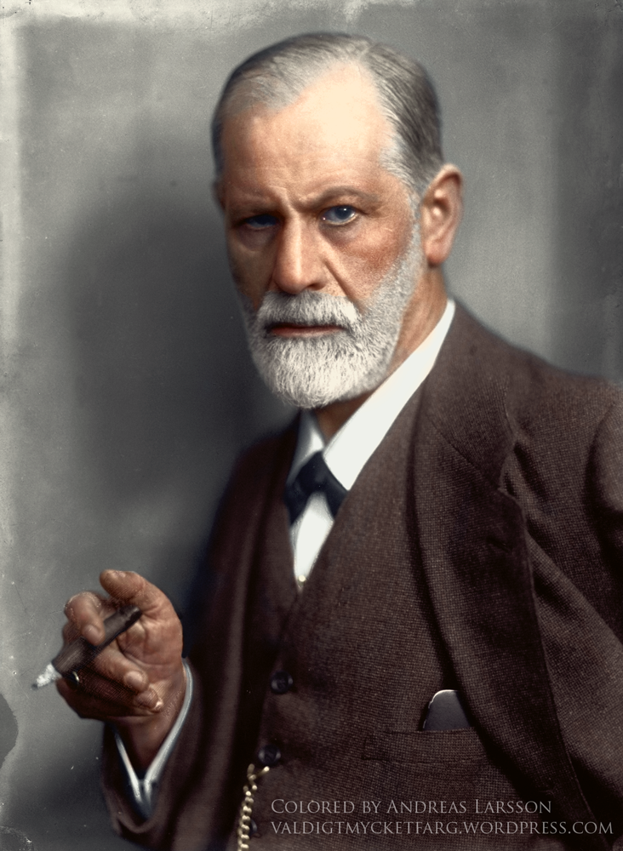
European Science beyond the West
5. Sigmund Freud (1856–1939) cast doubt on human
rationality

Slide 36
Why did the Scientific Revolution occur in Europe rather than in China or the Islamic world?
Europe | Islamic World | China

Slide 37
Why did the Scientific Revolution occur in Europe rather than in China or the Islamic world?
Europe | Islamic World | China
Europe’s historical development as a reinvigorated and fragmented civilization gave rise to conditions favorable to scientific enterprise. Europeans had evolved including a legal system that guaranteed a measure of independence from the Church, universities, and other professional associations. They didn’t have to operate under the dictates of the Church Western Europe was in a position to draw extensively upon the knowledge of other cultures, especially that of the Islamic world. In the 16th-18th centuries, Europeans had engaged in the Columbian Exchange and found themselves at the center of a massive new exchange of information of lands, peoples, animals, societies, and religions from around the world. These new concepts shook older ways of thinking and opened up a new way of thinking. | Science was patronized by a variety of local authorities, but it occurred outside the formal system of higher education. Quranic studies and religious law held the central place, whereas philosophy and natural science were viewed with great suspicion. | Chinese education focused on preparing for a rigidly defined set of civil service examinations and emphasized the humanistic and moral texts of classical Confucianism. Scientific subjects were relegated to the margins of the Chinese educational system.

Slide 38
The Scientific Revolution in the early modern era
Change
Was largely conducted by men who had already
rejected basic beliefs of the Christian faith.
b. Confirmed the teaching and the authority of the Church and therefore was sponsored by it.
c. Fundamentally altered ideas about the place of
humankind within the cosmos.
d. Drew nearly all its leading figures from England.

