Slide 1
Ways of the World: A Brief Global History First Edition
Robert W. Strayer
CHAPTER XVI
Religion and Science
1450–1750
An Asian Comparison

Slide 2
An Asian Comparison: China and the Jesuits
1. Christianity reached China during the powerful,
prosperous Ming and Qing dynasties
a.
b.
2. No mass conversion in China
a.
b.
c.
Notes:
1. Christianity reached China during the powerful, prosperous Ming and Qing dynasties
a. called for a different missionary strategy; needed government permission for operation
b. Jesuits especially targeted the official Chinese elite
2. no mass conversion in China
a. some scholars and officials converted
b. Jesuits were appreciated for mathematical, astronomical, technological, and cartographical skills
c. missionary efforts gained 200,000–300,000 converts in 250 years

Slide 3
An Asian Comparison: China and the Jesuits
3. Missionaries didn’t offer much that the Chinese needed
a.
b.
Notes:
3. Missionaries didn’t offer much that the Chinese needed
a. Christianity was clearly an all-or-nothing religion that would call for rejection of much Chinese culture
b. Early eighteenth century: papacy and other missionary orders opposed Jesuit accommodation policy

Slide 4
Persistence and Change in Afro-Asian Cultural Traditions
A. African religious elements accompanied slaves
to the Americas
1.
2. Europeans often tried to suppress African
elements as sorcery
3.
Notes:
A. African religious elements accompanied slaves to the Americas
1. development of Africanized forms of Christianity in the Americas, with divination, dream interpretation, visions, spirit possession
2. Europeans often tried to suppress African elements as sorcery
3. Persistence of syncretic religions (Vodou, Santeria, Candomble, Macumba) Traditions

Slide 5
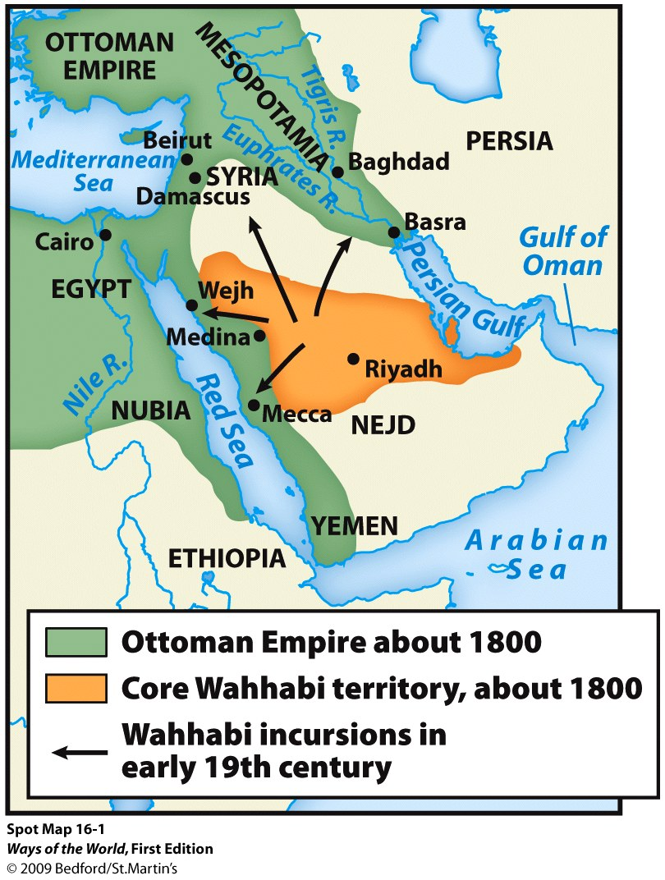
Expansion and Renewal in the Islamic World
1. Continued spread of Islam depended not on conquest but on wandering holy men, scholars, and traders
Notes:
1. Continued spread of Islam depended not on conquest but on wandering holy men, scholars, and traders

Slide 6
Expansion and Renewal in the Islamic World
2. The syncretism of Islamization was increasingly offensive to orthodox Muslims
a.
b.
c.
Notes:
1. Continued spread of Islam depended not on conquest but on wandering holy men, scholars, and traders
2. The syncretism of Islamization was increasingly offensive to orthodox Muslims
a. Helped provoke movements of religious renewal in the eighteenth century
b. Series of jihads in West Africa (eighteenth/early nineteenth centuries) attacked corrupt Islamic practices
c. Growing tension between localized and “pure” Islam

Slide 7
Expansion and Renewal in the Islamic World
3. The most well-known Islamic renewal movement of the period was
Wahhabism
a. developed in the Arabian Peninsula in mid-eighteenth century
b. founder Abd al-Wahhab (1703–1792) was a theologian
c. aimed to restore absolute monotheism, end veneration of saints
Notes:
3. The most well-known Islamic renewal movement of the period was Wahhabism
a. developed in the Arabian Peninsula in mid-eighteenth century
b. founder Abd al-Wahhab (1703–1792) was a theologian
c. aimed to restore absolute monotheism, end veneration of saints
d. aimed to restore strict adherence to the sharia (Islamic law)
e. movement developed a political element when Abd al-Wahhab allied with Muhammad Ibn Saud; led to creation of a state
f. the state was “purified”
g. the political power of the Wahhabis was broken in 1818, but the movement remained influential in Islamic world
h. reform movements persisted and became associated with resistance to Western cultural intrusion

Slide 8
Expansion and Renewal in the Islamic World
d. Aimed to restore strict adherence to the sharia
(Islamic law)
e.
f.
g.
h.
Notes:
d. aimed to restore strict adherence to the sharia (Islamic law)
e. movement developed a political element when Abd al-Wahhab allied with Muhammad Ibn Saud; led to creation of a state
f. the state was “purified”
g. the political power of the Wahhabis was broken in 1818, but the movement remained influential in Islamic world
h. reform movements persisted and became associated with resistance to Western cultural intrusion

Slide 9
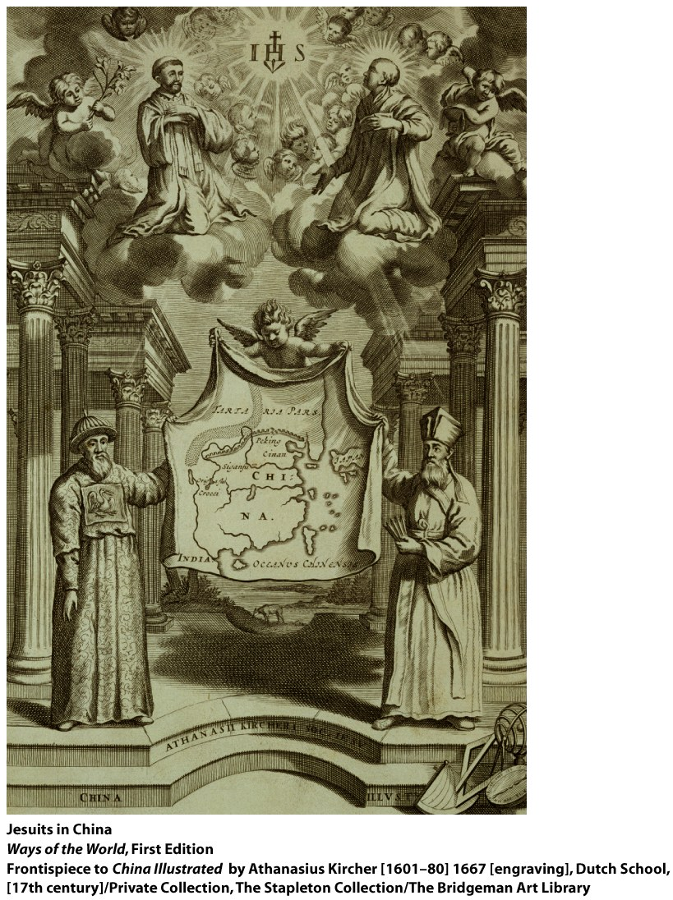
1. Chinese and Indian cultural/religious change wasn’t as dramatic as what occurred in Europe a. Confucian and Hindu cultures didn’t spread widely in early modern period b. But neither remained static
China: New Directions in an Old Tradition
Notes:
1. Chinese and Indian cultural/religious change wasn’t as dramatic as what occurred in Europe a. Confucian and Hindu cultures didn’t spread widely in early modern period b.but neither remained static 2. Ming and Qing dynasty China still operated within a Confucian framework a. addition of Buddhist and Daoist thought led to creation of Neo-Confucianism b. both dynasties embraced the Confucian tradition

Slide 10
2. Ming and Qing dynasty China still operated within a Confucian framework a. b.
China: New Directions in an Old Tradition
Notes:
1. Chinese and Indian cultural/religious change wasn’t as dramatic as what occurred in Europe a. Confucian and Hindu cultures didn’t spread widely in early modern period b. but neither remained static 2. Ming and Qing dynasty China still operated within a Confucian framework a. addition of Buddhist and Daoist thought led to creation of Neo-Confucianism b. both dynasties embraced the Confucian tradition

Slide 11
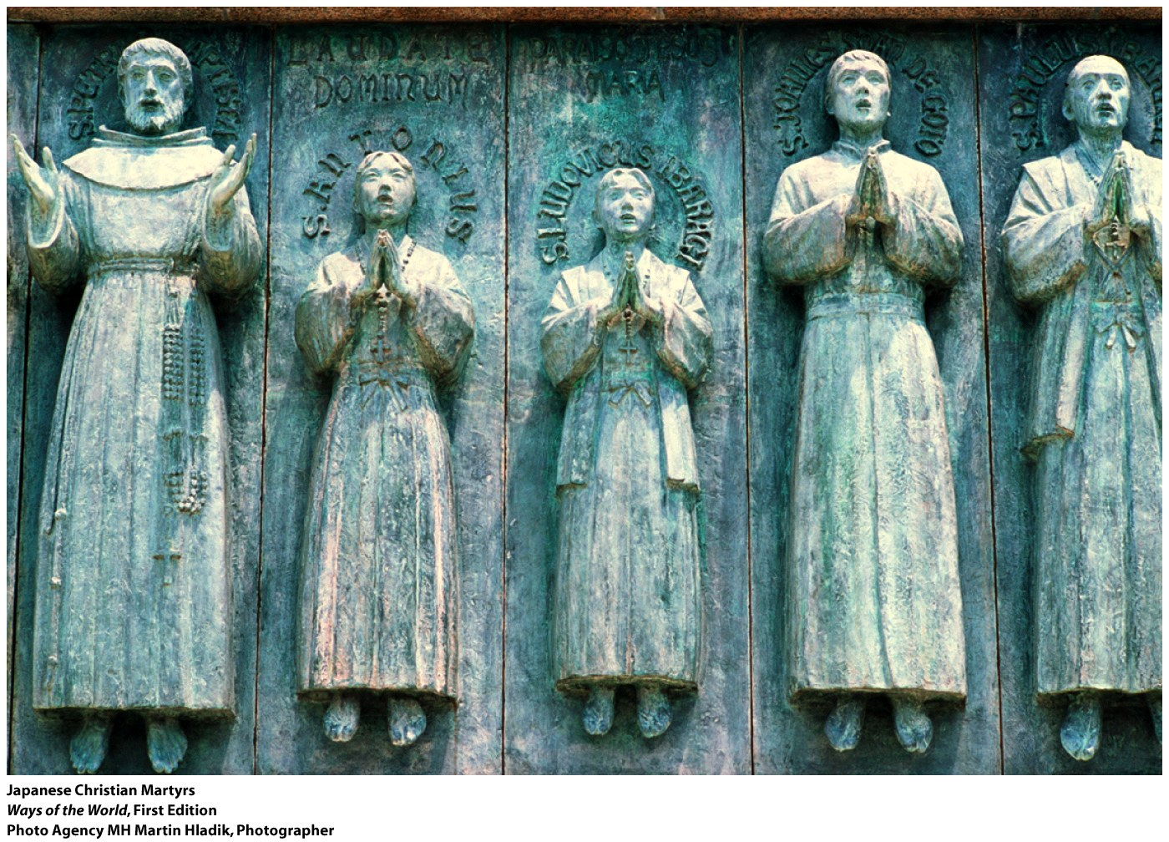
China: New Directions in an Old Tradition
3. Considerable amount of debate and new thinking in China
a. Wang Yangming (1472–1529): anyone can achieve a virtuous life by introspection, without Confucian education
b. Chinese Buddhists also tried to make religion more accessible to commoners—withdrawal from the world not necessary for enlightenment
c. Similarity to Martin Luther’s argument that individuals could seek salvation without help from a priestly hierarchy
d. kaozheng (“research based on evidence”) was a new direction in Chinese elite culture
Notes:
3. considerable amount of debate and new thinking in China
a. Wang Yangming (1472–1529): anyone can achieve a virtuous life by introspection, without Confucian education
b. Chinese Buddhists also tried to make religion more accessible to commoners—withdrawal from the world not necessary for enlightenment
c. similarity to Martin Luther’s argument that individuals could seek salvation without help from a priestly hierarchy
d. kaozheng (“research based on evidence”) was a new direction in Chinese elite culture

Slide 12
China: New Directions in an Old Tradition
4. Lively popular culture among the less well
educated
a. production of plays, paintings, and literature
b. great age of novels, such as Cao Xueqin’s The
Dream of the Red Chamber (Mid-18th century)
Notes:
4. lively popular culture among the less well educated
a. production of plays, paintings, and literature
b. great age of novels, such as Cao Xueqin’s The Dream of the Red Chamber (mid-eighteenth century)

Slide 13
India: Bridging the Hindu/Muslim Divide
1. Several movements brought Hindus and Muslims
together in new forms of religious expression
2. Bhakti movement was especially important
a. Devotional Hinduism
b. Effort to achieve union with the divine through
songs, prayers, dances, poetry, and rituals
Notes:
1. Several movements brought Hindus and Muslims together in new forms of religious expression
2. Bhakti movement was especially important
a. Devotional Hinduism
b. Effort to achieve union with the divine through songs, prayers, dances, poetry, and rituals

Slide 14
India: Bridging the Hindu/Muslim Divide
c. Appealed especially to women
d. Often set aside caste distinctions
e. Much common ground with Sufism, helped to
blur the line between Islam and Hinduism in India
f. Mirabai (1498–1547) is one of the best-loved
bhakti poets
Notes:
. Appealed especially to women
d. Often set aside caste distinctions
e. Much common ground with Sufism, helped to blur the line between Islam and Hinduism in India
f. Mirabai (1498–1547) is one of the best-loved bhakti poets

Slide 15
India: Bridging the Hindu/Muslim Divide
3. Growth of Sikhism
a. Founder Guru Nanak (1469–1539) had been part of
the bhakti movement
b. Nanak and his successors set aside caste distinctions
*Proclaimed essential equality of men and women
c. Gradually developed as a new religion of the Punjab
d. Evolved into a militant community in response to
hostility
Notes:
religion that blended Islam and Hinduism
a. founder Guru Nanak (1469–1539) had been part of the bhakti movement; came to believe that Islam and Hinduism were one
b. Nanak and his successors set aside caste distinctions and proclaimed essential equality of men and women
c. gradually developed as a new religion of the Punjab
d. Evolved into a militant community in response to hostility
Had to defend themselves against Mughal and Hindu hostility

Slide 16
Which of the following is a true statement concerning Christianity and Islam during the early modern era?
Comparison
Islam spread to few new regions during the period, while Christianity spread to many new regions.
b. Declining numbers of people continued to practice Christianity, while growing numbers adopted Islam.
c. Both Islam and Christianity became more exclusive religions that shunned converts.
d. The spread of Islam during the early modern era relied less on conquest and colonization than the spread of Christianity.

Slide 17
