Slide 1
Ways of the World: A Brief Global History First Edition
Robert W. Strayer
CHAPTER XVII
Atlantic Revolutions and Their Echoes
1750–1914

Slide 3
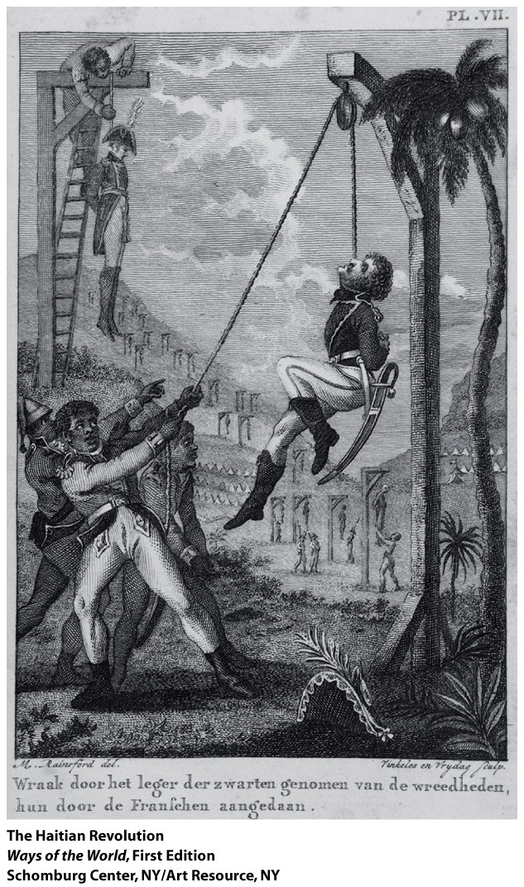
The Haitian Revolution, 1791–1804
1. Saint Domingue
(later called Haiti)
was a French Caribbean colony
a.
b.
Notes:
1. Saint Domingue (later called Haiti) was a French Caribbean colony
a. regarded as the richest colony in the world
b. vast majority of population were slaves

Slide 4
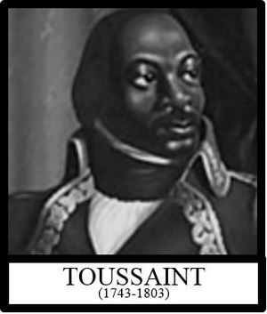
The Haitian Revolution, 1791–1804
2. Example of the French Revolution sparked a spiral of
violence
a. But revolution meant
different things to different
people
b.
c.
d.
Notes:
2. example of the French Revolution sparked a spiral of violence
a. but revolution meant different things to different people
b. massive slave revolt began in 1791
c. became a war between a number of factions
d. power gradually shifted to the slaves, who were led by former slave Toussaint Louverture

Slide 5
The Haitian Revolution, 1791–1804
3. The result was a unique revolution—the only
completely successful slave revolt in world history
a. Renamed the country Haiti (“mountainous” or “rugged” in Taino)
b.
c.
d.
Notes:
3. the result was a unique revolution—the only completely successful slave revolt in world history
a. renamed the country Haiti (“mountainous” or “rugged” in Taino)
b. identified themselves with the original native inhabitants
c. declared equality for all races
d. divided up plantations among small farmers

Slide 6
The Haitian Revolution, 1791–1804
4. Haiti’s success generated great hope and great fear
a.
b. Caused horror among whites, led to social conservatism
c. Increased slavery elsewhere, as plantations claimed
Haiti’s market share
d.
Notes:
4. Haiti’s success generated great hope and great fear
a. created new “insolence” among slaves elsewhere, inspired other slave rebellions
b. caused horror among whites, led to social conservatism
c. increased slavery elsewhere, as plantations claimed Haiti’s market share
d. Napoleon’s defeat in Haiti convinced him to sell Louisiana Territory to the United States
INSOLENCE- rude and disrespectful behavior

Slide 8
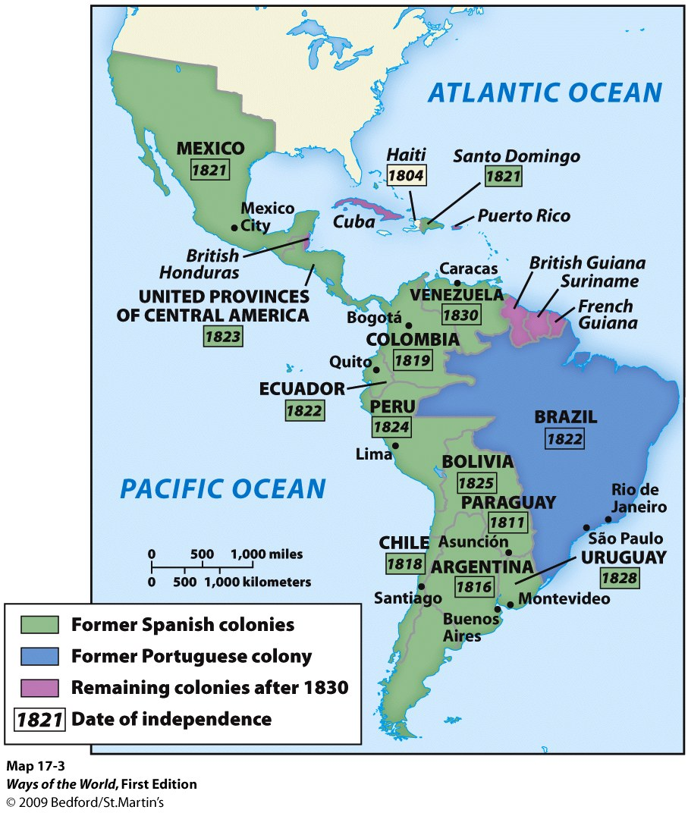
Spanish American Revolutions, 1810–1825
1. Latin American revolutions were
inspired by earlier revolutionary
movements
2.
3. Reasons why Latin American
independence movements were
limited at first
a.
b.
c.
Notes:
2. native-born elites (creoles) in Spanish colonies of Latin America were offended at the Spanish monarchy’s efforts to control them in the eighteenth century
3. reasons why Latin American independence movements were limited at first
a. little tradition of local self-government
b. society was more authoritarian, with stricter class divisions
c. whites were vastly outnumbered

Slide 9
Spanish American Revolutions, 1810–1825
4. Creole elites had revolution thrust upon them by
events in Europe
a.
b.
c.
Notes:
4. creole elites had revolution thrust upon them by events in Europe
a. 1808: Napoleon invaded Spain and Portugal, put royal authority in disarray
b. Latin Americans were forced to take action
c. most of Latin America was independent by 1826

Slide 10
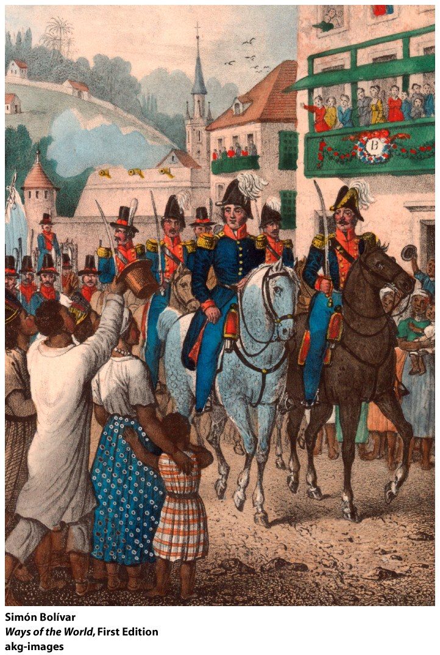
Spanish American Revolutions, 1810–1825
5. longer process than in North America
a. Latin American societies
were torn by class, race,
and regional divisions
b. Fear of social rebellion
from below shaped the
whole independence
movement
Notes:
5. longer process than in North America
a. Latin American societies were torn by class, race, and regional divisions
b. fear of social rebellion from below shaped the whole independence movement

Slide 11
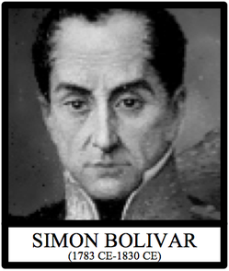
Spanish American Revolutions, 1810–1825
6. Leaders of independence movements appealed to the lower
classes in terms of nativism: all free people born in the
Americas were Americanos
a.
Notes:
6.leaders of independence movements appealed to the lower classes in terms of nativism: all free people born in the Americas were Americanos
a. many whites and mestizos regarded themselves as Spanish
b. but many leaders were liberals, influenced by the ideals of the Enlightenment and the French Revolution
c. in reality, lower classes, Native Americans, and slaves got little benefit from independence

Slide 12
Spanish American Revolutions, 1810–1825
b. But many leaders were liberals, influenced by the
ideals of the Enlightenment and the French
Revolution
c. In reality, _______________, ________________
and ____________ got little benefit from
independence
Notes:
b. but many leaders were liberals, influenced by the ideals of the Enlightenment and the French Revolution
c. in reality, lower classes, Native Americans, and slaves got little benefit from independence

Slide 13
Spanish American Revolutions, 1810–1825
7. It proved impossible to unite the various Spanish colonies,
unlike the United States
a. Distances were greater
b. Colonial experiences were different
c. Stronger regional identities
8. After Latin America gained independence, its traditional
relationship with North America was gradually reversed
a.
b.
Notes:
7. it proved impossible to unite the various Spanish colonies, unlike the United States
a. distances were greater
b. colonial experiences were different
c. stronger regional identities
8. after Latin America gained independence, its traditional relationship with North America was gradually reversed
a. the United States grew wealthier and more democratic, became stable
b. Latin American countries became increasingly underdeveloped, impoverished, undemocratic, and unstable

Slide 14
Where did the least radical of all the Atlantic revolutions occur?
a. North America
b. Haiti
c. France
d. Latin America
Notes:
A

Slide 15
Which of the following was NOT a long-term outcome of the Atlantic revolutions?
a. The emergence of a feminist movement
b. The emergence of an abolition of slavery movement
c. The spread of the idea that governments should be based on the idea of popular sovereignty
d. The discrediting of nationalism as a result of the excesses of the French Revolution
Notes:
D

