Slide 1
Ways of the World: A Brief Global History First Edition
Robert W. Strayer
CHAPTER XVII
Echoes of Revolution
1750–1914

Slide 2
Echoes of Revolution
A. Smaller revolutions occurred in Europe in 1830, 1848, and 1870.
1. Led to greater social equality and liberation from
foreign rule
2. Enlarged voting rights: by 1914, major states of
Western Europe, the United States, and Argentina had
universal male suffrage

Slide 3
Echoes of Revolution
3. Even in Russia, there was a constitutional movement
in 1825
4. Abolitionist, nationalist, and feminist movements
arose to question other patterns of exclusion and
oppression

Slide 4
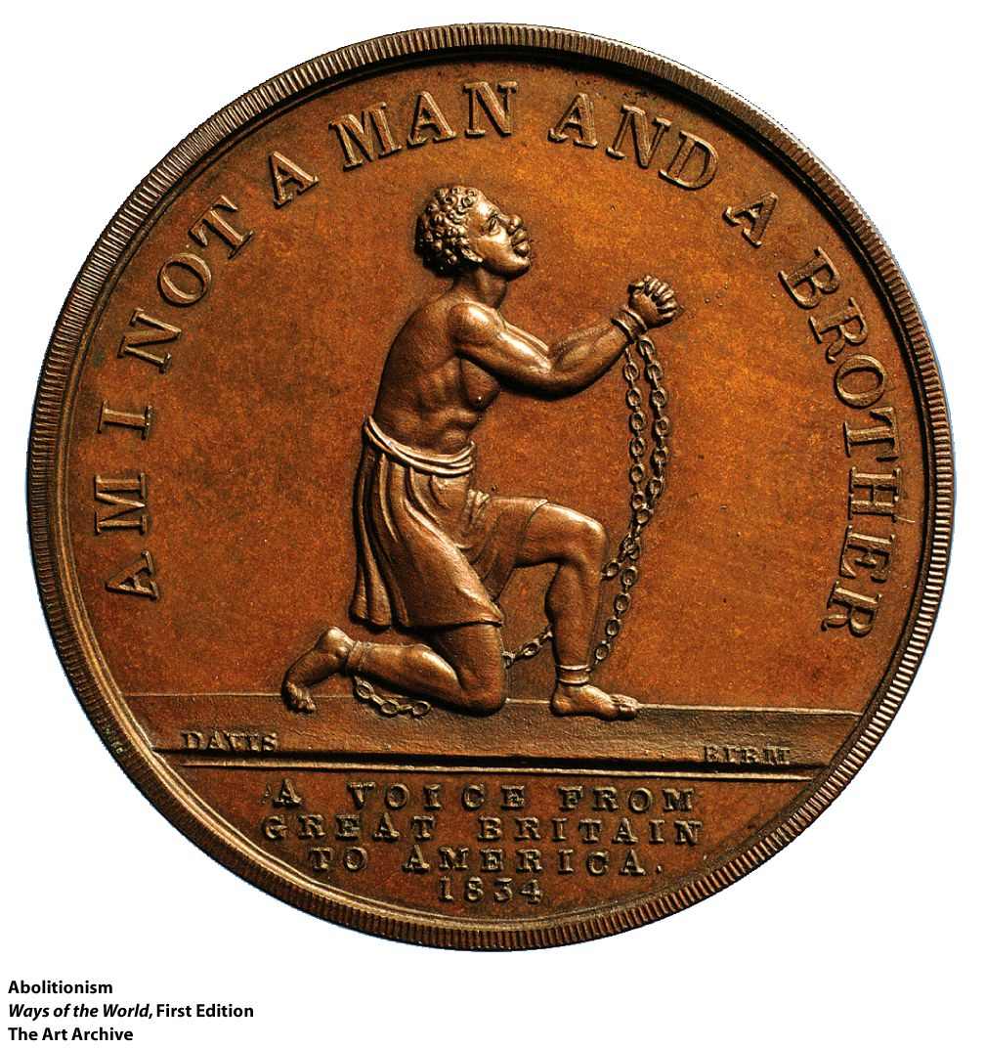
The Abolition of Slavery Nations
1.
2. Enlightenment thinkers were
increasingly critical of slavery
a. American and French revolutions
focused attention on slaves’ lack of
liberty and equality
b. Religious groups, especially Quakers and
Protestant evangelicals, became increasingly
vocal in opposition to slavery
c. Growing belief that slavery wasn’t
necessary for economic progress
Notes:
1.slavery was largely ended around the world between 1780 and 1890
2. Enlightenment thinkers were increasingly critical of slavery
a. American and French revolutions focused attention on slaves’ lack of liberty and equality
b. religious groups, especially Quakers and Protestant evangelicals, became increasingly vocal in opposition to slavery
c. growing belief that slavery wasn’t necessary for economic progress

Slide 5
The Abolition of Slavery Nations
3. Three major slave rebellions in the British West Indies showed
that slaves were discontent; brutality of suppression appalled
people
4. Abolitionist movements were most powerful in Britain
a. 1807: Britain forbade the sale of slaves within its empire
b. 1834: Britain emancipated all slaves
c. Other nations followed suit, under growing international
pressure
d. Most Latin American countries abolished slavery by 1850s
e. emancipation of the Russian serfs (1861)

Slide 6
The Abolition of Slavery Nations
5. Resistance to abolition was vehement among interested
parties
6. Abolition often didn’t lead to the expected results
a.
b.
c.
d.
e. More slaves were used within Africa to produce export
crops
Notes:
5. resistance to abolition was vehement among interested parties
6.abolition often didn’t lead to the expected results
a. usually there was little improvement in the economic lives of former slaves
b. unwillingness of former slaves to work on plantations led to a new wave of global migration, especially from India and China c. few of the newly freed gained anything like political equality
d. most former Russian serfs remained impoverished
e. more slaves were used within Africa to produce export crops

Slide 7
Nationalism Develops
Add this slide to your notes
Nationalism and Nation-States
Nationalism—loyalty to a nation of people with common culture and history
Nation-State—nation with its own independent government
In 1815 Europe, only France, England and Spain are nation-states
Liberals and radicals support nationalism, but conservatives do not.
Notes:
Three Philosophies: In the early 1800s, three schools of political thought conflict in Europe
Conservative—landowners and nobles want traditional monarchies
Liberal—wealthy merchants and business owners want limited democracy
Radical—believe in liberty and equality. They want everyone to have a vote.

Slide 8
Nations v. Nationalism
1. Revolutionary movements gave new prominence to more
recent kind of human community—the nation
a. Idea that humans are divided into separate nations, each
With a distinct culture and territory and deserving an
Independent political life
b. Before the nineteenth century, foreign rule in itself wasn’t
regarded as heinous
c. most important loyalties were to clan, village, or region
Notes:
1. Revolutionary movements gave new prominence to more recent kind of human community—the nation
a. idea that humans are divided into separate nations, each with a distinct culture and territory and deserving an independent political life
b. before the nineteenth century, foreign rule in itself wasn’t regarded as heinous
c. most important loyalties were to clan, village, or region

Slide 9
Nations v. Nationalism
2. Independence movements acted in the name of new
nations
3. Erosion of older identities and loyalties
a.
b.
c.
Notes:
2. independence movements acted in the name of new nations
3. erosion of older identities and loyalties
a. science weakened the hold of religion
b. migration to cities or abroad weakened local allegiances
c. printing standardized languages

Slide 10
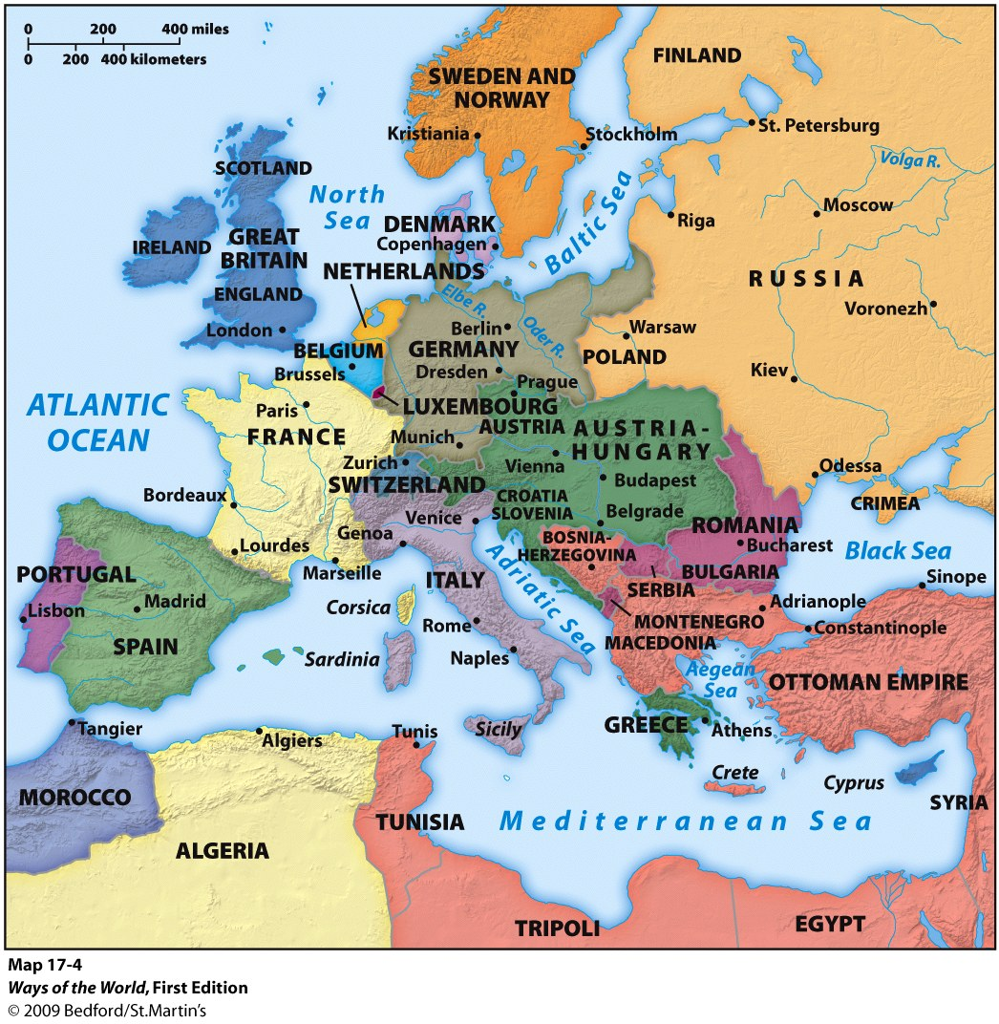
Nations v. Nationalism
4. Nationalism was often presented as a
reawakening of older cultural
identities
5. Nationalism was enormously
powerful in the nineteenth
century
a. Inspired political unification of
Germany and Italy
b. Inspired separatist movements by
Greeks,Serbs, Czechs, Hungarians,
Poles, Ukrainians, the Irish, and Jews
c. Fueled preexisting rivalry
among European states
No “d”
Notes:
4. nationalism was often presented as a reawakening of older cultural identities
5. nationalism was enormously powerful in the nineteenth century
a. inspired political unification of Germany and Italy
b. inspired separatist movements by Greeks, Serbs, Czechs, Hungarians, Poles, Ukrainians, the Irish, and Jews
c. fueled preexisting rivalry among European states

Slide 11
Nations v. Nationalism
6. Nationalism took on a variety of political
ideologies
a. “Civic nationalism” identified the “nation” with a
particular territory, encouraged assimilation
b. Some defined the nation in racial terms (e.g.,
Germany)
7. Nationalism was not limited to Europe
Notes:
6. nationalism took on a variety of political ideologies
a. “civic nationalism” identified the “nation” with a particular territory, encouraged assimilation
b. some defined the nation in racial terms (e.g., Germany)
7. nationalism was not limited to Europe

Slide 12
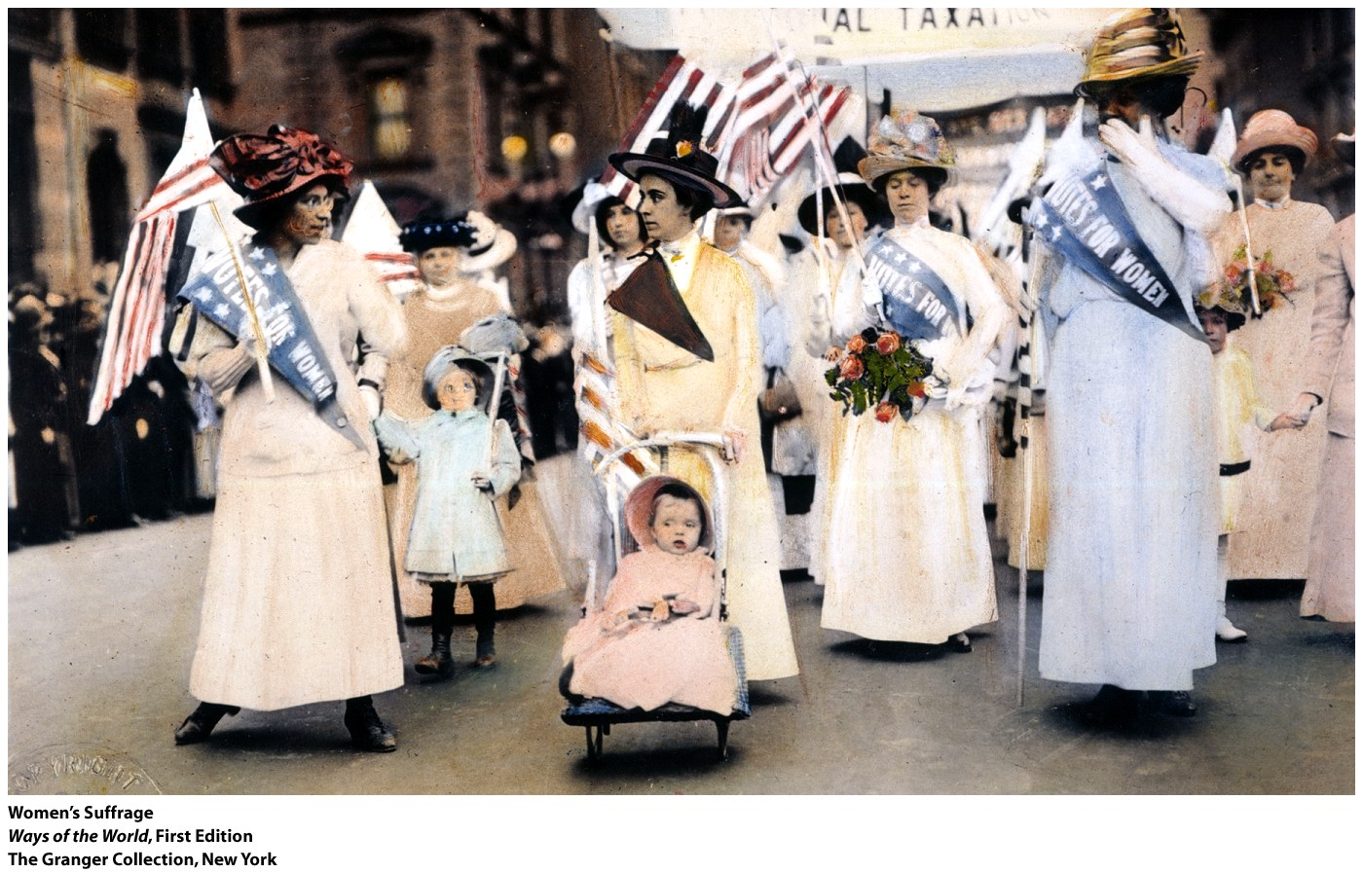
Feminist Beginnings
1. A feminist movement developed in the nineteenth century,
especially in Europe and North America

Slide 13
Feminist Beginnings
2. European Enlightenment thinkers sometimes challenged the idea that women were innately inferior
a.
b. More educational opportunities and less household drudgery for
middle-class women
c.
d. Maternal feminism: argued women’s distinctive role as
mothers
3. First organized expression of feminism: women’s rights conference
in Seneca Falls, New York, in 1848
4. Feminist movement was transatlantic from the beginning
Notes:
2. European Enlightenment thinkers sometimes challenged the idea that women were innately inferior
a. during the French Revolution, some women argued that liberty and equality must include women
b. more educational opportunities and less household drudgery for middle-class women
c. women increasingly joined temperance movements, charities, abolitionist movements, missionary work, etc.
d. maternal feminism: argued women’s distinctive role as mothers

Slide 14
Feminist Beginnings
5. By the 1870s, movements focused above all on
suffrage
a. Became a middle-class, not just elite, movement
b. Most worked through peaceful protest and
persuasion
c. Became a mass movement in the most
industrialized countries by turn of century

Slide 15
Feminist Beginnings
6. by 1900:
a.
b. Women’s literacy rates were rising
c. Some U.S. states passed laws allowing women to
control their property and wages
d.
e.
f.
Notes:
6. by 1900:
a. Some women had been admitted to universities
b. Women’s literacy rates were rising
c. Some U.S. states passed laws allowing women to control their property and wages
d. Some areas liberalized divorce laws
e. Some women made their way into new professions: teaching, nursing, social work
f. 1893: New Zealand became first country to grant universal female suffrage

Slide 16
Feminist Beginnings
7. The movement led to discussion of the role of
women in modern society
a.
b.
8. Bitter opposition
a. Some argued strains of education and life beyond
the home would cause reproductive damage
b. Some saw suffragists, Jews, and socialists as “a
foreign body” in national life
9. Feminism spread beyond Europe and the United States,
but less widely than nationalism
Notes:
7. The movement led to discussion of the role of women in modern society
a. Taboo sexual topics were aired
b. Deep debates over women’s proper roles

