Slide 1
CHAPTER XVIII
Revolutions of Industrialization
1750–1914
The Industrial Revolution and Latin America in the 19th Century

Slide 2
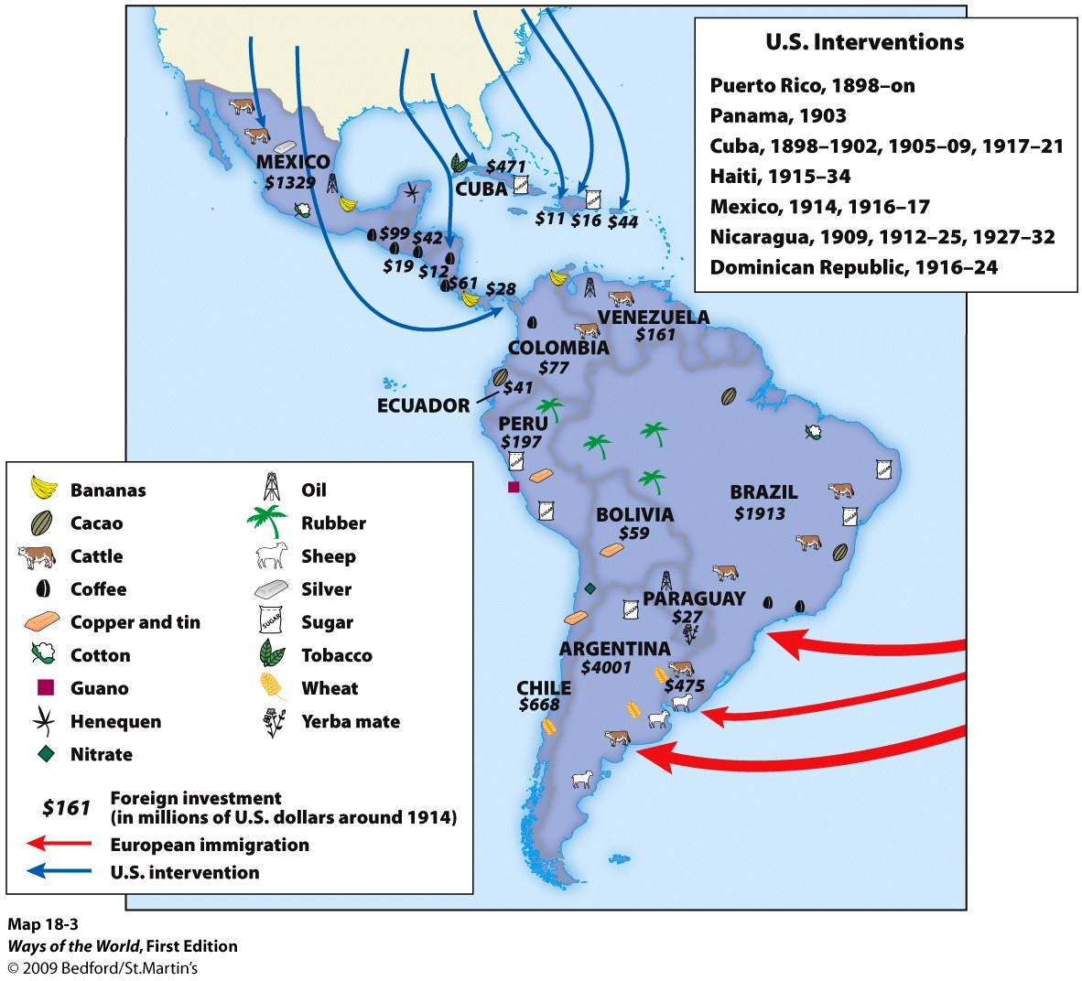
The Industrial Revolution and Latin America in the 19th Century
A. Beyond Europe and North America, only ______
underwent major industrialization in the
nineteenth century.
Japan
Notes:
A. Beyond Europe and North America, only Japan underwent major industrialization in the nineteenth century.
1. elsewhere, only modest experiments in industry
2. did not transform societies
3. nonindustrialized societies still felt the impact of European and North American developments

Slide 3
The Industrial Revolution and Latin America in the 19th Century
1. Elsewhere, only modest experiments in industry
2. Did not transform societies
3. Nonindustrialized societies still felt the impact
of European and North American developments
Notes:
A. Beyond Europe and North America, only Japan underwent major industrialization in the nineteenth century.
1. elsewhere, only modest experiments in industry
2. did not transform societies
3. nonindustrialized societies still felt the impact of European and North American developments

Slide 4
The Industrial Revolution and Latin America in the 19th Century
B. After Independence in Latin America
1. The struggle for independence in Latin America took a
long time and was very destructive
2. The four vice-royalties of Spanish America became
eighteen separate countries
3. International wars hindered development of the new
nations
a. Mexico lost vast territories to the United States
(1846–1848)
b. Paraguay was devastated by war (1864–1870)
Notes:
B. After Independence in Latin America
1. the struggle for independence in Latin America took a long time and was very destructive
2. the four vice-royalties of Spanish America became eighteen separate countries
3. international wars hindered development of the new nations
a. Mexico lost vast territories to the United States (1846–1848)
b. Paraguay was devastated by war (1864–1870)

Slide 5
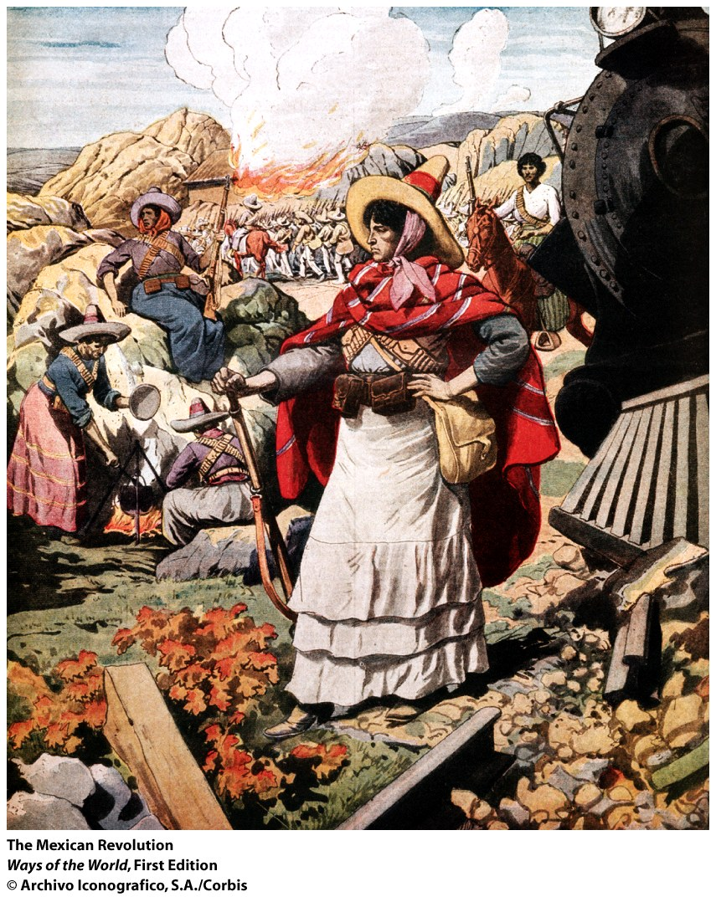
4. Political life was highly unstable
a. Conservatives tried to maintain
the old status quo
b. Liberals attacked the Church,
sought some social reforms,
preferred federalism to a
centralized government
system
c. Often, military strongmen
(caudillos) gained power
d. States ran through multiple
constitutions
Notes:
4. political life was highly unstable
a. conservatives tried to maintain the old status quo
b. liberals attacked the Church, sought some social reforms, preferred federalism to a centralized government system
c. often, military strongmen (caudillos) gained power
d. states ran through multiple constitutions

Slide 6
5. Independence brought little fundamental change to
social life
a. Slavery was abolished (though not until late 1880s in
Brazil and Cuba)
b. Most legal distinctions between racial categories
were abolished
c. But creole whites remained overwhelmingly in
control of productive economic resources
d. Small middle class allowed social mobility for a few
e. The vast majority were impoverished
Notes:
5. independence brought little fundamental change to social life
a. slavery was abolished (though not until late 1880s in Brazil and Cuba)
b. most legal distinctions between racial categories were abolished
c. but creole whites remained overwhelmingly in control of productive economic resources
d. small middle class allowed social mobility for a few
e. the vast majority were impoverished

Slide 7
Facing the World Economy
1. 2nd half of the nineteenth century: greater
stability, integration into world economy
2. Rapid growth of Latin American exports to
industrializing countries
a. Exported food products and raw materials
b. Imported textiles, machinery, tools, weapons,
luxury goods
3. Major investment of European and U.S. capital in
Latin America
Notes:
1. second half of the nineteenth century: greater stability, integration into world economy
2. rapid growth of Latin American exports to industrializing countries
a. exported food products and raw materials
b. imported textiles, machinery, tools, weapons, luxury goods
3. major investment of European and U.S. capital in Latin America

Slide 8
Becoming like Europe?
1. Rapid population increase
2. Rapid urbanization
3. Actively sought European immigrants
4. Few people benefited from the export boom
a. Upper-class landowners did very well
b. Middle class grew some
c. But over 90 percent of the population was still
lower-class
Notes:
1. rapid population increase
2. rapid urbanization
3. actively sought European immigrants
4. few people benefited from the export boom
a. upper-class landowners did very well
b. middle class grew some
c. but over 90 percent of the population was still lower-class

Slide 9
Becoming like Europe?
5. Industrial workers made up a modest segment
of the lower class
a. Attempted unions and strikes
b. Harshly repressed
6. Most of the poor remained rural
Notes:
5. industrial workers made up a modest segment of the lower class
a. attempted unions and strikes
b. harshly repressed
6. most of the poor remained rural

Slide 10
Becoming like Europe?
Mexico
7. Only in __________did conditions provoke a
nationwide revolution
a. Overthrow of the dictator Porfirio Díaz
(1876–1911)
b. Major, bloody conflict (1910–1920)
c. Huge peasant armies
d. Transformed Mexico
Notes:
7. only in Mexico did conditions provoke a nationwide revolution
a. overthrow of the dictator Porfirio Díaz (1876–1911)
b. major, bloody conflict (1910–1920)
c. huge peasant armies
d. transformed Mexico

Slide 11
Becoming like Europe?
8. Export boom did not cause a thorough Industrial
Revolution in Latin America
a. There was little internal market for
manufactured goods
b. Rich landowners and cattlemen had little
incentive to invest in manufacturing
c. Governments supported free trade, so cheaper
and higher-quality foreign goods were available
than could be made at home
d. Instead, economic growth was dependent on
________ and _____ _______
Europe
North America
Notes:
8. export boom did not cause a thorough Industrial Revolution in Latin America
a. there was little internal market for manufactured goods
b. rich landowners and cattlemen had little incentive to invest in manufacturing
c. governments supported free trade, so cheaper and higher-quality foreign goods were available than could be made at home
d. instead, economic growth was dependent on Europe and North America

Slide 12
Reflections: History and Horse Races
A. Historians are fascinated by historic “firsts.”
B. But a focus on “firsts” can be misleading.
1. Most “_____ ___________” in history were not
___________
2. The Industrial Revolution was certainly an
“unexpected outcome of converging
circumstances”
First achievements
intentional
Notes:
A. Historians are fascinated by historic “firsts.”
B. But a focus on “firsts” can be misleading.
1. Most “first achievements” in history were not intentional
2. The Industrial Revolution was certainly an “unexpected outcome of converging circumstances”

Slide 13
Reflections: History and Horse Races
C. Europeans have used their development of
industrialization to claim an innate superiority.
1. It’s important to emphasize the unexpectedness of
the Industrial Revolution
2. Spread of industrialization around the world
diminishes the importance of the “why Europe?”
question
3. Industrialization will increasingly be seen as a
global process

Slide 14
Industrialization
Connection
a. Had little impact on most regions that did not industrialize.
b. Was limited to Europe and North America because other regions proved unable to adopt the new technologies and production techniques.
c. Had a profound impact on regions where the Industrial Revolution did not take place because of the demands of industrial economies for raw materials and markets.
d. Resulted in Europe becoming less involved in world trade because it no longer needed products manufactured elsewhere.
Notes:
C

Slide 15
What was the impact of the export boom on the various social segments of Latin American society?
 | Positive Effects | Negative Effects
Upper Class
Middle Class
Lower Class

Slide 16
What was the impact of the export boom on the various social segments of Latin American society?
 | Positive Effects | Negative Effects
Upper Class | Land-owning upper class was 1% of the population They saw their property values increase. They benefited the most. | They benefited the most.
Middle Class | Middle class was 8% of the population Skills proved valuable and prosperity grew
Lower Class | Urban workers who labored in the mines, ports, in the railroads, and a few factories organized themselves and created unions and engaged in strikes. | Suffered the most and benefited the least from the export boom Many farmers lost land from the government attacks on communal landholdings and peasant indebtedness to wealthy landowners. Women and children now were required to work as field laborers.
Notes:
Handout KEY

Slide 17
What were the differences between industrialization in the U.S. and that in Russia?
United States | Russia
U.S. was the Western world’s most exuberant democracy in the 19th C. Change bubbled up from society as free farmers, workers, and businessmen sought new opportunities and operated in a political system that gave them varying degrees of expression. Workers in the U.S. were treated better and had more outlets for grievances because of trade unions. U.S. industrialization was associated with capitalism and competition. | Russia remained an outpost of absolute monarchy. Change was far more initiated by the state itself in its efforts to catch up with the more powerful innovated states of Europe. Russia developed an unusually radical class consciousness, based on harsh conditions and the absence of any legal outlet for the grievances. Industrialization in Russia was associated with violent social revolutions through a socialist political party inspired by the teachings of Karl Marx.
Notes:
Handout KEY

