Slide 1
Ways of the World: A Brief Global History First Edition
Robert W. Strayer
CHAPTER XVIII
Revolutions of Industrialization
1750–1914

Slide 2
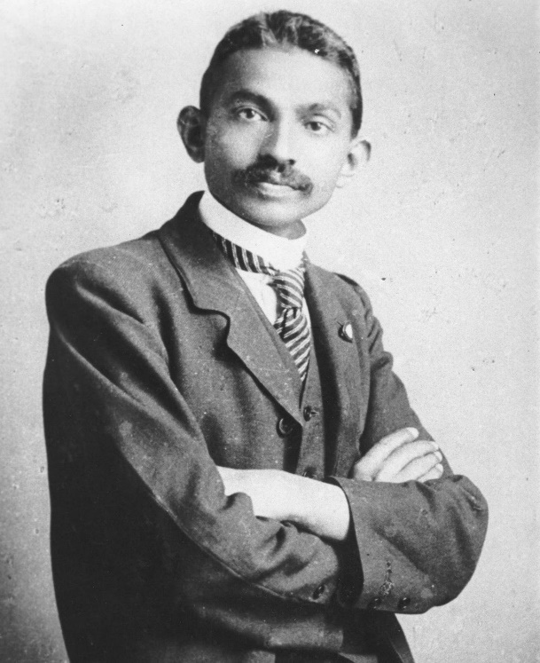
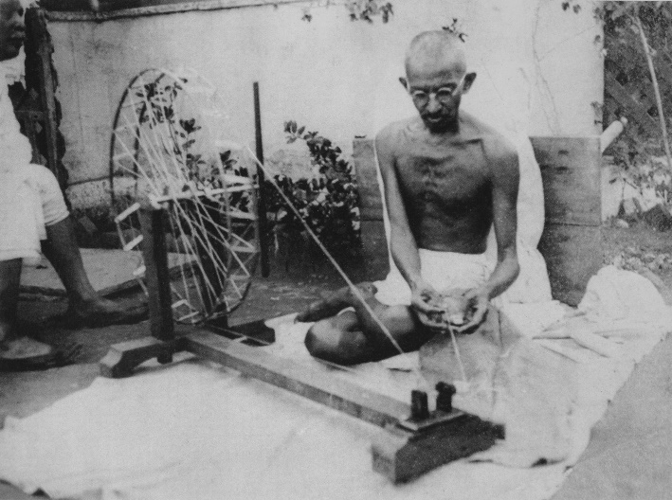
A. Mahatma Gandhi criticized industrialization
as economic exploitation.
1. Few people have agreed with him
2. Every kind of society has embraced at least the idea of industrialization since
it started in Great Britain in the late
eighteenth century

Slide 3
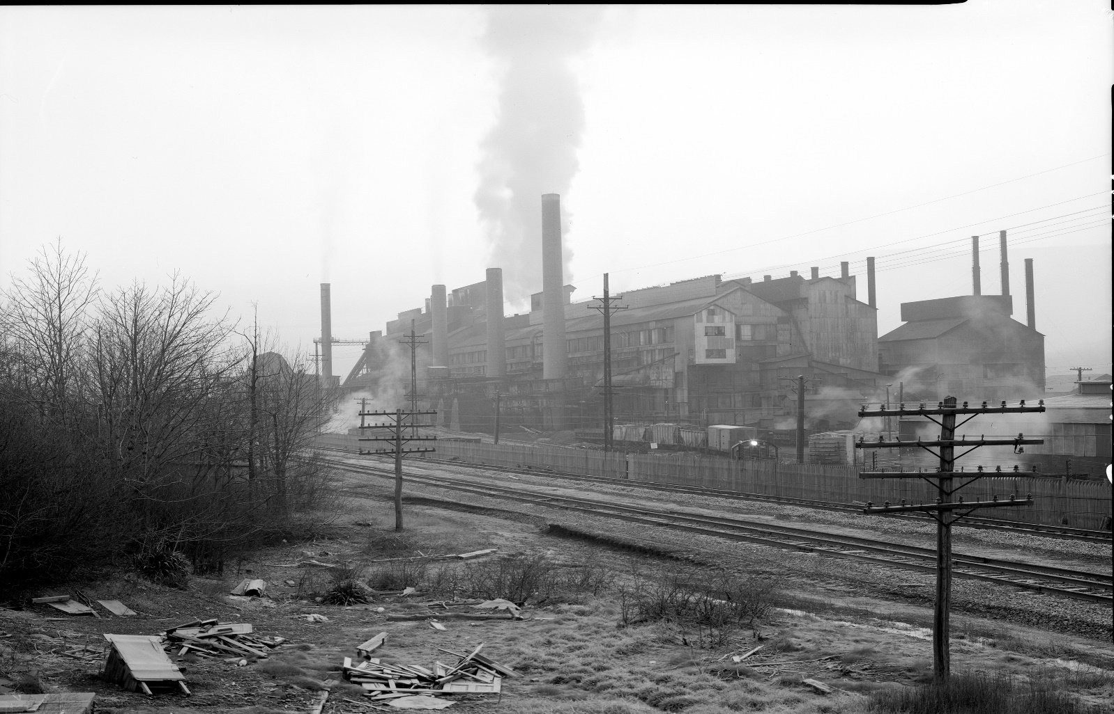
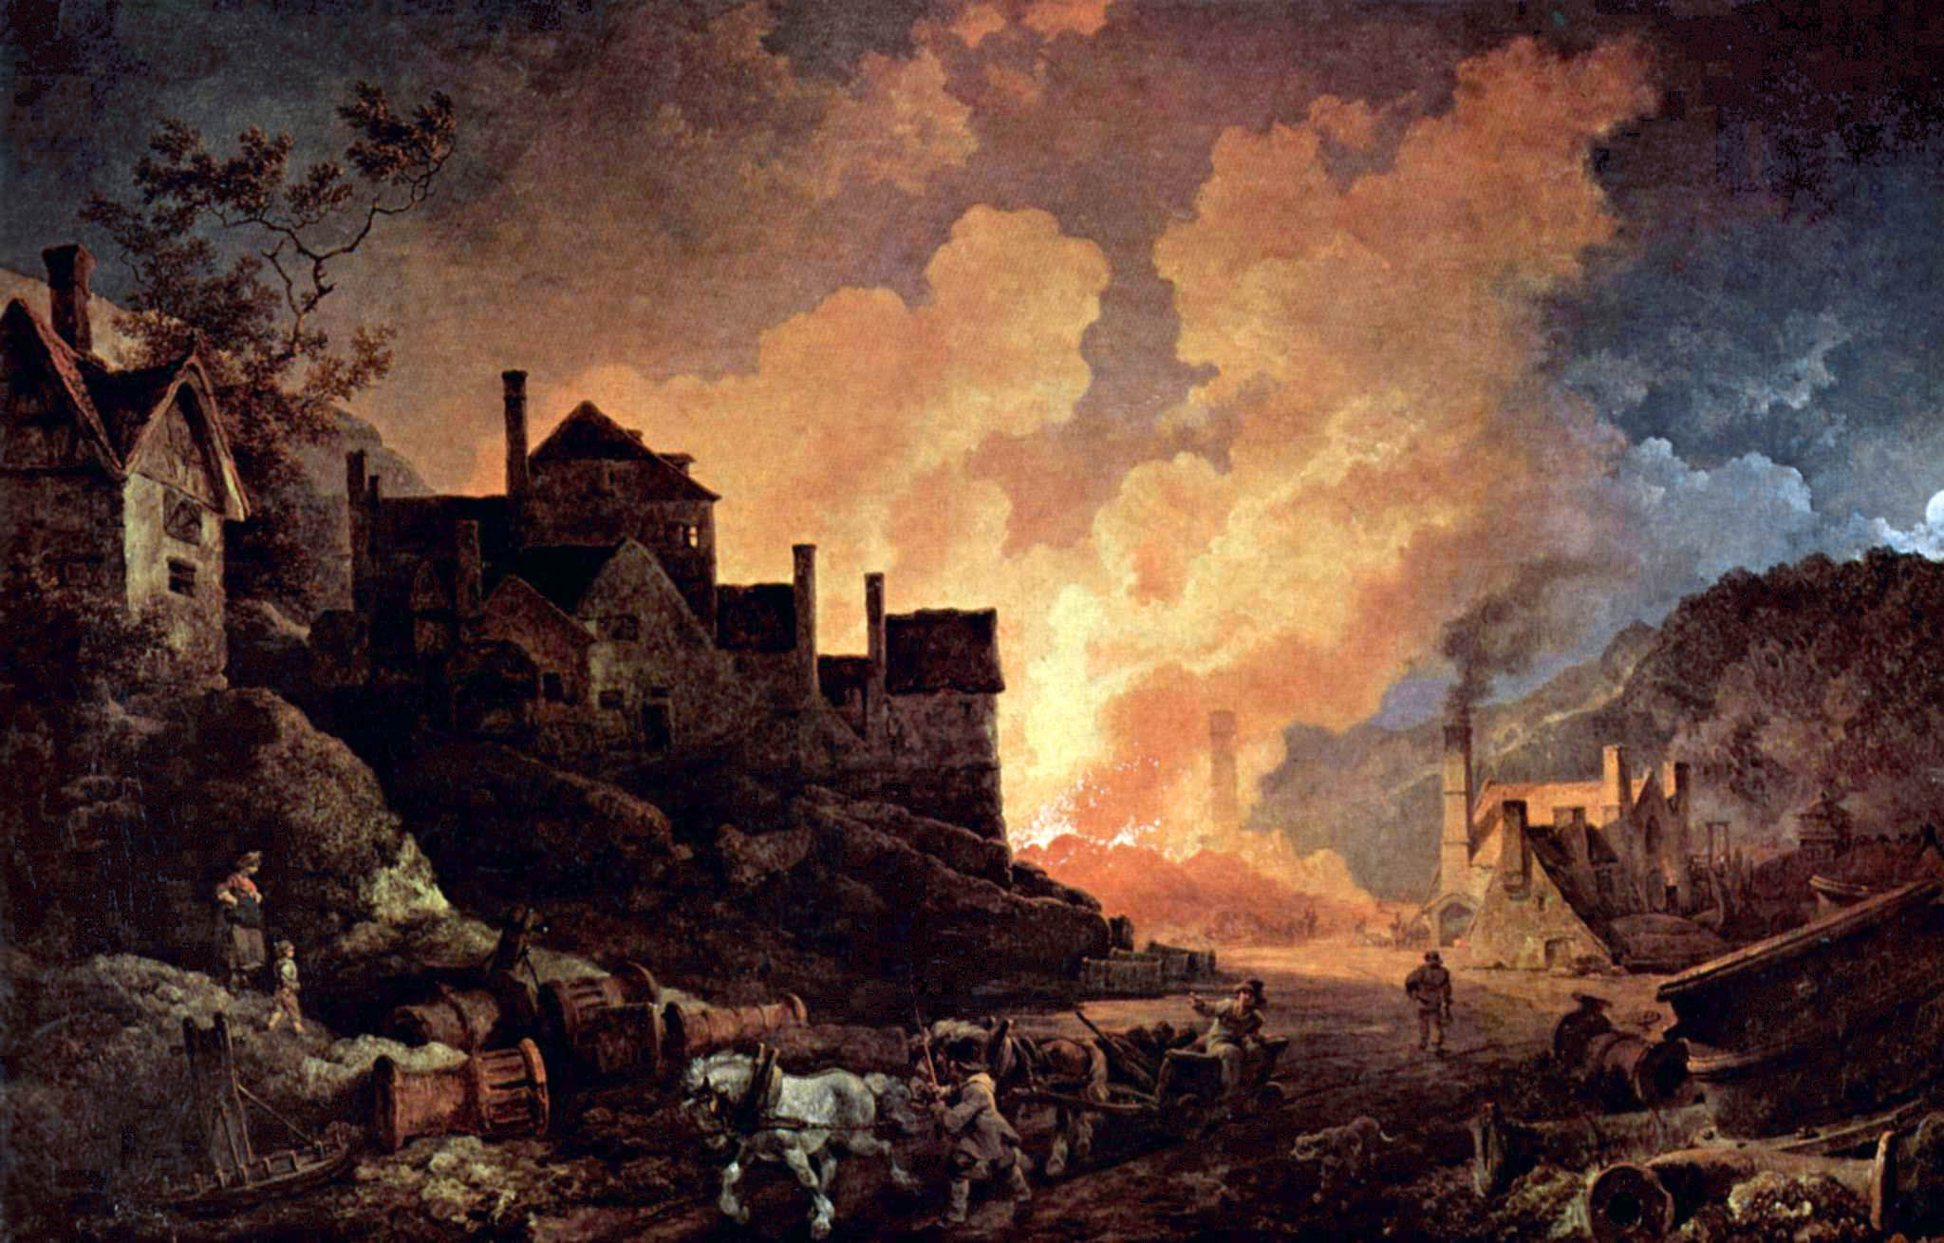
B. The Industrial Revolution was one of the
most significant elements of Europe’s
_______ _____________

Slide 4
1. Initial industrialization period was 1750–1900
2. Drew on the Scientific Revolution
3.
4. Pushed Europe into a position of global
dominance
5.

Slide 5
Explaining the Industrial Revolution
The global context for the Industrial Revolution lies in a very ________ _________in human numbers from about 375 million people in 1400 to about 1 billion in the early nineteenth century.
Accompanying this growth was the utilization of ________ ________, which made unprecedented proportions of energy available for human use. Access to this new energy gave rise to an enormously increased output of goods and services.

Slide 6
Explaining the Industrial Revolution
1. Use of new energy sources (steam engines,
petroleum engines)
2. In Britain, output increased fiftyfold in the period
1750–1900
3. Based on a “culture of innovation”
4.

Slide 7
Explaining the Industrial Revolution
5. Greatest breakthrough was the steam engine
a. Soon spread from the textile industry to many
other types of production
b. Agriculture was transformed
6. Spread from Britain to Western Europe, then to the
___________, ______, and ________

Slide 8
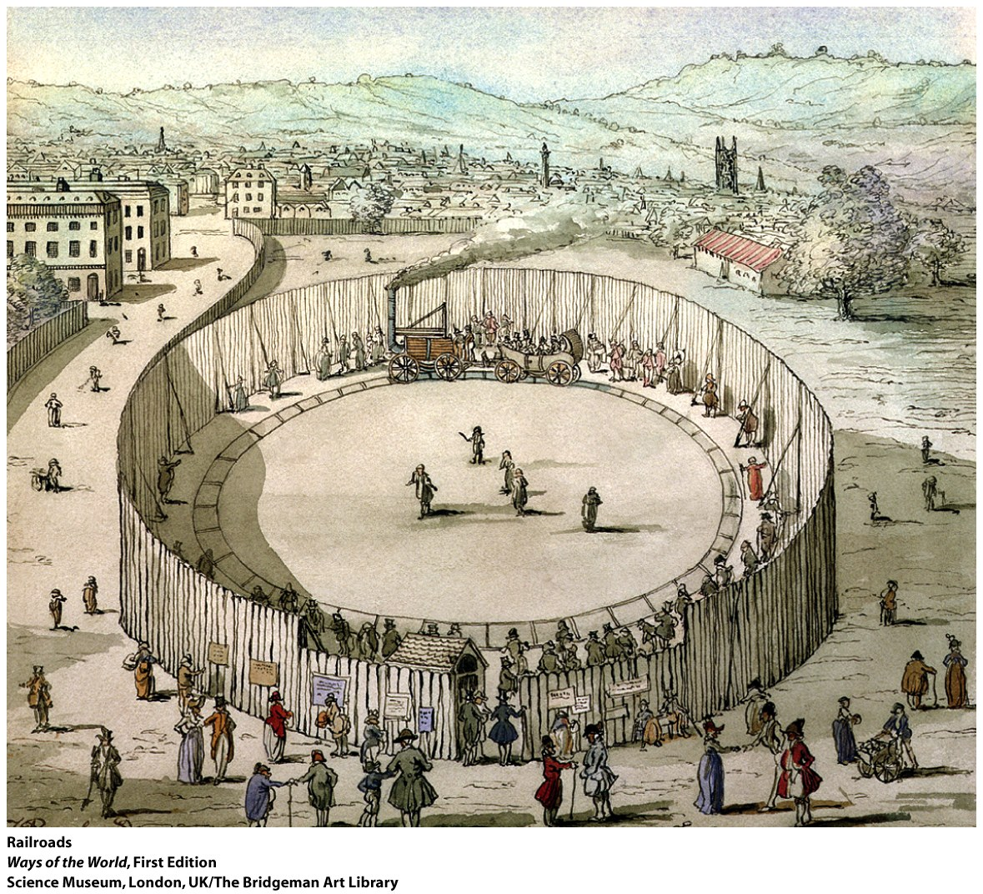

Slide 9
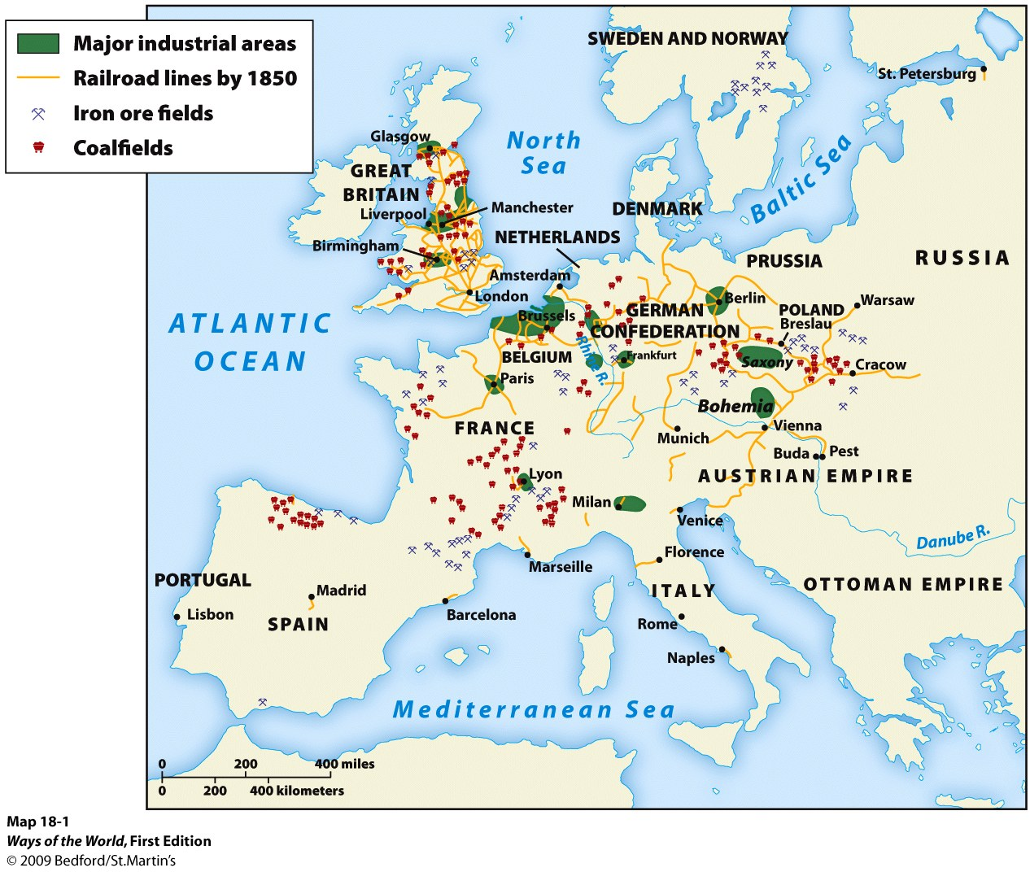
Why Europe?
Many scholars have debated why industrialization appeared first in Great Britain, and why it started in the late nineteenth century
Notes:
Many scholars have debated why industrialization appeared first in Great Britain, and why it started in the late nineteenth century

Slide 10
Why Europe?
2. Earlier views attributing it to something unique
in European society or culture have been
challenged by:
a. The fact that other parts of the world (e.g.,
China, the Islamic world) have had times of
great technological and scientific flourishing
b. The fact that Europe ____ ____ ______ ___
_____ _____ ________ as late as 1750
c. The rapid spread of industrial techniques to much
of the world in the past 250 years

Slide 11
Why Europe?
3. Contemporary historians tend to see the Industrial
Revolution as a rather quick and unexpected
eruption in the period 1750–1850
4. Why it might have occurred in Europe
a. Some patterns of European ______ ______
_______ _______
b. European rulers had an unusual alliance
with merchant classes

Slide 12
Why Europe?
5. Other societies developed market-based
economies by the eighteenth century (e.g.,
Japan, India, and China)
a. But Europe was at the center of the most
varied exchange network
b. Contact with culturally different peoples
_________ ______ ___ ________
encouraged change and innovation
c. The Americas provided silver, raw materials, and
foods

Slide 13
Why Britain?
1. Britain was the most _____________of Europe’s
larger countries
a. Small farmers had been pushed out (enclosure
movement)
b. Market production fueled by a number of
agricultural innovations
c. Guilds had largely disappeared

Slide 14
Why Britain?
2. Ready supply of industrial workers with few options
3. British _________ were interested in commerce
aristocrats
4. British commerce was _________
worldwide

Slide 15
Why Britain?
5. British political life encouraged commercialization and
economic innovation
a. Policy of ____________ __________ (established 1688)
welcomed people with technical skills regardless of
faith
b. British government imposed tariffs to __________ its
businessmen
c. It was easy to form companies and forbid workers’ unions

Slide 16
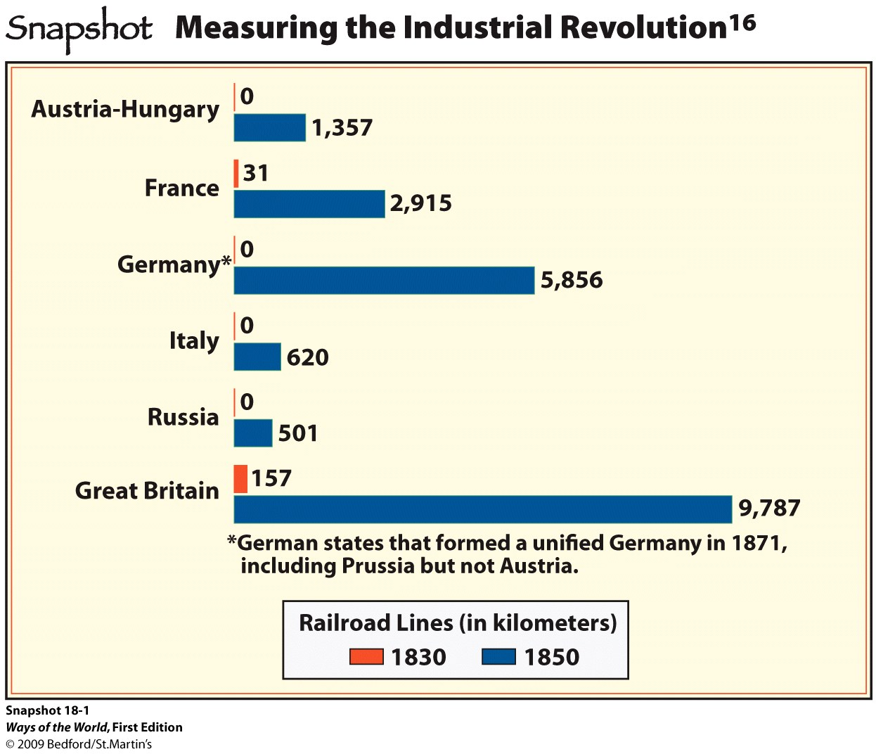
Why Britain?
d. Unified internal market, thanks to road and
canal system
e. _____ ___ protected inventors’ interests
Patent laws
f. Checks on royal
authority gave more
room for private
enterprise

Slide 17
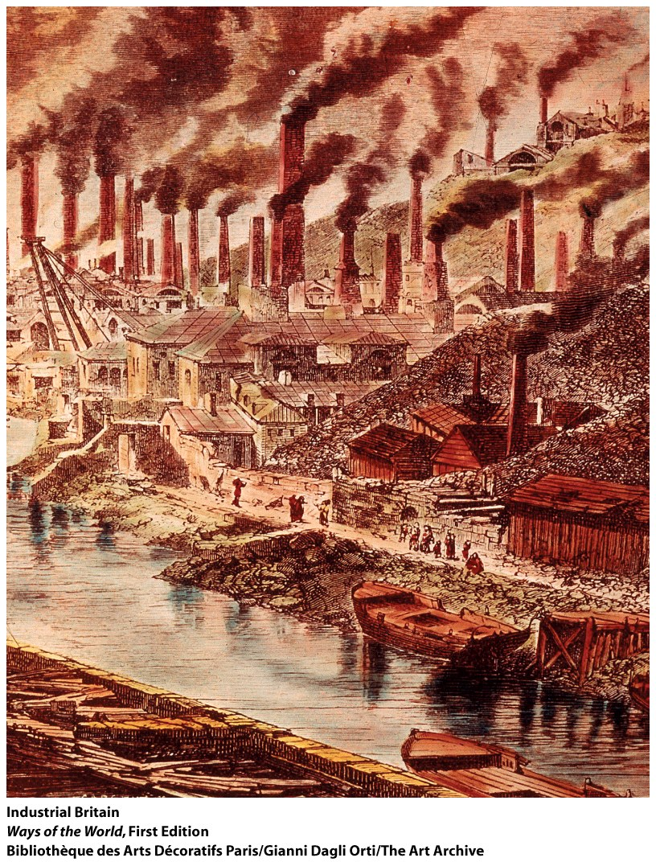
Why Britain?
6. Emphasis of the Scientific Revolution was
different in Great Britain
a. On the continent: logic, deduction,
mathematical reasoning
b. In Britain: ___________ and _________,
measurement, mechanical
c. In Britain, artisan/craftsman inventors
were in close contact with _______ and
____________
d. The British Royal Society (founded 1660)
took the role of promoting “________
__________”

Slide 18
Why Britain?
7. Britain had plenty of _____and ____ ____, often
conveniently located
8. Britain was not devastated by the Napoleonic wars
9. Social change was possible without _________

Slide 21
Which of the following was NOT a long-term outcome of the Industrial Revolution?
Change
a. Creation of a culture of innovation
b. Significant changes to people’s working patterns
c. Enormous increase in the output of goods
d. Efforts by governments, especially in Europe, to slow or stop industrialization

Slide 22
What was the impact of the export boom on the various social segments of Latin American society?
 | Positive Effects | Negative Effects
Upper Class
Middle Class
Lower Class

