Slide 1
Ways of the World: A Brief Global History First Edition
Robert W. Strayer
CHAPTER XVIII
Revolutions of Industrialization
1750–1914
First Industrial Society

Slide 2
The First Industrial Society
A. There was a massive increase in output as
industrialization took hold in Britain.
1. Rapid development of railroad systems
2. Much of the dramatic increase was in______,
____________, and _______
mining
manufacturing
services
Notes:
A. There was a massive increase in output as industrialization took hold in Britain.
1. rapid development of railroad systems
2. much of the dramatic increase was in mining, manufacturing, and services

Slide 3
The First Industrial Society
3. Agriculture became less important by comparison
(in 1891, agriculture generated only 8 percent of
British national income)
4. Vast transformation of daily life
a. It was a traumatic process for many
b. Different people were affected in different
ways
Notes:
3. agriculture became less important by comparison (in 1891, agriculture generated only 8 percent of British national income)
4. vast transformation of daily life
a. it was a traumatic process for many
b. different people were affected in different ways

Slide 4
The British Aristocracy
1. Landowning aristocrats had little material loss in the
Industrial Revolution
2. But the aristocracy_________, because urban wealth
became more important
a. Many _____________, ______________, and
__________ were enriched
b. Aristocrats had declining political clout
c. By 1900, businessmen led the major political parties
declined
businessmen
manufacturers
bankers
Notes:
1. landowning aristocrats had little material loss in the Industrial Revolution
2. but the aristocracy declined, because urban wealth became more important
a. many businessmen, manufacturers, and bankers were enriched
b. aristocrats had declining political clout
c. by 1900, businessmen led the major political parties

Slide 5
The British Aristocracy
3. Titled nobles retained great social prestige and
personal wealth
a. Many found an outlet in Britain’s colonial
possessions
Notes:
3. titled nobles retained great social prestige and personal wealth
a. many found an outlet in Britain’s colonial possessions

Slide 6
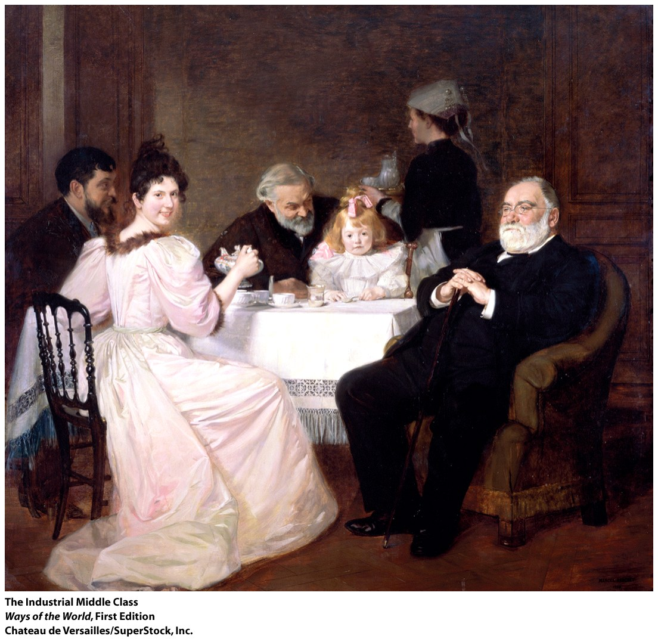
The Middle Classes
1. The middle classes had
the most obvious gains
from industrialization
2. Upper middle class:
some became _______
________, bought into
aristocratic life
extremely
wealthy
Notes:
1. the middle classes had the most obvious gains from industrialization
2. upper middle class: some became extremely wealthy, bought into aristocratic life

Slide 7
The Middle Classes
3. Middle class: large numbers of smaller businessmen and
professionals
a. Politically liberal
b. Stood for thrift, hard work, rigid morals, and
cleanliness
c. Samuel Smiles, Self-Help (1859): _____________
________________________________________
d. Middle-class women were more frequently cast
as homemakers, wives, and mothers; as the
moral center of family life; and as managers of
consumption
individuals
are responsible for their own destiny
Notes:
3. middle class: large numbers of smaller businessmen and professionals
a. politically liberal
b. stood for thrift, hard work, rigid morals, and cleanliness
c. Samuel Smiles, Self-Help (1859): individuals are responsible for their own destiny
d. Middle-class women were more frequently cast as homemakers, wives, and mothers; as the moral center of family life; and as managers of consumption

Slide 8
The Middle Classes
4. Lower middle class: service sector workers
(clerks, secretaries, etc.)
a. By 1900, they were around 20 percent of
Britain’s population
b. Employment opportunities for women as well
as men
Notes:
4. lower middle class: service sector workers (clerks, secretaries, etc.)
a. by 1900, they were around 20 percent of Britain’s population
b. employment opportunities for women as well as men

Slide 9
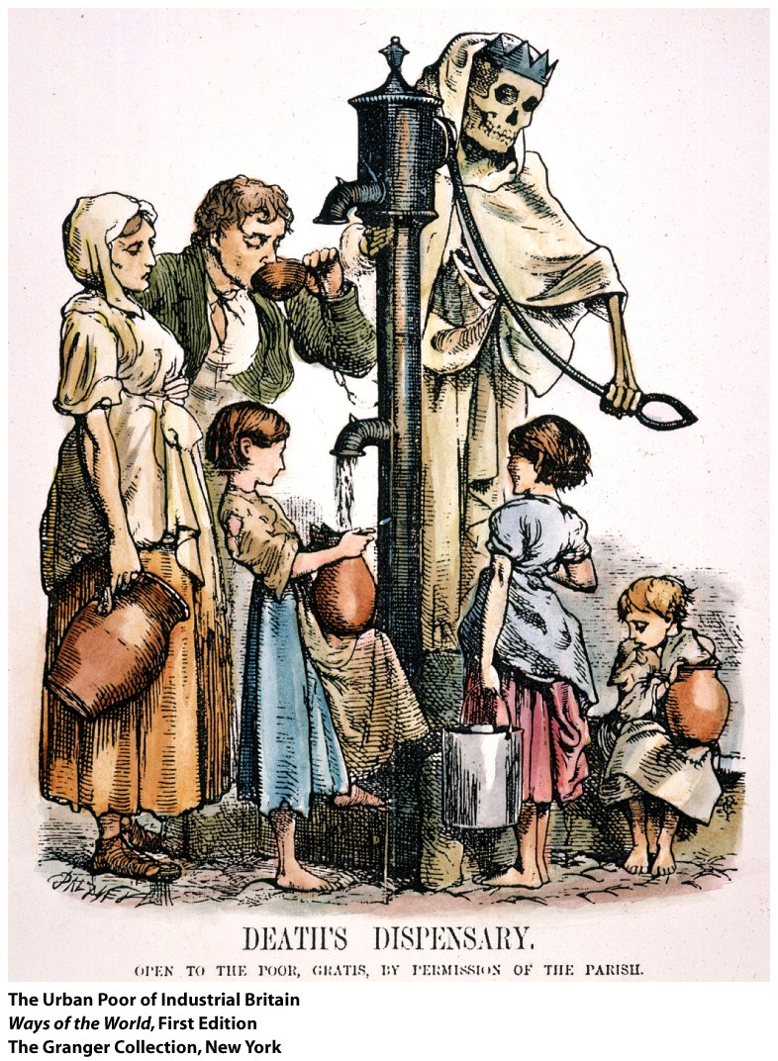
The Laboring Classes
1. In the nineteenth century, about 70
percent of Britons were workers
2. Laboring classes suffered
most/benefited least from
industrialization
3. Rapid urbanization
a. by 1851, a majority of Britain’s
population was urban
b. by 1900, _________was the
largest city in the world
(6 million)
London
Notes:
1. in the nineteenth century, about 70 percent of Britons were workers
2. laboring classes suffered most/benefited least from industrialization
3. rapid urbanization
a. by 1851, a majority of Britain’s population was urban
b. by 1900, London was the largest city in the world (6 million)

Slide 10
The Laboring Classes
4. __________ urban conditions
a. Vast overcrowding
b. Inadequate _________ and _____ _______
c. Epidemics
d. Few public services or open spaces
e. Little contact between the rich and the poor
Horrible
sanitation
water supplies
Notes:
4. Horrible urban conditions
a. vast overcrowding
b. inadequate sanitation and water supplies
c. epidemics
d. few public services or open spaces
e. little contact between the rich and the poor

Slide 11
The Laboring Classes
5. Industrial factories offered a very different work
environment
a. Long hours, low wages, and child labor were
typical for the poor
b. What was new was the _______and
__________ of work, _________ supervision,
discipline
c. Industrial work was insecure
d. Many girls and young women worked
routine
monotony
direct
Notes:
5. industrial factories offered a very different work environment
a. long hours, low wages, and child labor were typical for the poor
b. what was new was the routine and monotony of work, direct supervision, discipline
c. industrial work was insecure
d. many girls and young women worked

Slide 12
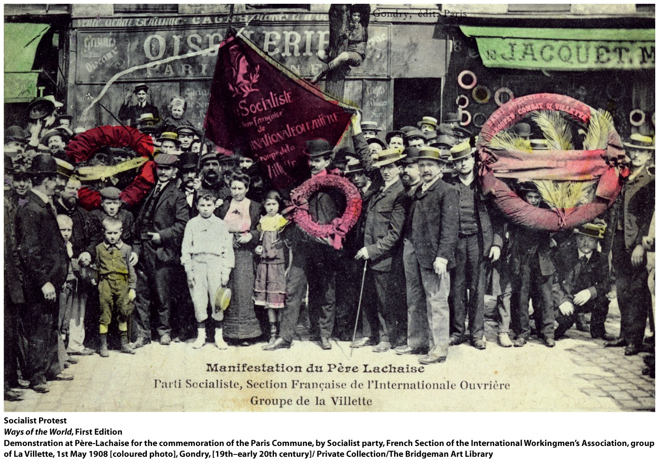
Social Protest among the Laboring Classes
1.“Friendly societies,” especially of artisans, for self-
help were common
2. Other skilled artisans sometimes wrecked
machinery and burned mills
Notes:
1.“friendly societies,” especially of artisans, for self-help were common
2. other skilled artisans sometimes wrecked machinery and burned mills

Slide 13
Social Protest among the Laboring Classes
3. Some joined political movements, aimed to
enfranchise working-class men
4. Trade unions were legalized in 1824
a. Growing numbers of factory workers joined them
b. Fought for better wages and working conditions
c. At first, upper classes ________ them
feared
Notes:
3.some joined political movements, aimed to enfranchise working-class men
4. trade unions were legalized in 1824 a. growing numbers of factory workers joined them
b. fought for better wages and working conditions
c. at first, upper classes feared them

Slide 14
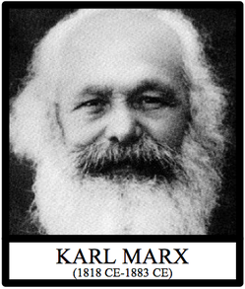
5. Socialist ideas spread gradually
a. Karl Marx (1818–1883) laid out a full ideology of socialism,
predicting that revolution would lead to the inevitable
collapse of industrial capitalism and result in a ___________
________ ________
b. Socialist ideas were attractive among more radical trade
unionists and some middle-class intellectuals in the late
nineteenth century
classless
socialist
society
Notes:
5. socialist ideas spread gradually
a. Karl Marx (1818–1883) laid out a full ideology of socialism, predicting that revolution would lead to the inevitable collapse of industrial capitalism and result in a classless socialist society
b. socialist ideas were attractive among more radical trade unionists and some middle-class intellectuals in the late nineteenth century

Slide 15
6. British working-class movement remained moderate
a. Material conditions for workers improved in second half
of the century
b. Capitalists and impoverished working class didn’t
polarize because of the large middle and lower middle class
c.
7. But immense inequalities remained
8. By 1900, Britain was in economic decline relative to newly
industrialized countries like _____________ and the
_______ _____
Workers bettered their standard of living
Germany
United States
Notes:
6. British working-class movement remained moderate
a. material conditions for workers improved in second half of the century
b. capitalists and impoverished working class didn’t polarize because of the large middle and lower middle class
c. workers bettered their standard of living
7. but immense inequalities remained
8. by 1900, Britain was in economic decline relative to newly industrialized countries like Germany and the
United States

