Slide 1
CHAPTER XVIII
Revolutions of Industrialization
1750–1914
Comparing Industrialization in the
United States and Russia

Slide 2
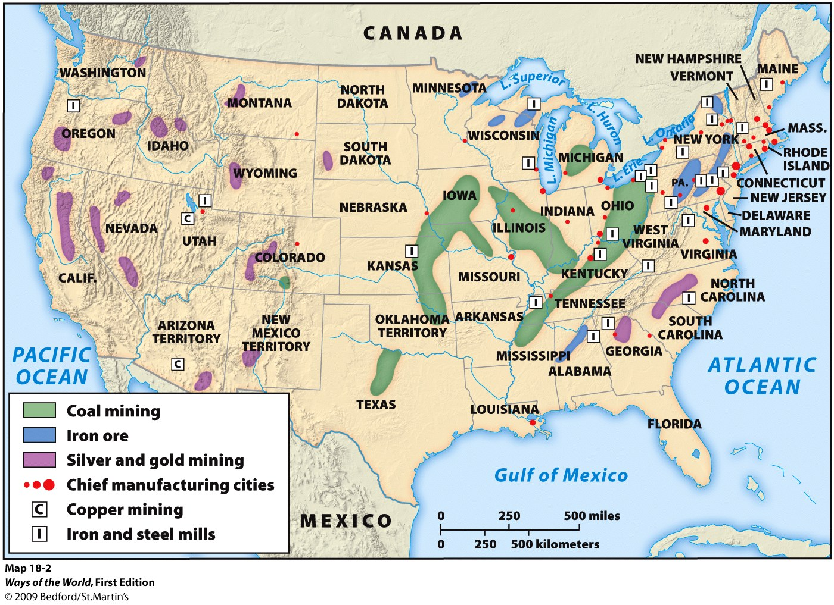

Slide 3
Variations on a Theme: Comparing Industrialization in the United States and Russia
A. The Industrial Revolution soon spread to
continental Western Europe.
1. By 1900, it was established in the ___________,
________, and ______
United States
Russia
Japan
Notes:
A. The Industrial Revolution soon spread to continental Western Europe.
1. by 1900, it was established in the United States, Russia, and Japan

Slide 4
Variations on a Theme: Comparing Industrialization in the United States and Russia
2. Industrialization had ______ ______ outcomes
wherever it was established broadly similar
a. Aristocratic, artisanal, and peasant classes
declined
b. Middle-class women withdrew from paid labor
altogether
c. Establishment of trade unions and socialist
movements
broadly similar
Notes:
2. industrialization had broadly similar outcomes wherever it was established
a. aristocratic, artisanal, and peasant classes declined
b. middle-class women withdrew from paid labor altogether
c. establishment of trade unions and socialist movements

Slide 5
Variations on a Theme: Comparing Industrialization in the United States and Russia
3. But the spread of industrialization was affected by the cultures
of the lands where it was established, pace and timing of
industrialization, nature of major industries, role of the state,
political expression of social conflict, etc.
a. French industrialization was _______, perhaps less
disruptive
b. Germany focused at first on ______ _______
4. Variations are most apparent in the cases of the United States
and Russia
slower
heavy industry
Notes:
3. but the spread of industrialization was affected by the cultures of the lands where it was established, pace and timing of industrialization, nature of major industries, role of the state, political expression of social conflict, etc.
a. French industrialization was slower, perhaps less disruptive
b. Germany focused at first on heavy industry

Slide 6
The United States: Industrialization without Socialism
B. The United States: Industrialization without
Socialism
1. American industrialization began with New England
textiles (1820s)
2. Explosive growth after the _____ ____
a. By 1914, the United States was the world’s leading
_________ _____
b. European countries provided about one-third of
capital investment financing U.S. growth
Civil War
industrial power
Notes:
B. The United States: Industrialization without Socialism
1. American industrialization began with New England textiles (1820s)
2. explosive growth after the Civil War
a. by 1914, the United States was the world’s leading industrial power
b. European countries provided about one-third of capital investment financing U.S. growth

Slide 7
The United States: Industrialization without Socialism
3. U.S. government played an important role through
tax breaks, land grants to railroads, laws making
formation of corporations easy, absence of overt
regulation
4. Pioneering of _____ __________techniques
5. Creation of a “______ __ __________” through
advertising, catalogs, and department stores
6. Self-made industrialists became ______ ______
(Ford, Carnegie, Rockefeller)
mass production
culture of consumption
cultural heroes
Notes:
3. U.S. government played an important role through tax breaks, land grants to railroads, laws making formation of corporations easy, absence of overt regulation
4. pioneering of mass production techniques
5. creation of a “culture of consumption” through advertising, catalogs, and department stores
6. self-made industrialists became cultural heroes (Ford, Carnegie, Rockefeller)

Slide 8
The United States: Industrialization without Socialism
7. Serious social divisions rose
a. Growing gap between _____________
b. Constant labor of the working class
c. Creation of vast ________
d. Growing labor protest
rich and poor
slums
Notes:
7. serious social divisions rose
a. growing gap between rich and poor
b. constant labor of the working class
c. creation of vast slums
d. growing labor protest

Slide 9
The United States: Industrialization without Socialism
e. No major socialist movement emerged in the United
States, due to conservatism of American unions,
heterogeneity of U.S. population, American workers’
higher standard of living
f. “Populists” denounced corporate interests
g. Progressives were more successful, especially after
1900
h. Socialism was labeled as fundamentally “___________”
un-American
Notes:
e. no major socialist movement emerged in the United States, due to conservatism of American unions, heterogeneity of U.S. population, American workers’ higher standard of living
f. “populists” denounced corporate interests
g. Progressives were more successful, especially after 1900
h. socialism was labeled as fundamentally “un-American”

Slide 10
Russia: Industrialization and Revolution
1. Russia was an _________ _______, with the
greatest state control of anywhere in the Western
world
a. In 1900: no national parliament, no legal
political parties, no nationwide elections
b. Dominated by a titled nobility (many highly
Westernized)
c. Until 1861, most Russians were serfs
absolute monarchy
Notes:
1. Russia was an absolute monarchy, with the greatest state control of anywhere in the Western world
a. in 1900: no national parliament, no legal political parties, no nationwide elections
b. dominated by a titled nobility (many highly Westernized)
c. until 1861, most Russians were serfs

Slide 11
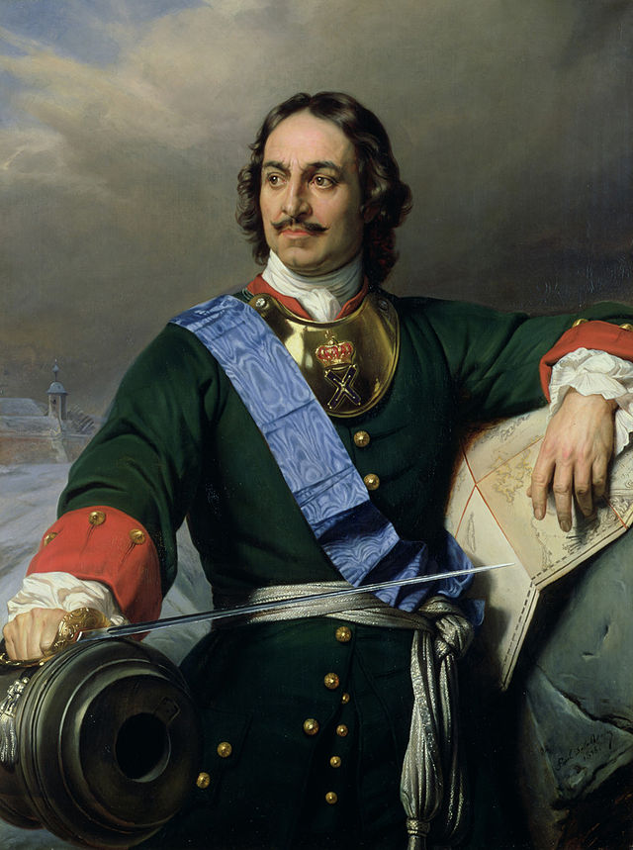
Russia: Industrialization and Revolution
2. In Russia, the state, not
society, usually initiated
change
a. Peter the Great
(r. 1689–1725)
was an early example of
“____________ ______ ___ ”
transformation from above
Notes:
2. in Russia, the state, not society, usually initiated change
a. Peter the Great (r. 1689–1725) was an early example of “transformation from above”

Slide 12
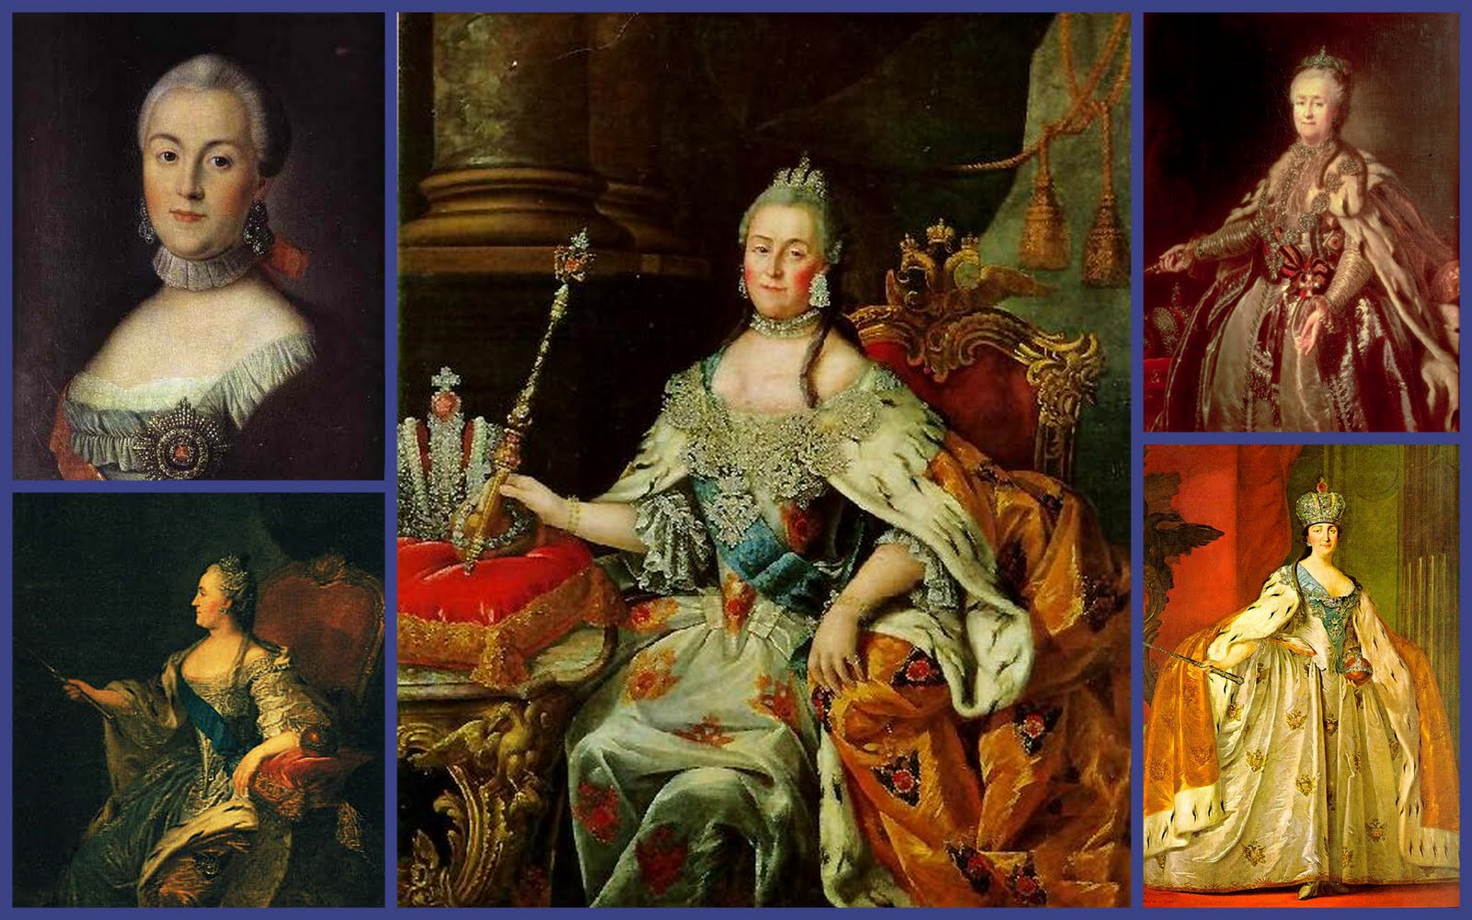
Russia: Industrialization/Revolution
b. Catherine the Great (r. 1762–1796) also worked to
____________ Russian culture and intellectual life
Europeanize
Notes:
b. Catherine the Great (r. 1762–1796) also worked to Europeanize Russian culture and intellectual life

Slide 13
Russia: Industrialization and Revolution
c. The state directed freeing of the serfs
in 1861
d. The state set out to improve Russia’s
economic and ________ __________
Industrial backwardness
Notes:
c. the state directed freeing of the serfs in 1861
d. the state set out to improve Russia’s economic and industrial backwardness

Slide 14
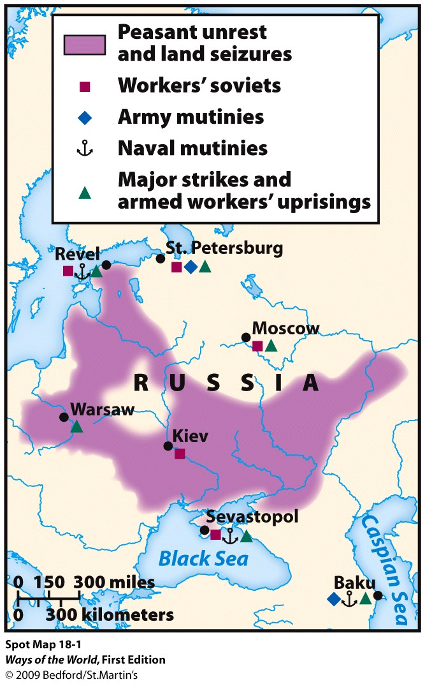
Russia: Industrialization and Revolution
3. Russian Industrial Revolution was
launched by the 1890s
a. Focused on ________ and_______
________
b. Substantial foreign
investment
c. Industry was concentrated in a
few major cities
d. Fewer but ________factories than
was typical in Western Europe
railroads
heavy
industry
larger
Notes:
3. Russian Industrial Revolution was launched by the 1890s
a. focused on railroads and heavy industry
b. substantial foreign investment
c. industry was concentrated in a few major cities
d. fewer but larger factories than was typical in Western Europe

Slide 15
Russia: Industrialization and Revolution
4. Growing middle class disliked Russia’s deep
conservatism, sought a greater role in political life
a. But they were dependent on the state for
contracts and jobs
b. Also relied on the state to suppress worker
radicalism
Notes:
4. growing middle class disliked Russia’s deep conservatism, sought a greater role in political life
a. but they were dependent on the state for contracts and jobs
b. also relied on the state to suppress worker radicalism

Slide 16
Russia: Industrialization and Revolution
5. Russian working class (only about 5 percent of the population)
rapidly radicalized
a. Harsh conditions
b. No legal outlet for grievances
c. Large-scale strikes
6. Marxist socialism appealed to some educated Russians,
gave them hope for the future
a. Founded the Russian Social-Democratic Labor Party (1898)
b. Got involved in workers’ education, union organizing, and
revolutionary action
Notes:
5. Russian working class (only about 5 percent of the population) rapidly radicalized
a. harsh conditions
b. no legal outlet for grievances
c. large-scale strikes
6. Marxist socialism appealed to some educated Russians, gave them hope for the future
a. founded the Russian Social-Democratic Labor Party (1898)
b. got involved in workers’ education, union organizing, and revolutionary action

Slide 17
Russia: Industrialization and Revolution
7. Major insurrection broke out in 1905, after defeat in
war by Japan
a. In Moscow and St. Petersburg, workers went on strike,
created their own representative councils (“soviets”)
b. Peasant uprisings, student demonstrations
c. Non-Russian nationalities revolted
d. Military mutiny
e. Brutally suppressed, but forced the tsar’s regime to
make reforms
Notes:
7. Major insurrection broke out in 1905, after defeat in war by Japan
a. in Moscow and St. Petersburg, workers went on strike, created their own representative councils (“soviets”)
b. peasant uprisings, student demonstrations
c. non-Russian nationalities revolted
d. military mutiny
e. brutally suppressed, but forced the tsar’s regime to make reforms

Slide 18
Russia: Industrialization and Revolution
8. Limited political reforms failed to pacify the radicals or bring
stability
a. Growing belief that only a revolution would help
b. World War I provided the revolutionary moment
9. Russian Revolution broke out in 1917
a. Brought the most radical of the socialist groups to
power—the Bolsheviks, led by Vladimir Ilyich Ulyanov (Lenin) `
b. Only in Russia did industrialization lead to violent social
revolution
Notes:
8. limited political reforms failed to pacify the radicals or bring stability
a. growing belief that only a revolution would help
b. World War I provided the revolutionary moment
9. Russian Revolution broke out in 1917
a. brought the most radical of the socialist groups to power—the Bolsheviks, led by Vladimir Ilyich Ulyanov (Lenin) `
b. only in Russia did industrialization lead to violent social revolution

Slide 19
What were the differences between industrialization in the U.S. and that in Russia?
United States | Russia
Notes:
Handout

Slide 20
Industrialization in both Russia and the United States
Comparison
a. Occurred with greater state support than in Britain.
b. Resulted in the emergence of powerful Marxist socialist movements.
c. Failed to spark rapid urbanization.
d. Took root at the same time as the emergence of more democratic governments.

