Slide 1
Ways of the World: A Brief Global History First Edition
Robert W. Strayer
CHAPTER XX
Colonial Encounters
1750–1914

Slide 2
The emergence of nineteenth-century European colonial empires in Africa
Connection
a. Led to the widespread industrialization of Africa.
b. Involved many more people in producing for the market rather than only for their own communities.
c. Resulted in closer contact with Africans, which by 1900 led European elites to reject the idea that Africans were from a less “advanced” race.
d. Led to the collapse of traditional social structures in favor of an all-African identify.
Notes:
B

Slide 3
A Second Wave of European Conquests
A. The period 1750–1900 saw a second, distinct phase of European colonial conquest.
B. The establishment of the second-wave European empires was based on military force or the threat of using it.
1. Original European military advantage lay in organization, drill, and command structure
2. Over the nineteenth century, Europeans developed an enormous firepower advantage (repeating rifles and machineguns)
3. Numerous wars of conquest: the Westerners almost always won
Notes:
A. The period 1750–1900 saw a second, distinct phase of European colonial conquest.
1. focused on Asia and Africa
2. several new players (Germany, Italy, Belgium, U.S., Japan)
3. was not demographically catastrophic like the first phase
4. was affected by the Industrial Revolution
5. in general, Europeans preferred informal control (e.g., Latin America, China, the Ottoman Empire)
B. The establishment of the second-wave European empires was based on military force or the threat of using it.
1. original European military advantage lay in organization, drill, and command structure
2. over the nineteenth century, Europeans developed an enormous firepower advantage (repeating rifles and machine guns)
3. numerous wars of conquest: the Westerners almost always won

Slide 4
A Second Wave of European Conquests
C. Becoming a colony happened in a variety of ways.
1. India and Indonesia: grew from interaction with European trading firms
2. Most of Africa, Southeast Asia, and the Pacific islands: deliberate conquest
a. “the scramble for Africa” was based on inter-European rivalry over only about 25 years
(1875–1900)
3. Decentralized societies without a formal state structure were the hardest to conquer
4. Australia and New Zealand: more like the colonization of North
America (with massive European settlement and diseases killing off
most of the native population)
Notes:
C. Becoming a colony happened in a variety of ways.
1. India and Indonesia: grew from interaction with European trading firms
a. assisted by existence of many small and rival states
2. most of Africa, Southeast Asia, and the Pacific islands: deliberate conquest
a. “the scramble for Africa” was based on inter-European rivalry over only about 25 years (1875–1900)
3. decentralized societies without a formal state structure were the hardest to conquer
4. Australia and New Zealand: more like the colonization of North America (with massive European settlement and diseases killing off most of the native population)
.

Slide 5
A Second Wave of European Conquests
5. Taiwan and Korea: Japanese takeover was
done European-style
6. United States and Russia continued to
expand
7. Liberia: settled by freed U.S. slaves
8. Ethiopia and Siam (Thailand) avoided
colonization skillfully
D. Asian and African societies generated a wide range
of responses to the European threat.
Notes:
5. Taiwan and Korea: Japanese takeover was done European-style
6. United States and Russia continued to expand
7. Liberia: settled by freed U.S. slaves
8. Ethiopia and Siam (Thailand) avoided colonization skillfully
D. Asian and African societies generated a wide range of responses to the European threat.
Liberia ^{i}/laɪˈbɪəriə/, officially the Republic of Liberia, is a country on the West African coast. Liberia means "Land of the Free" in Latin.^{[7]} It is bordered by Sierra Leone to its west, Guinea to its north and Ivory Coast to its east. It covers an area of 111,369 square kilometres (43,000 sq mi) and is home to 4,503,000 people.^{[3]} English is the official language and over 20 indigenous languages are spoken, representing the numerous tribes who make up more than 95% of the population.

Slide 6
Under European Rule
A. European takeover was often traumatic for the colonized peoples; the loss of life and property could be devastating.
B. Cooperation and Rebellion
1. some groups and individuals cooperated willingly with their new masters
2. governments and missionaries promoted European education
Notes:
A. European takeover was often traumatic for the colonized peoples; the loss of life and property could be devastating.
B. Cooperation and Rebellion
1. some groups and individuals cooperated willingly with their new masters
a. employment in the armed forces
b. elite often kept much of their status and privileges
2. governments and missionaries promoted European education
a. growth of a small class with Western education
b. governments relied on them increasingly over time

Slide 7
Under European Rule
3. Periodic rebellions
a. e.g., the Indian Rebellion of 1857–1858, based on a
series of grievances
b. Rebellion began as a mutiny among Indian troops
c. Rebel leaders advocated revival of the Mughal Empire
d. Widened India’s racial divide; the British were less
tolerant of natives
e. Led the British government to assume direct control
over India
Notes:
3. periodic rebellions
a. e.g., the Indian Rebellion of 1857–1858, based on a series of grievances
b. rebellion began as a mutiny among Indian troops
c. rebel leaders advocated revival of the Mughal Empire
d. widened India’s racial divide; the British were less tolerant of natives
e. led the British government to assume direct control over India

Slide 8
Cooperation and Rebellion

Slide 9
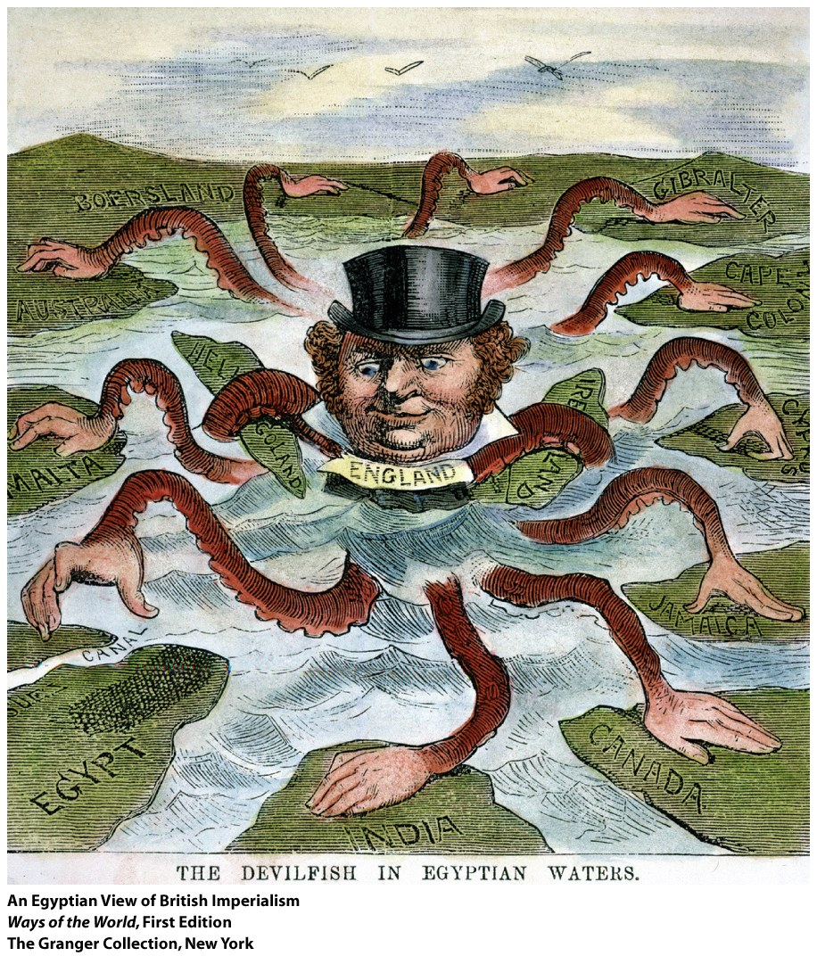
Colonial Empires with a Difference
1. In the new colonial empires, race was a prominent point distinguishing rulers from the ruled
a. Education for colonial subjects was limited and emphasized practical matters, suitable for “primitive minds”
b. Even the best-educated natives rarely made it into the upper ranks of the civil service
Notes:
1. in the new colonial empires, race was a prominent point distinguishing rulers from the ruled
a. education for colonial subjects was limited and emphasized practical matters, suitable for “primitive minds”
b. even the best-educated natives rarely made it into the upper ranks of the civil service
2. racism was especially pronounced in areas with a large number of European settlers (e.g., South Africa)
3. colonial states imposed deep changes in people’s daily lives

Slide 10
Colonial Empires with a Difference
2. Racism was especially pronounced in areas with a large number of European settlers (e.g., South Africa)
3. Colonial states imposed deep changes in people’s daily lives
Notes:
2. racism was especially pronounced in areas with a large number of European settlers (e.g., South Africa)
3. colonial states imposed deep changes in people’s daily lives

Slide 11
Colonial Empires with a Difference
4. Colonizers were fascinated with counting and
classifying their new subjects
a. In India, appropriated an idealized caste system
b. In Africa, identified or
invented distinct “tribes”
5. Colonial policies contradicted European core values and practices at home
Notes:
4. colonizers were fascinated with counting and classifying their new subjects
a. in India, appropriated an idealized caste system
b. in Africa, identified or invented distinct “tribes”
5. colonial policies contradicted European core values and practices at home
a. colonies were essentially dictatorships
b. colonies were the antithesis of “national independence”
c. racial classifications were against Christian and Enlightenment ideas of human equality
d. many colonizers were against spreading “modernization” to the colonies
e. in time, the visible contradictions in European behavior helped undermine the foundations of colonial rule

Slide 12
Ways of Working: Comparing Colonial Economies
A. Colonial rule had a deep impact on people’s ways of working.
1. World economy increasingly demanded Asian and African raw materials
2. Subsistence farming diminished
a. Need to sell goods for money to pay taxes
b. Desire to buy new products
3. Artisans were largely displaced by manufactured goods
4. Asian and African merchants were squeezed out by Europeans

Slide 13
Nineteenth-century European colonial empires in Africa and Asia were able to secure their political authority primarily
Change
a. Through the use of a combination of coercion and the
cooperation of at least some local elites.
b. Because of the demographic collapse of local populations after their exposure to European diseases.
c. Through sustained campaigns to “westernize” entire indigenous populations.
d. By requiring European emigrants who arrived in these new colonies to intermarry and freely mix with local populations.
Notes:
A

Slide 14
Economies of Coercion: Forced Labor and the Power of the State
1. Many colonial states demanded unpaid labor on public projects
2. Worst abuses were in the Congo Free State
3. “Cultivation system” of the Netherlands East Indies (Indonesia)
4. Many areas resisted the forced cultivation of cash crops
Notes:
1. many colonial states demanded unpaid labor on public projects
2. worst abuses were in the Congo Free State
a. personally governed by Leopold II of Belgium
b. reign of terror killed millions with labor demands
c. forced labor caused widespread starvation, as people couldn’t grow their own crops
d. Belgium finally stepped in and took control of the Congo (1908) to stop abuses
3. “cultivation system” of the Netherlands East Indies (Indonesia)
a. peasants had to devote at least 20 percent of their land to cash crops to pay as taxes
b. the proceeds were sold for high profits, financed the Dutch economy
c. enriched the traditional authorities who enforced the system
4. many areas resisted the forced cultivation of cash crops
a. German East Africa: major rebellion in 1905 against forced cotton cultivation
b. Mozambique: peasant sabotage and smuggling kept the Portuguese from achieving their goals there

Slide 15
Economies of Cash-Crop Agriculture: The Pull of the Market
1. Many people were happy to increase production for world markets
2. Considerable profit to small farmers in areas like the Irrawaddy Delta
3. In the southern Gold Coast (Ghana), African farmers took the initiative to develop export agriculture
4. Many colonies specialized in one or two cash crops, creating dependence
Notes:
. many people were happy to increase production for world markets
2. considerable profit to small farmers in areas like the Irrawaddy Delta
3. in the southern Gold Coast (Ghana), African farmers took the initiative to develop export agriculture
a. leading supplier of cocoa by 1911
b. created a hybrid peasant-capitalist society
c. but labor shortages led to exploitation of former slaves, men marrying women for their labor power, influx of migrants
4. many colonies specialized in one or two cash crops, creating dependence

Slide 16
Economies of Wage Labor: Working for Europeans
1. Wage labor in European enterprises was common
2. Hundreds of thousands of workers came to work on Southeast
Asian plantations
3. Millions of Indians migrated to work elsewhere in the British Empire
4. Especially in Africa, people moved to European farms/plantations
because they had lost their own land
Notes:
1. wage labor in European enterprises was common
2. hundreds of thousands of workers came to work on Southeast Asian plantations
3. millions of Indians migrated to work elsewhere in the British Empire
4. especially in Africa, people moved to European farms/plantations because they had lost their own land
a. European communities obtained vast amounts of land
b. South Africa in 1913: 88 percent of the land belonged to whites
c. much of highland Kenya was taken over by 4,000 white farmers
d. many former farmers were sent to “native reserves”
5. mines employed many
a. Malaysian tin mines attracted millions of Chinese workers
b. South African diamond mines created a huge pattern of worker migration
6. colonial cities attracted many workers
a. were seen as centers of opportunity
b. segregated, unsanitary, overcrowded
c. created a place for a native, Western-educated middle class
d. created an enormous class of urban poor that could barely live and couldn’t raise families

Slide 17
Economies of Wage Labor: Working for Europeans
5. Mines employed many
a. Malaysian tin mines attracted millions of Chinese workers
b. South African diamond mines created a huge pattern of
worker migration
6. Colonial cities attracted many workers
a. Were seen as centers of opportunity
b. Segregated, unsanitary, overcrowded
c. Created a place for a native, Western-educated middle class
d. Created an enormous class of urban poor that could barely
live and couldn’t raise families
Notes:
1. wage labor in European enterprises was common
2. hundreds of thousands of workers came to work on Southeast Asian plantations
3. millions of Indians migrated to work elsewhere in the British Empire
4. especially in Africa, people moved to European farms/plantations because they had lost their own land
a. European communities obtained vast amounts of land
b. South Africa in 1913: 88 percent of the land belonged to whites
c. much of highland Kenya was taken over by 4,000 white farmers
d. many former farmers were sent to “native reserves”
5. mines employed many
a. Malaysian tin mines attracted millions of Chinese workers
b. South African diamond mines created a huge pattern of worker migration
6. colonial cities attracted many workers
a. were seen as centers of opportunity
b. segregated, unsanitary, overcrowded
c. created a place for a native, Western-educated middle class
d. created an enormous class of urban poor that could barely live and couldn’t raise families

Slide 18
Which of the following was a feature of European colonial empires in the nineteenth century that was similar to earlier imperial creations?
Comparison
a. The prominence of “race” in distinguishing rulers and
ruled
b. The penchant for counting and classifying their subject peoples
c. The extent to which European colonial policies contradicted their own core values and practices at home
d. The use of military power to initially secure the empire
Notes:
D

Slide 19
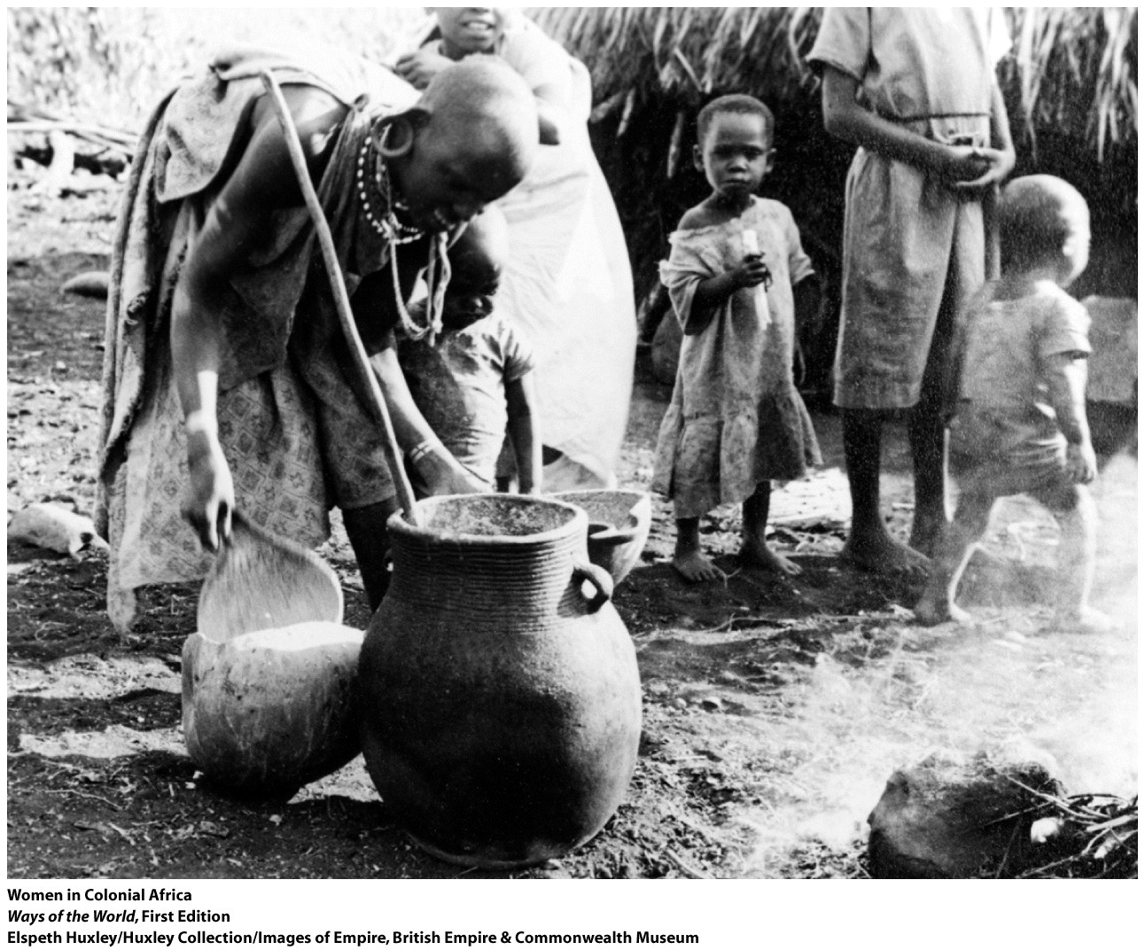
Women and the Colonial Economy: An African Case Study
1. In precolonial Africa, women were usually active farmers, had
some economic autonomy
2. In the colonial economy, women’s lives diverged ever more from those of men
Notes:
1. in precolonial Africa, women were usually active farmers, had some economic autonomy
2. in the colonial economy, women’s lives diverged ever more from those of men
a. men tended to dominate the lucrative export crops
b. women were left with almost all of the subsistence work
c. large numbers of men (sometimes a majority of the population) migrated to work elsewhere
d. women were left home to cope, including supplying food to men in the cities

Slide 20
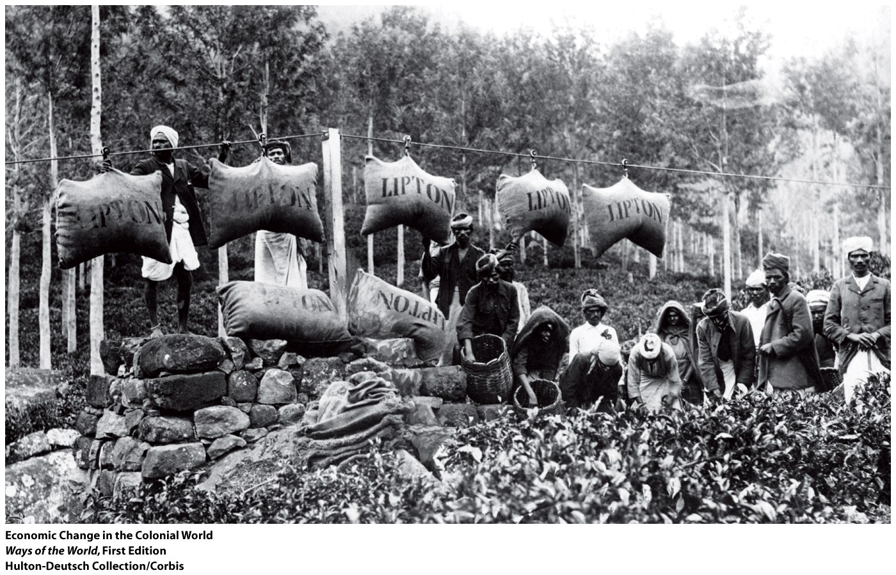
Women and the Colonial Economy: An African Case Study
3. Women coped in a variety of ways
4. The colonial economy also provided some opportunities to women
Notes:
3. women coped in a variety of ways
4. the colonial economy also provided some opportunities to women
a. especially small trade and marketing
b. sometimes women’s crops came to have greater cash value
c. some women escaped the patriarchy of husbands or fathers
d. led to greater fear of witchcraft and efforts to restrict female travel and sexuality

Slide 21
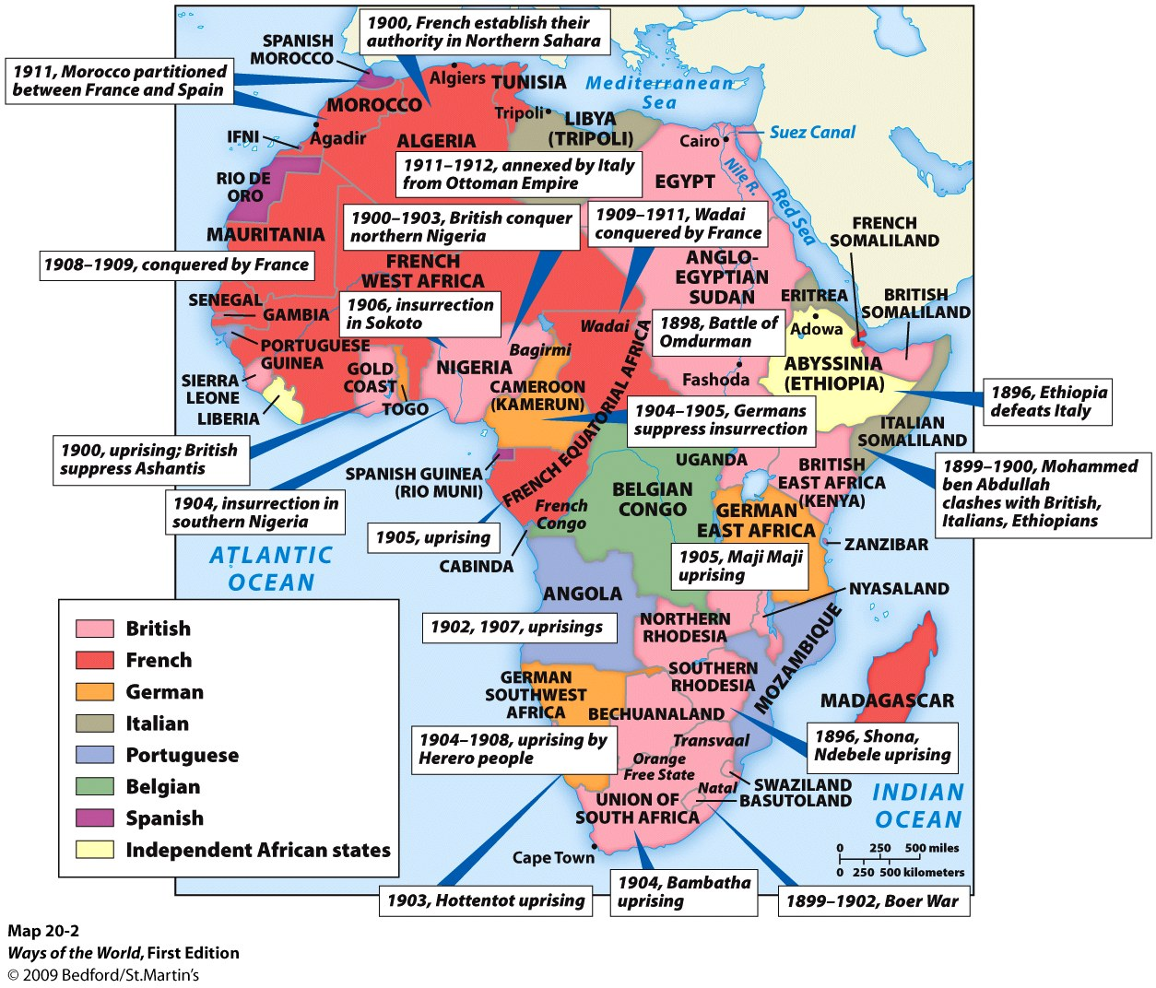
Assessing Colonial Development
1. What was the overall economic impact of colonial rule?
a. defenders: it jump-started modern growth
b. critics: long record of exploitation and limited, uneven growth
Notes:
1. What was the overall economic impact of colonial rule?
a. defenders: it jump-started modern growth
b. critics: long record of exploitation and limited, uneven growth
2. colonial rule did help integrate Asian and African economies into a global exchange network
3. colonial rule did introduce some modernizing elements
a. administrative and bureaucratic structures
b. communication and transportation infrastructure
c. schools
d. health care
4. colonial rule did not lead to breakthroughs to modern industrial societies

Slide 22
Assessing Colonial Development
2. Colonial rule did help integrate Asian and African economies into a global exchange network
3. Colonial rule did introduce some modernizing elements
a. Administrative and bureaucratic structures
b. Communication and transportation infrastructure
c. Schools
d. Health care
4. Colonial rule did not lead to breakthroughs to modern industrial societies
Notes:
1. What was the overall economic impact of colonial rule?
a. defenders: it jump-started modern growth
b. critics: long record of exploitation and limited, uneven growth
2. colonial rule did help integrate Asian and African economies into a global exchange network
3. colonial rule did introduce some modernizing elements
a. administrative and bureaucratic structures
b. communication and transportation infrastructure
c. schools
d. health care
4. colonial rule did not lead to breakthroughs to modern industrial societies

Slide 23
Believing and Belonging: Identity and Cultural Change in the Colonial Era

Slide 24
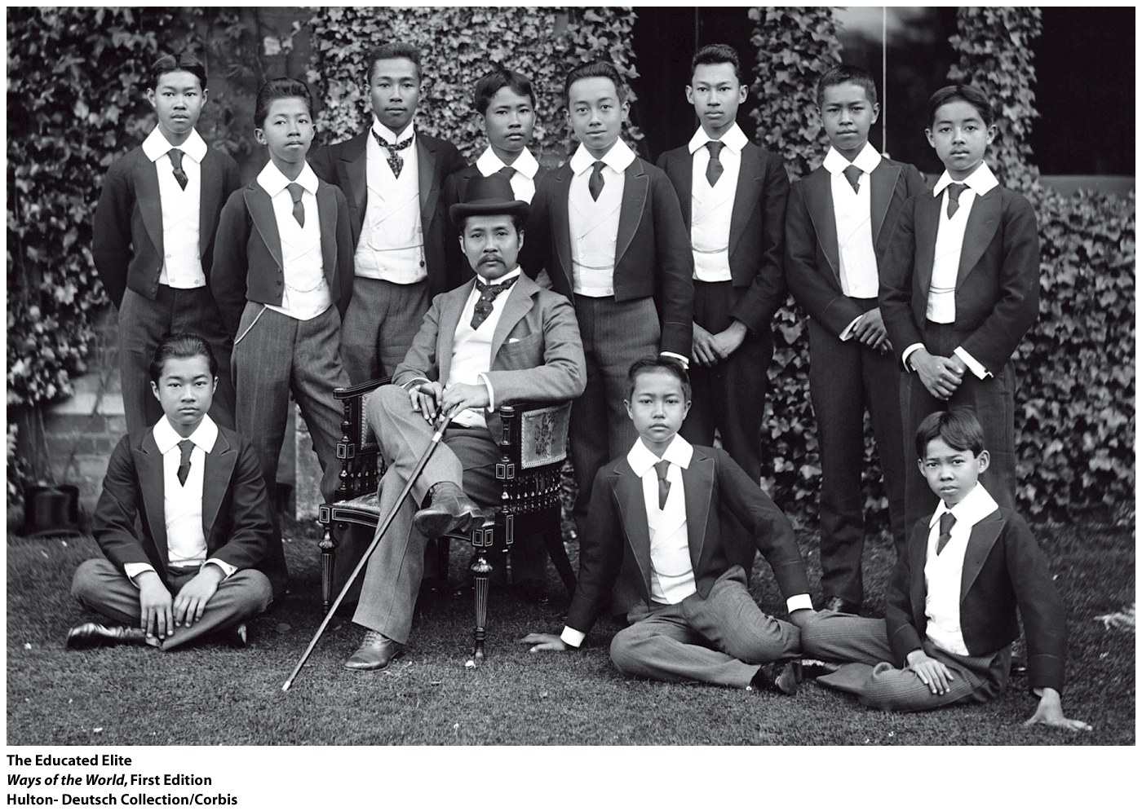
Education
1. Getting a Western education created a new identity for many
a. the almost magical power of literacy
b. escape from obligations like forced labor
c. access to better jobs
d. social mobility and elite status
Notes:
1. getting a Western education created a new identity for many
a. the almost magical power of literacy
b. escape from obligations like forced labor
c. access to better jobs
d. social mobility and elite status
2. many people embraced European culture
a. created a cultural divide between them and the vast majority of the population
3. many of the Western-educated elite saw colonial rule as the path to a better future, at least at first
a. in India, they organized reform societies to renew Indian culture
b. hopes for renewal through colonial rule were disappointed

Slide 25
Education
2. Many people embraced European culture
a. Created a cultural divide between them and the vast
majority of the population
3. Many of the Western-educated elite saw colonial rule as the
path to a better future, at least at first
a. In India, they organized reform societies to renew Indian
culture
b. hopes for renewal through colonial rule were disappointed
Notes:
1. getting a Western education created a new identity for many
a. the almost magical power of literacy
b. escape from obligations like forced labor
c. access to better jobs
d. social mobility and elite status
2. many people embraced European culture
a. created a cultural divide between them and the vast majority of the population
3. many of the Western-educated elite saw colonial rule as the path to a better future, at least at first
a. in India, they organized reform societies to renew Indian culture
b. hopes for renewal through colonial rule were disappointed

Slide 26
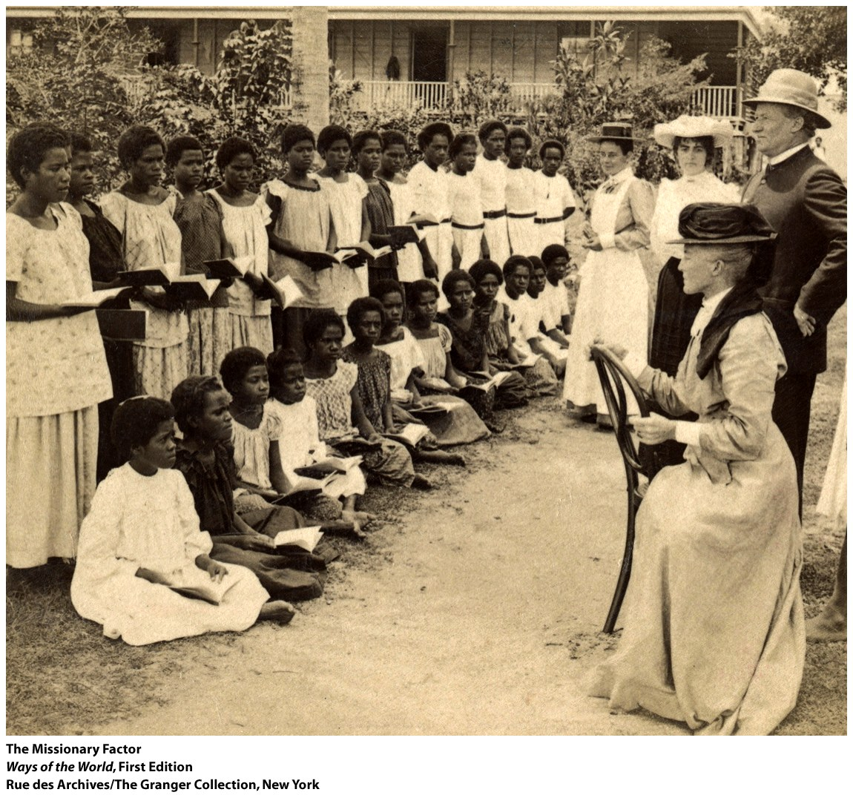
Religion
1. Widespread conversion to Christianity in New Zealand, the Pacific islands, and non-Muslim Africa
a. around 10,000 missionaries had gone to Africa by 1910
b. by the 1960s, some 50 million Africans were Christian
Notes:
1. widespread conversion to Christianity in New Zealand, the Pacific islands, and non-Muslim Africa
a. around 10,000 missionaries had gone to Africa by 1910
b. by the 1960s, some 50 million Africans were Christian
2. Christianity was attractive to many in Africa
a. military defeat shook belief in the old gods
b. Christianity was associated with modern education
c. Christianity gave opportunities to the young, the poor, and many women
d. Christianity spread mostly through native Africans
3. Christianity was Africanized
a. continuing use of charms, medicine men
b. some simply demonized their old gods
c. wide array of “independent churches” was established
4. Christianity did not spread widely in India
a. but it led intellectuals and reformers to define Hinduism
b. Hindu leaders looked to offer spiritual support to the spiritually sick Western world
c. new definition of Hinduism helped a clearer sense of Muslims as a distinct community to emerge

Slide 27
Religion
2. Christianity was attractive to many in Africa
a. Military defeat shook belief in the old gods
b. Christianity was associated with modern education
c. Christianity gave opportunities to the young, the poor, and many women
d. Christianity spread mostly through native Africans
Notes:
1. widespread conversion to Christianity in New Zealand, the Pacific islands, and non-Muslim Africa
a. around 10,000 missionaries had gone to Africa by 1910
b. by the 1960s, some 50 million Africans were Christian
2. Christianity was attractive to many in Africa
a. military defeat shook belief in the old gods
b. Christianity was associated with modern education
c. Christianity gave opportunities to the young, the poor, and many women
d. Christianity spread mostly through native Africans
3. Christianity was Africanized
a. continuing use of charms, medicine men
b. some simply demonized their old gods
c. wide array of “independent churches” was established
4. Christianity did not spread widely in India
a. but it led intellectuals and reformers to define Hinduism
b. Hindu leaders looked to offer spiritual support to the spiritually sick Western world
c. new definition of Hinduism helped a clearer sense of Muslims as a distinct community to emerge

Slide 28
Religion
3. Christianity was Africanized
a. Continuing use of charms, medicine men
b. Some simply demonized their old gods
c. Wide array of “independent churches” was established
4. Christianity did not spread widely in India
a. But it led intellectuals and reformers to define Hinduism
b. Hindu leaders looked to offer spiritual support to the
spiritually sick Western world
c. New definition of Hinduism helped a clearer sense of
Muslims as a distinct community to emerge
Notes:
1. widespread conversion to Christianity in New Zealand, the Pacific islands, and non-Muslim Africa
a. around 10,000 missionaries had gone to Africa by 1910
b. by the 1960s, some 50 million Africans were Christian
2. Christianity was attractive to many in Africa
a. military defeat shook belief in the old gods
b. Christianity was associated with modern education
c. Christianity gave opportunities to the young, the poor, and many women
d. Christianity spread mostly through native Africans
3. Christianity was Africanized
a. continuing use of charms, medicine men
b. some simply demonized their old gods
c. wide array of “independent churches” was established
4. Christianity did not spread widely in India
a. but it led intellectuals and reformers to define Hinduism
b. Hindu leaders looked to offer spiritual support to the spiritually sick Western world
c. new definition of Hinduism helped a clearer sense of Muslims as a distinct community to emerge

Slide 29
“Race” and “Tribe”
3. In the twentieth century, such ideas reached a broader public
a. hundreds of thousands of Africans took part in World War I
b. some Africans traveled widely
4. For most Africans, the most important new sense of belonging was the idea of “tribe” or ethnic identity
a. ethnic groups were defined much more clearly, thanks to
Europeans
b. Africans found ethnic identity useful
Notes:
1. notions of race and ethnicity were central to new ways of belonging
2. by 1900, some African thinkers began to define an “African identity”
a. united for the first time by the experience of colonial oppression
b. some argued that African culture and history had the characteristics valued by Europeans (complex political systems, etc.)
c. some praised the differences between Africa and Europe
3. in the twentieth century, such ideas reached a broader public
a. hundreds of thousands of Africans took part in World War I
b. some Africans traveled widely
4. for most Africans, the most important new sense of belonging was the idea of “tribe” or ethnic identity
a. ethnic groups were defined much more clearly, thanks to Europeans
b. Africans found ethnic identity useful

Slide 30
Answer Key for Chapter 20
Answer is B
Answer is A
Answer is D

