Slide 1
Ways of the World: A Brief Global History First Edition
Robert W. Strayer
CHAPTER XXI
The Collapse and Recovery of Europe
1914–1970s
The Great Depression
and The Rise of Dictators

Slide 2
HYPERINFLATION
The German Mark v. the U.S. Dollar
1914: $1 = 4 Marks
1921: $1 = 75 Marks
02/1923: $1 = 48,000 Marks
10/1923: $1 = 440,000,000 Marks (440 million)
11/1923: $1 = 4,200,000,000,000 Marks (4.2 trillion)

Slide 3
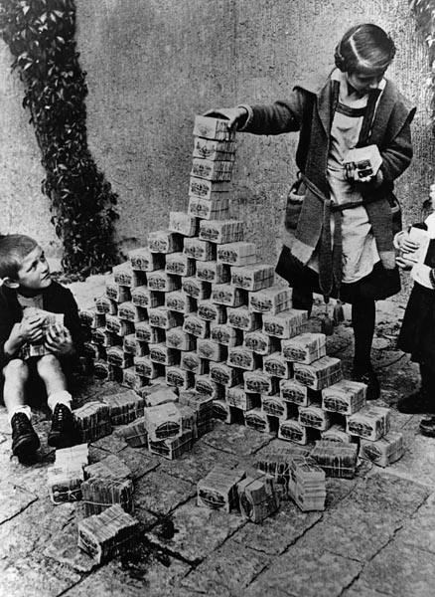
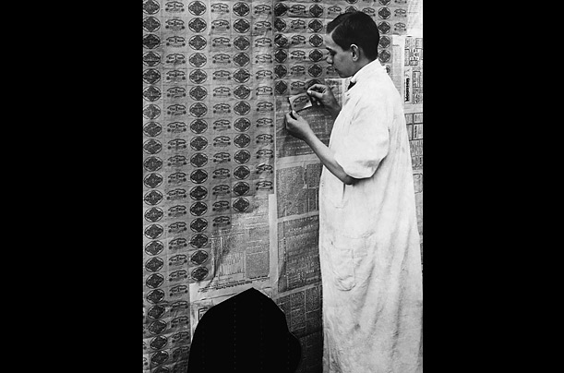

Slide 4
1919 Friekorp using captured British Tank to put down rebellion
Notes:
Vigilante groups (the Freikorps) assassinated hundreds of supporters of the Weimar government

Slide 5
Communist executed 1919

Slide 6
1919 German communists behind barricades

Slide 7
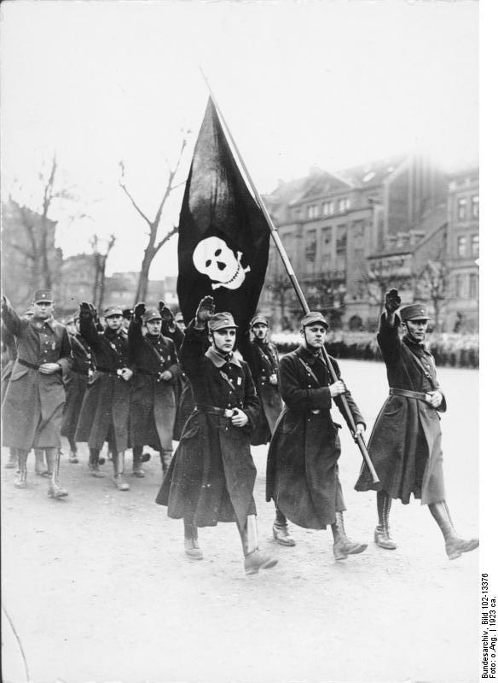
1923

Slide 8
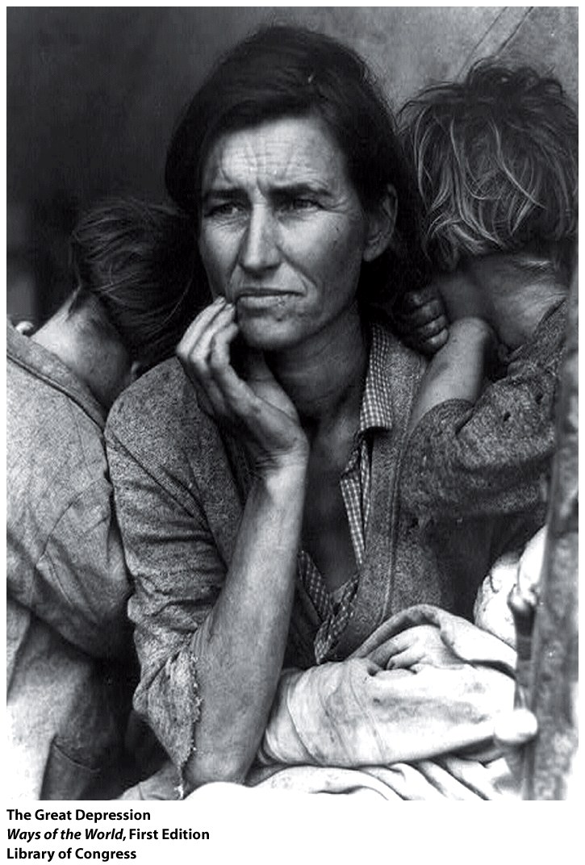
Capitalism Unraveling:
The Great Depression

Slide 9
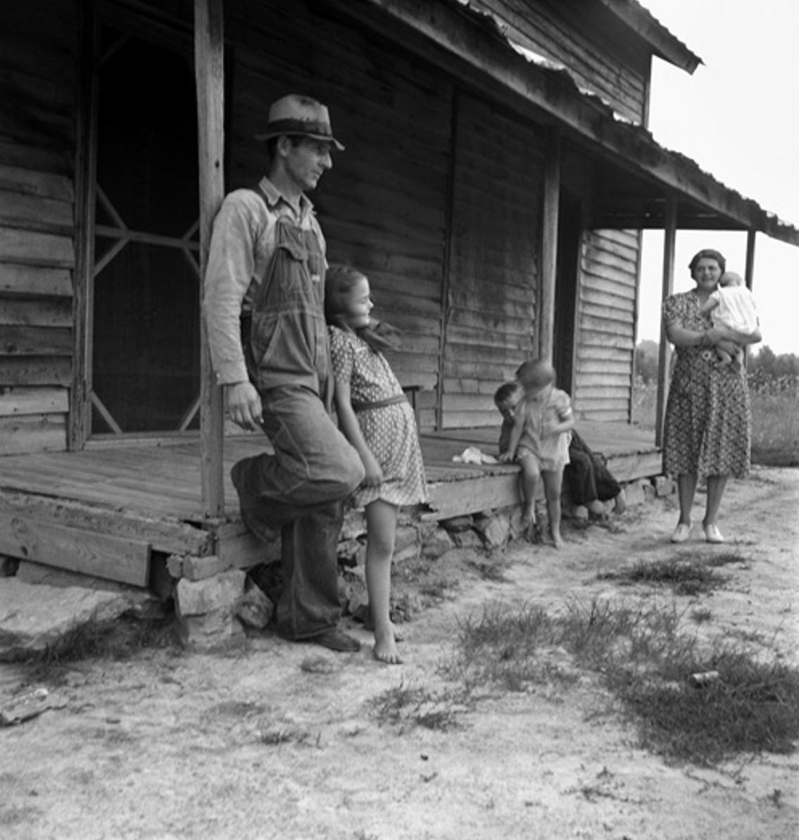
Notes:
Run on the bank
Speculative trading
Global slowdown, nobody was buying
Over-production
Growing inventory
Now:
FDIC
Stock Market shuts itself down
Pause in trading
Reserve cash

Slide 10
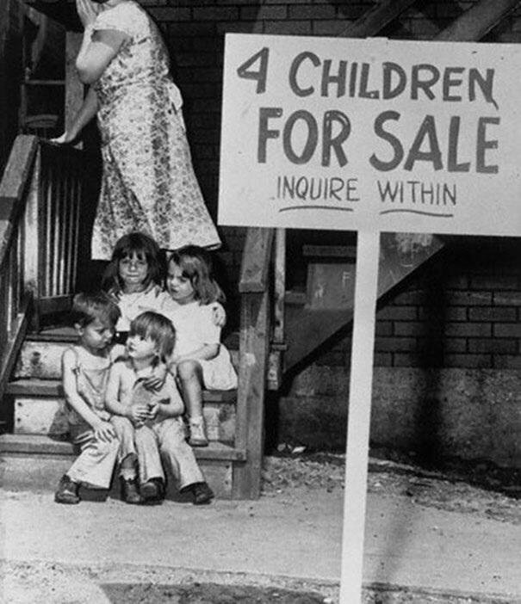

Slide 11
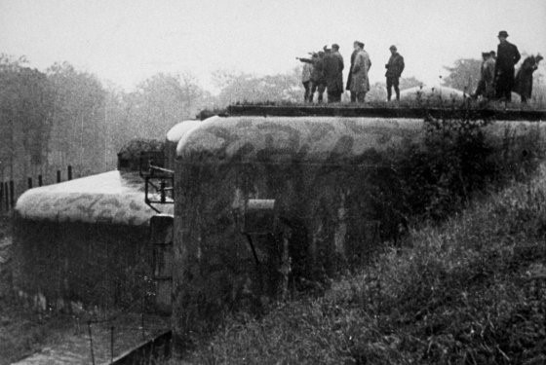

Slide 12
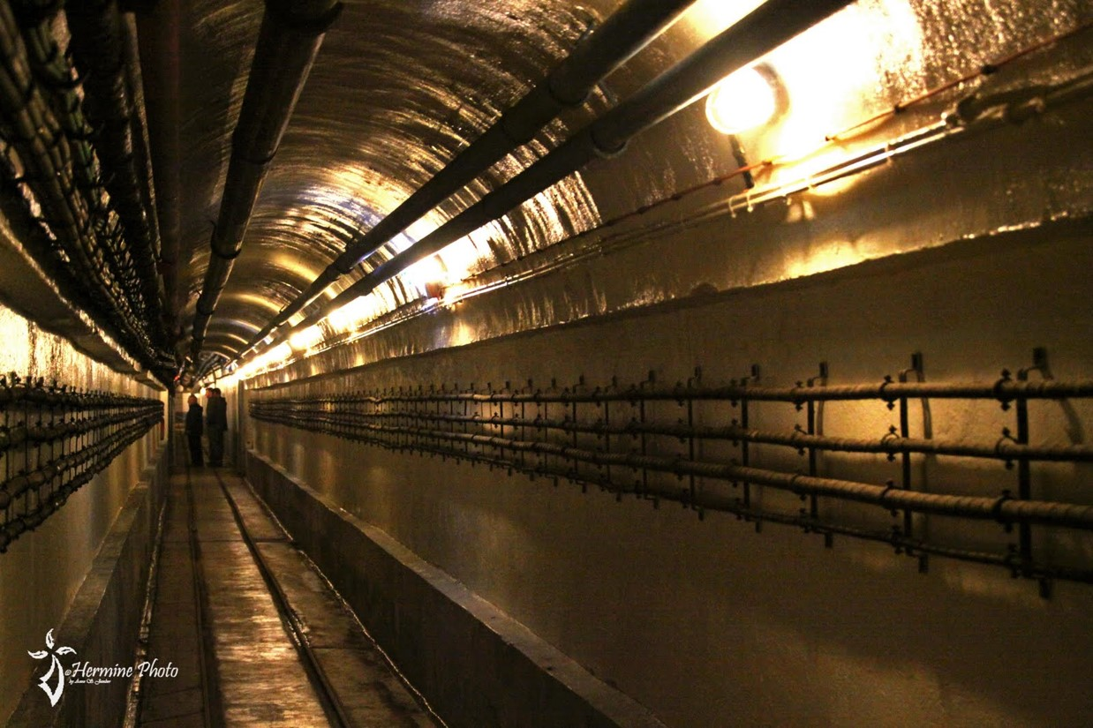

Slide 13
Notes:
Widespread economic suffering: massive inflation in 1923, then the Great Depression
1. Everyone wanted decisive government action
2. The National Socialist (Nazi) Party won growing public support
3. Used Jews as the ultimate scapegoat for the ills of society
a. Emphasis on a racial revolution
b. Jews were increasingly excluded from public life
4. Celebration of the superiority of the German race
a. Hitler as mystical Führer
b. Rule by intuition and force, not reason
9. The rise of Nazism represents a moral collapse within the West
a. highly selective use of earlier strands of European culture
b. made use of modern science

Slide 14
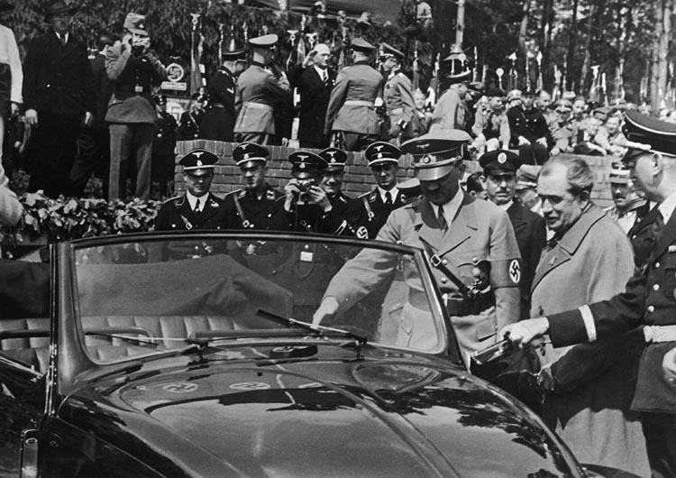
The Peoples Car (VW)
Notes:
1935 Peoples car
AH DID BRING Germany out of the depression

Slide 15
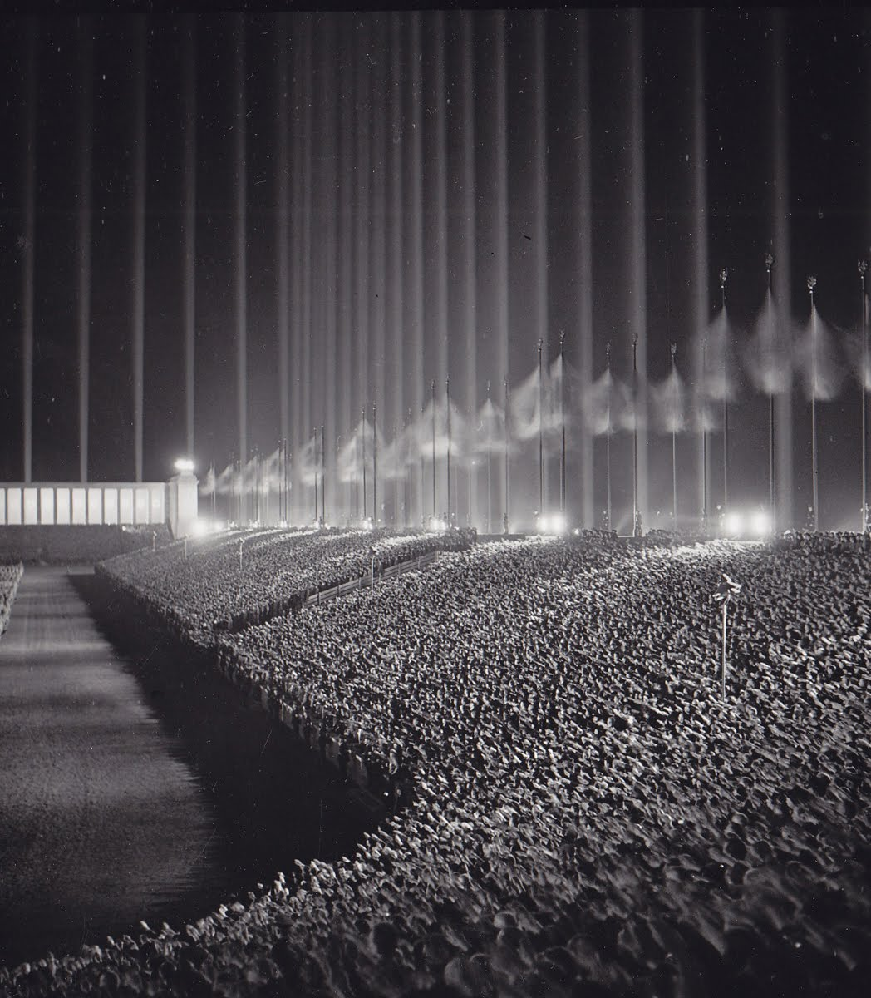
1937 Nuremberg

Slide 17
1938 Anschluss
Notes:
Ballot during the Anschluss

Slide 19
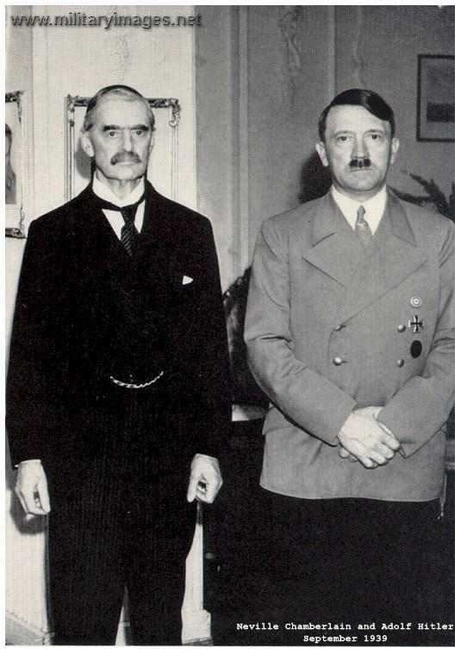
“Peace in our time”
Notes:
Without Czech being represented the Sudetenland was given to Germany
Why not just take it all? Why take the Sudetenland then proceed to take the rest?

Slide 21
Notes:
The Sudetenland contained formidable defenses

Slide 25
Who is this?

