Slide 1
Ways of the World: A Brief Global History First Edition
Robert W. Strayer
CHAPTER XXI
The Collapse and Recovery of Europe
1914–1970s
World War II and Aftermath

Slide 3
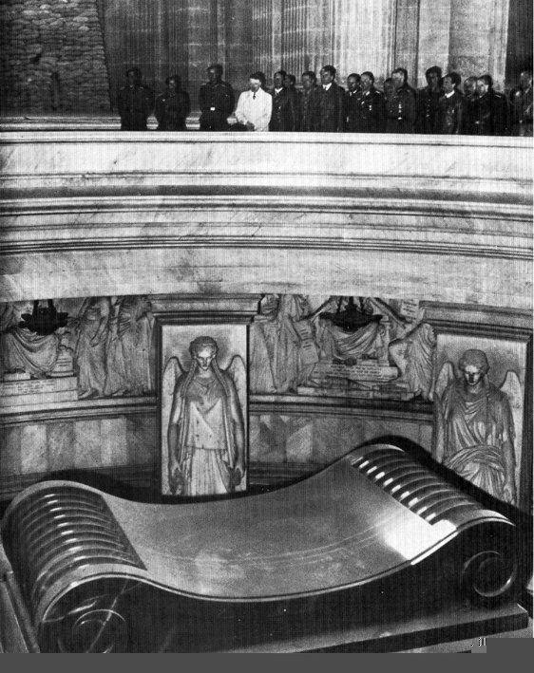
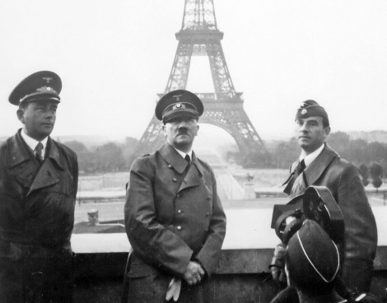

Slide 4
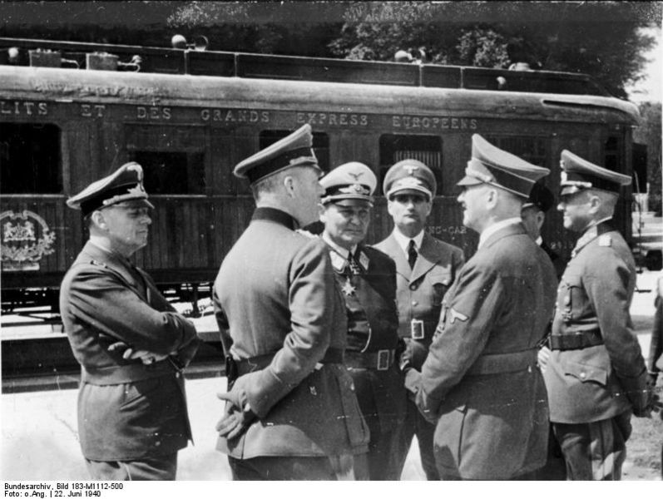
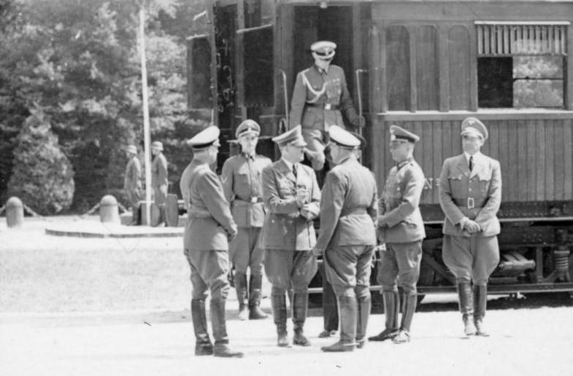

Slide 9
Notes:
What Hitler might look like

Slide 13
Notes:
Surrenders 1974

Slide 14
Notes:
US Fleet after WWII to be mothballed

Slide 15
Notes:
US Bombers without a job

Slide 16
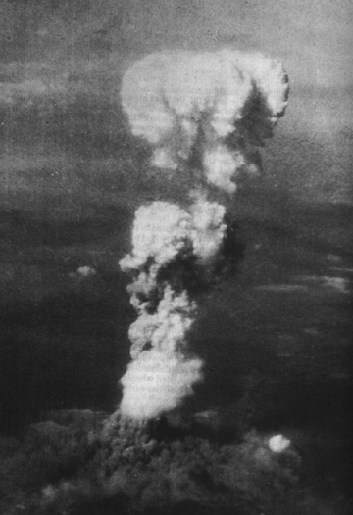
Notes:
Hiroshima eyes

Slide 17
Notes:
Shadow burned into the stairs

Slide 19
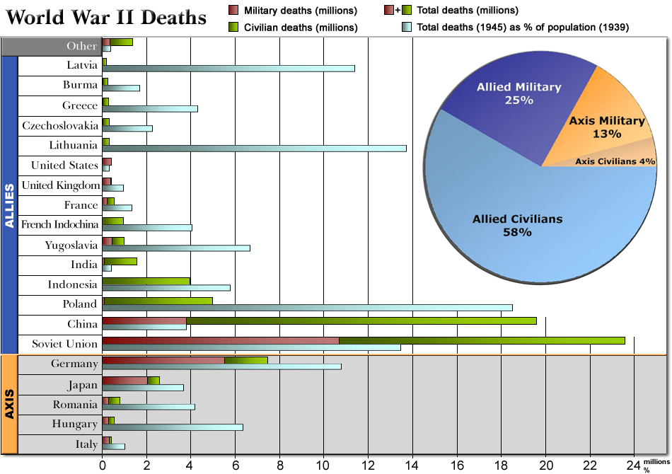
Total countries in WWII = 61
U.S. Deaths = 292,000
Total Deaths = 56-68 million worldwide

Slide 21
Results
The Holocaust killed 12 million civilians
Other atrocities occurred: Rape of Nanjing, Bataan Death March, Soviet mistreatment of the Poles
War Crime Trials were held for the Germans, Japanese and Italians
In total, 75 million people were killed
Europe and Japan were in ruins

Slide 22
Results
Germany and Japan were occupied
Map of Europe changed yet again—how?
Cold War began
United Nations set up
Led to the creation of Israel

Slide 23
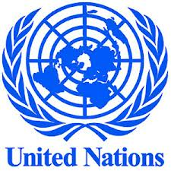
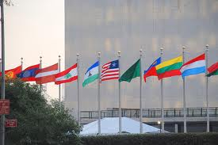
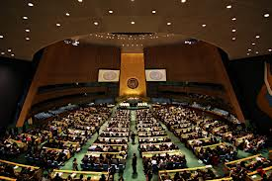
April 25, 1945…San Francisco, CA
50 Countries (now 192)
Designed the U.N. “Charter” or Constitution
General Assembly – each country 1 vote
Votes on Rotating Members
Budget
Votes on Resolutions by members
Security Council – 5 Permanent Members (Veto)
Other rotating members (now 10)
Roles of Security Council
Peacekeeping
Investigates int’l problems
Proposes solutions
Suggests settlements
Action: ask members for military force
Headquarters, NYC - USA

Slide 24
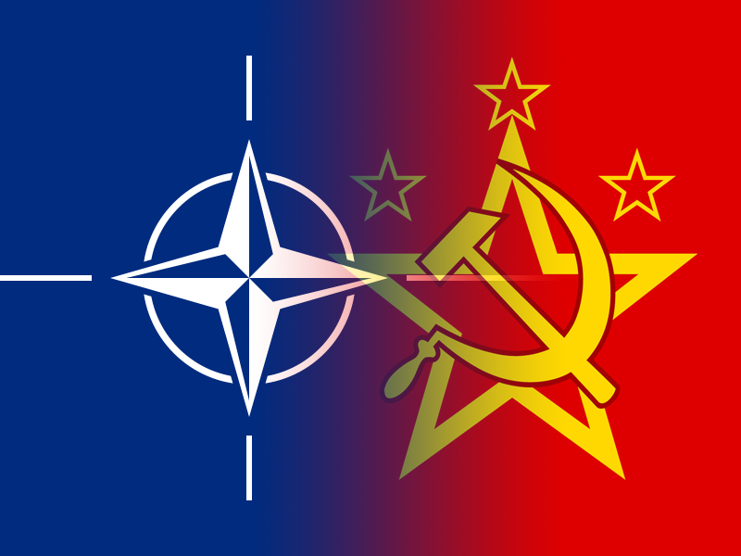
Cold War Begins
Who fired the first shot?
Why was Stalin so distrustful of the West?
NATO
Warsaw Pact
Notes:
NATO 1949
Warsaw Pact 1955

Slide 25
Notes:
Bolshevik prisoners and American soldiers

Slide 26
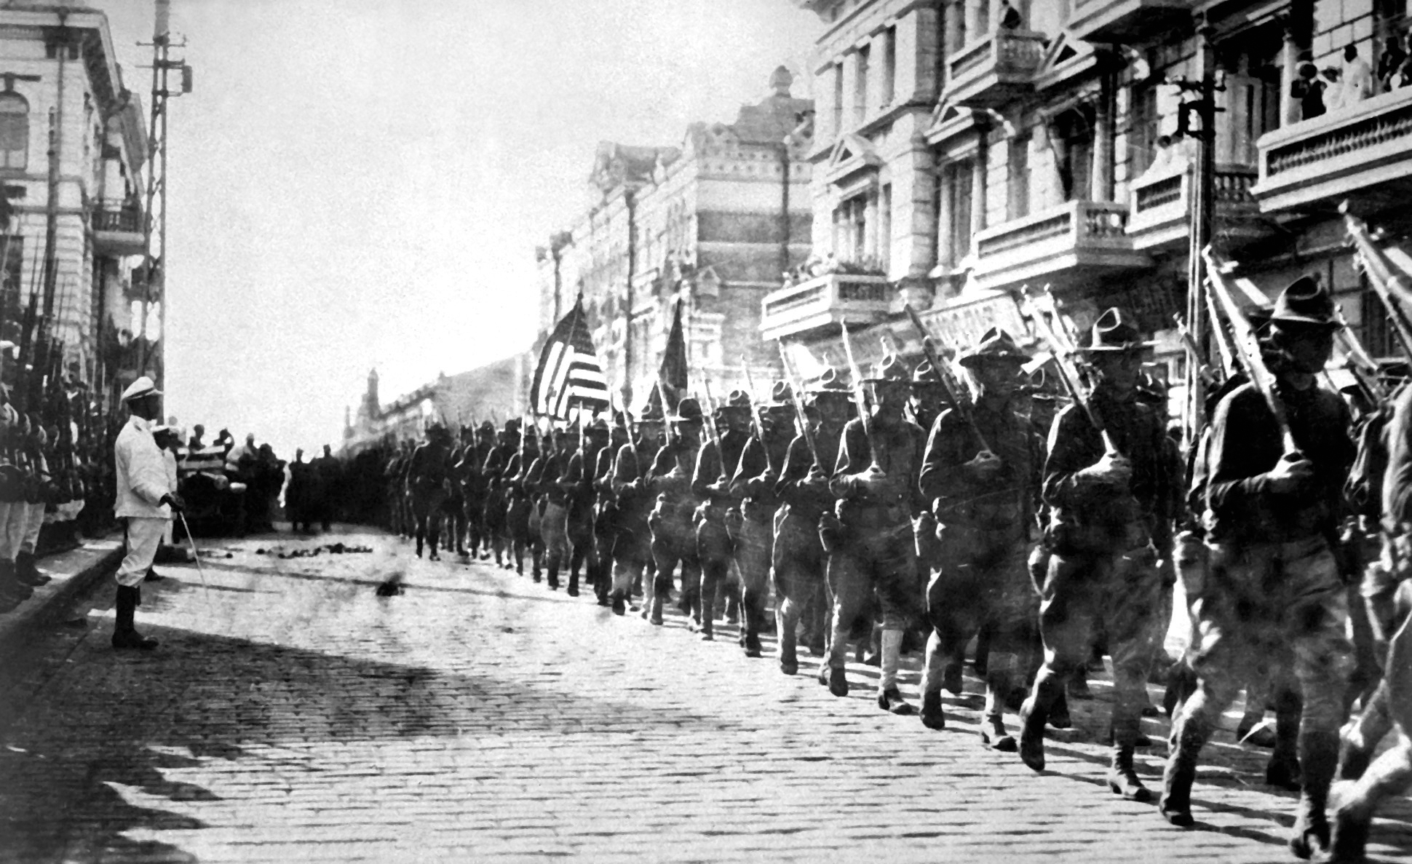
Cold War Begins

Slide 27
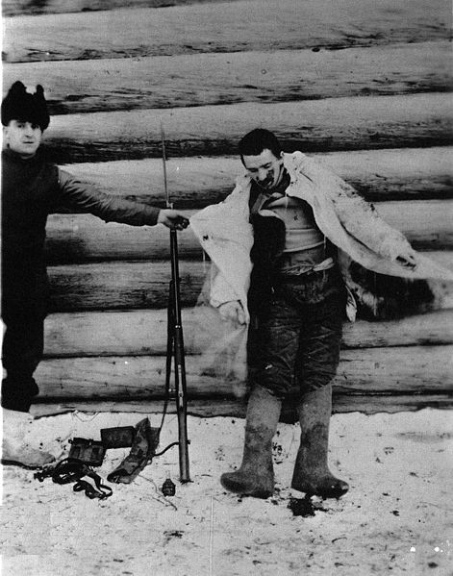
Cold War Begins

Slide 28
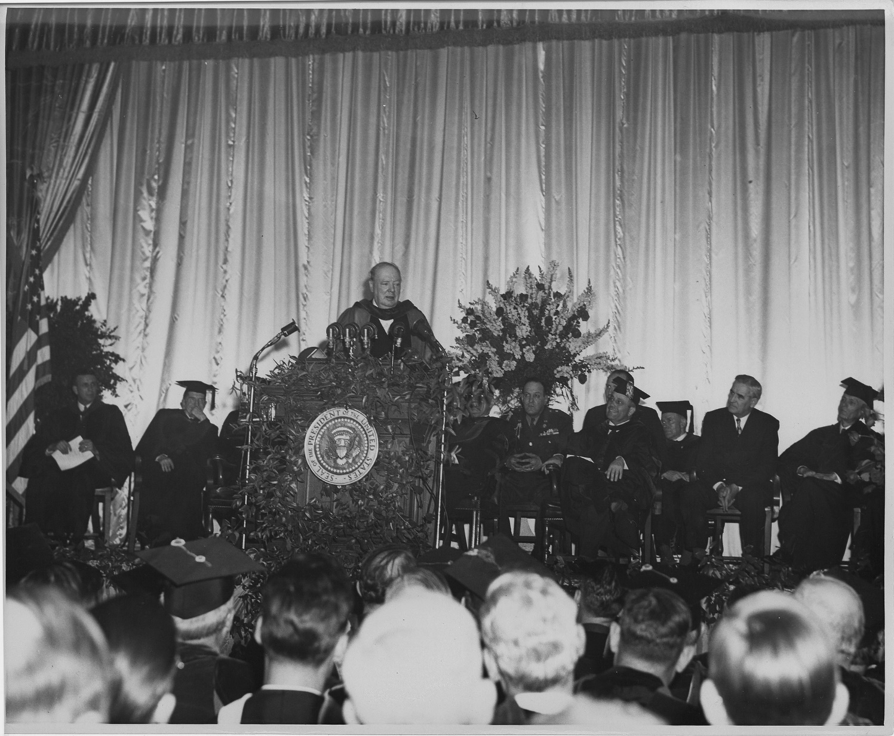
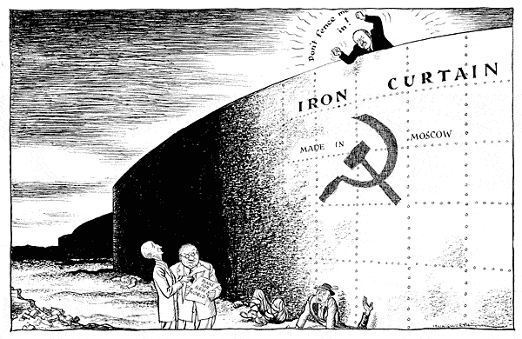
Cold War Begins
Notes:
Iron Curtain speech

Slide 29
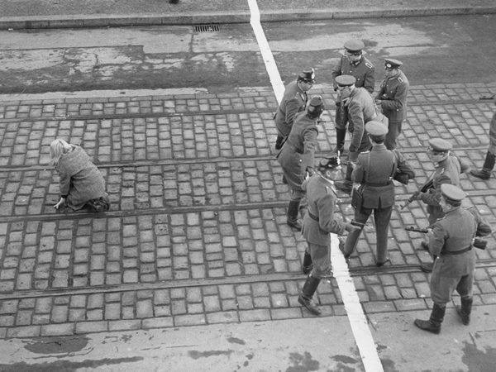
Berlin
Notes:
The Berlin Airlift…

Slide 30
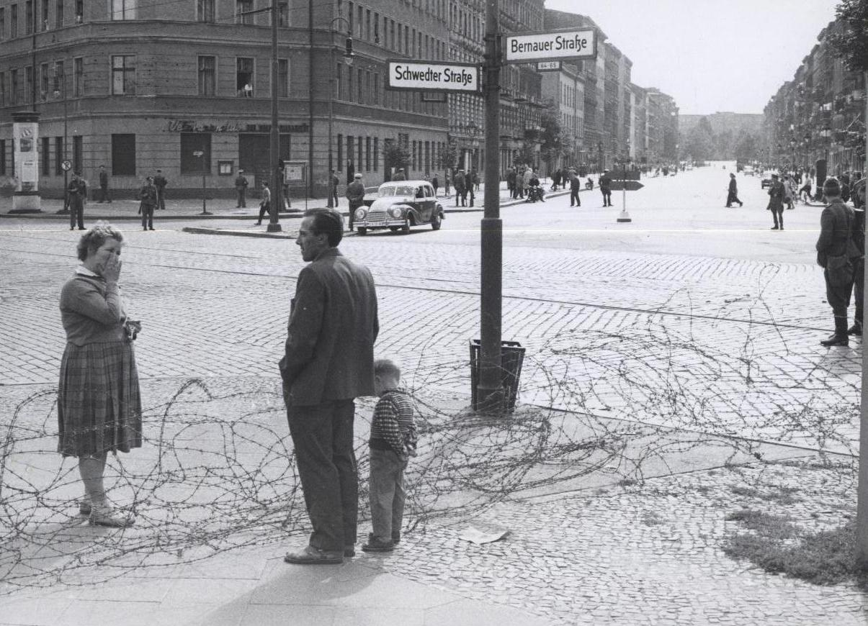
Berlin

Slide 31
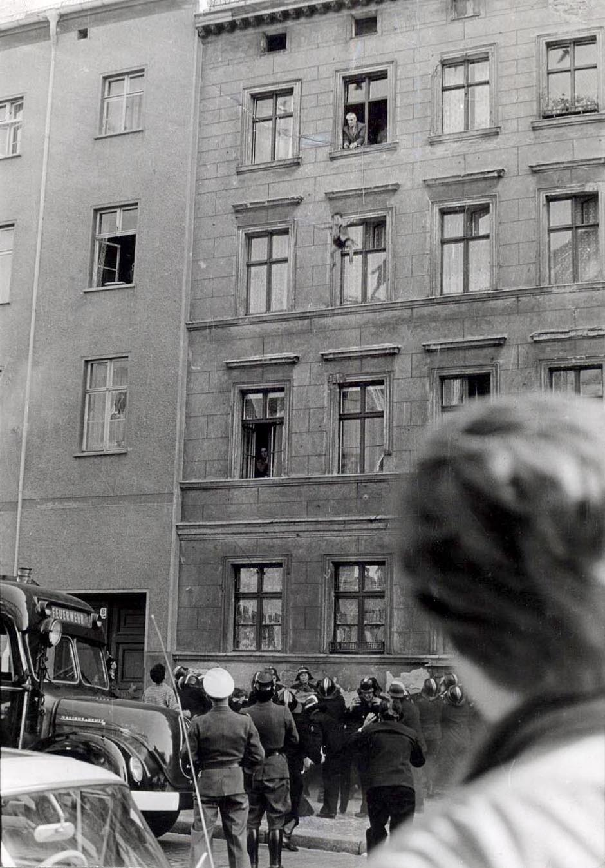
Berlin

Slide 32
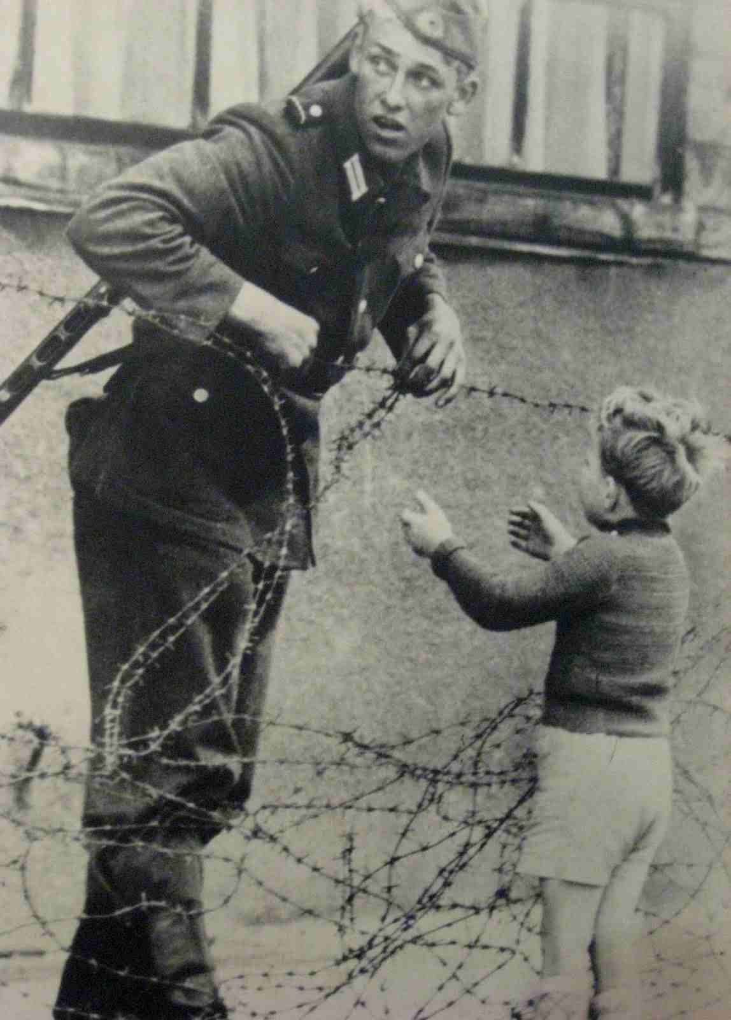
Berlin

Slide 33
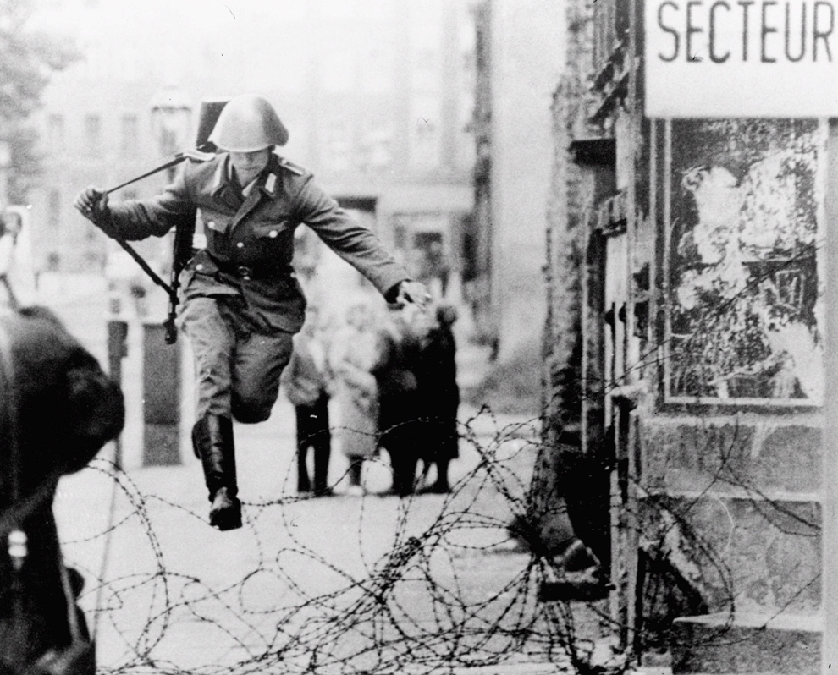
Berlin

Slide 34
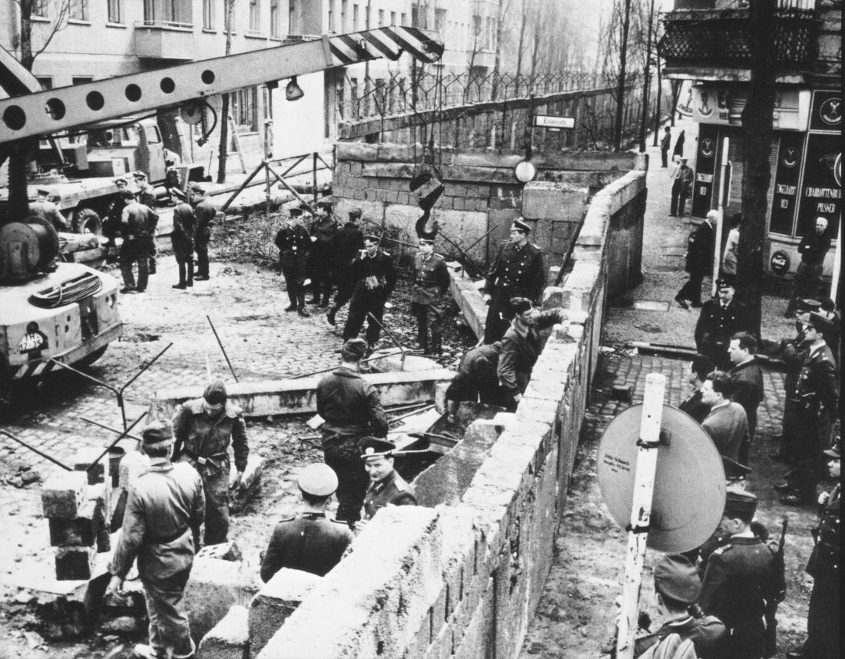
Berlin

Slide 35
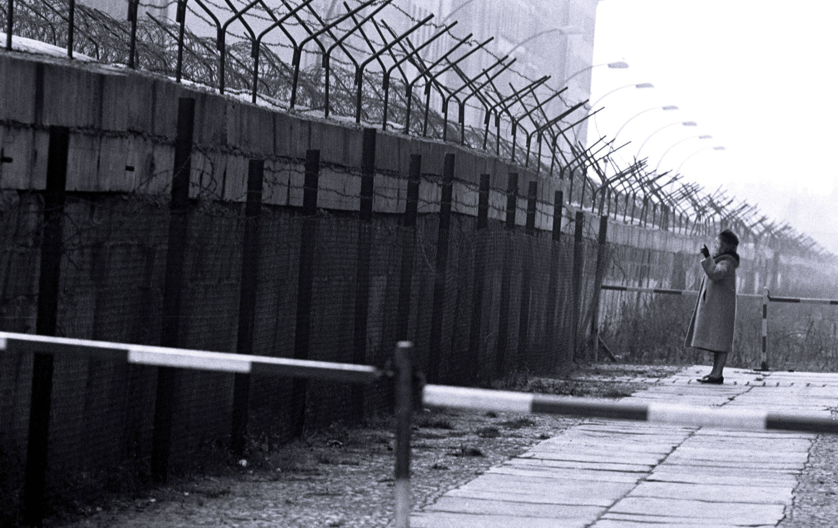
Berlin

Slide 36
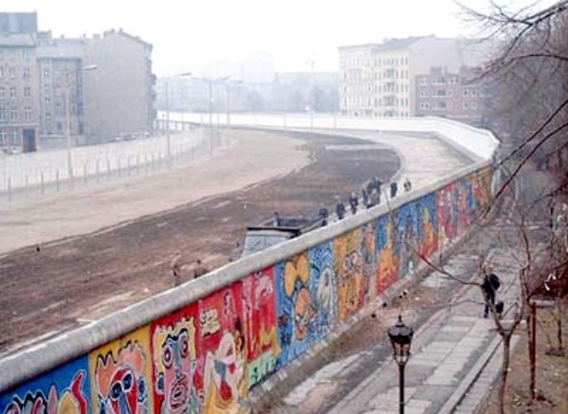
Berlin

Slide 37
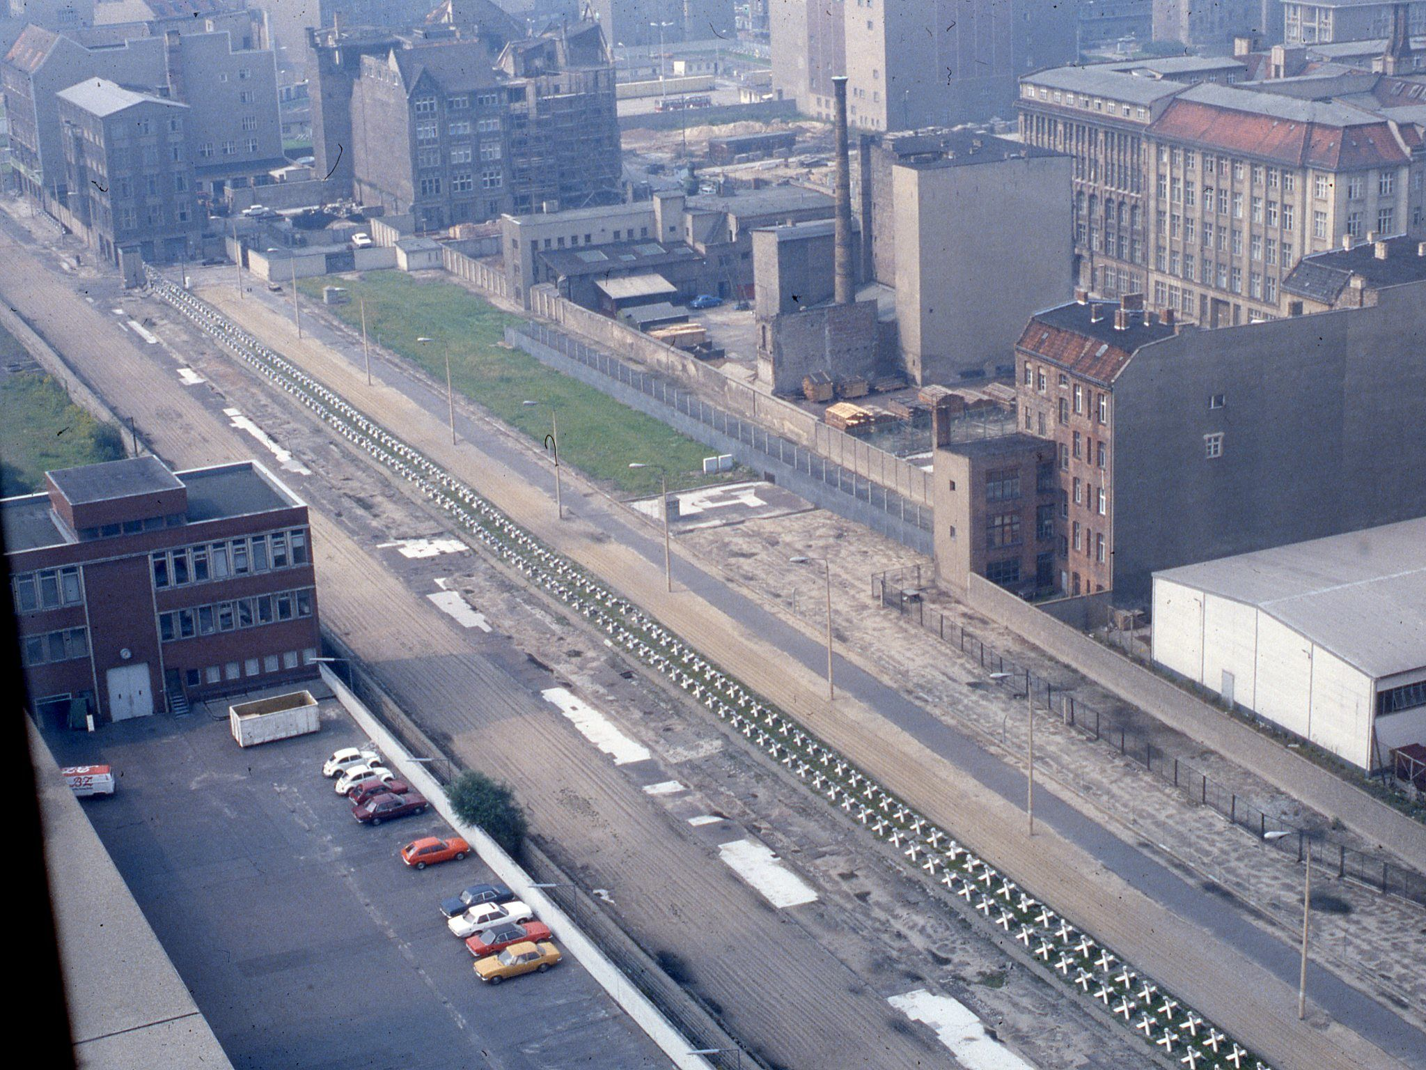
Berlin

