Slide 1
Ways of the World: A Brief Global History First Edition
Robert W. Strayer
CHAPTER XXI
The Collapse and Recovery of Europe
1914–1970s

Slide 2
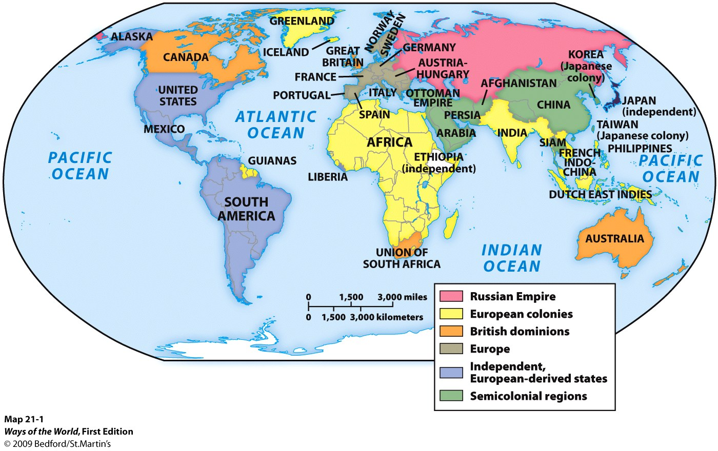
The First World War:
European Civilization in Crisis, 1914–1918
A. By 1900, Europeans, or people of European ancestry, controlled most other peoples of the world.

Slide 3
An Accident Waiting to Happen
OCTOBER 3, 2010
Germany made its last reparations payment for World War I.

Slide 4
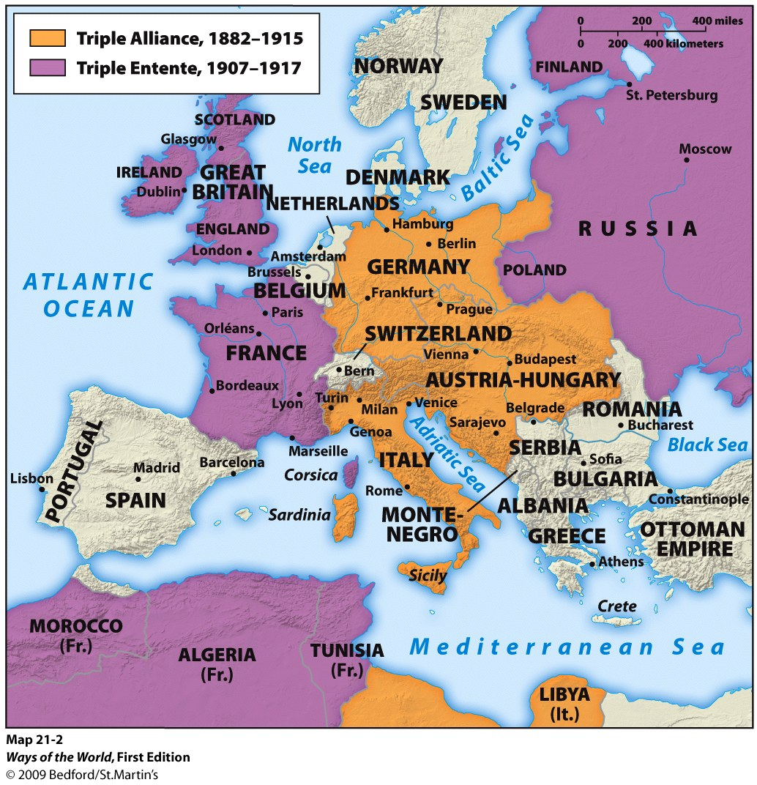
An Accident Waiting to Happen
BALANCE OF POWER
Alliances made countries feel safe

Slide 5
