Slide 1
Ways of the World: A Brief Global History First Edition
Robert W. Strayer
CHAPTER XXI
The Collapse and Recovery of Europe
1914–1970s

Slide 2
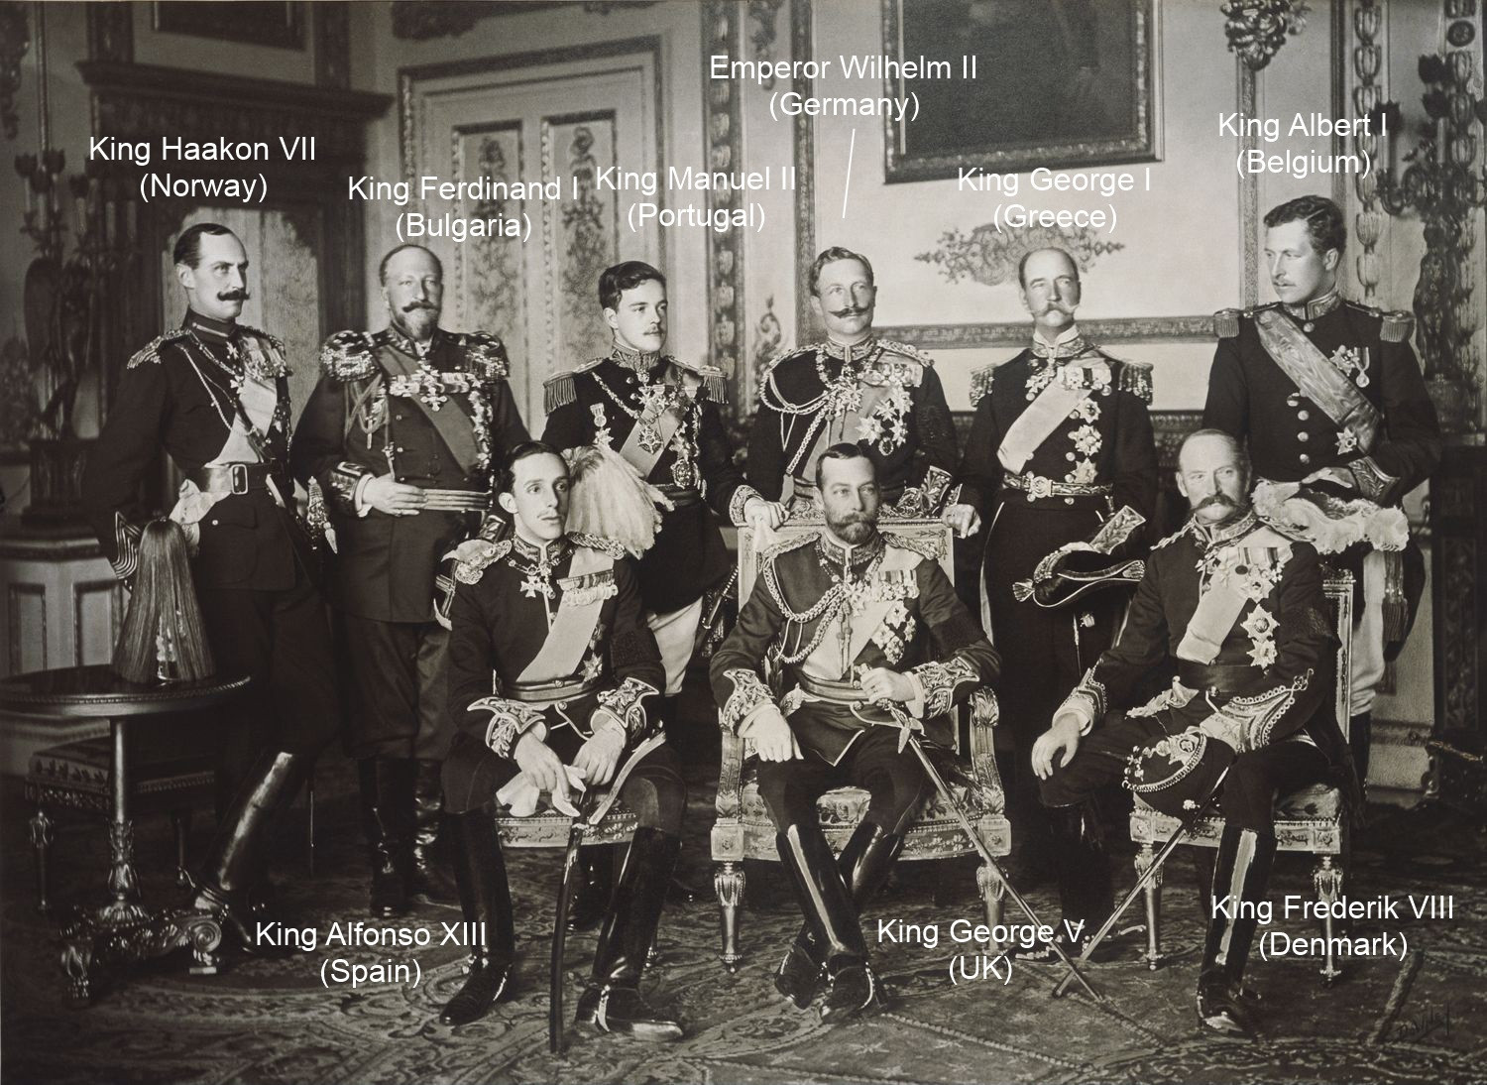
Notes:
Nine European Sovereigns at Windsor for the funeral of King Edward VII in May of 1910, four years before the war began. Standing, from left to right: King Haakon VII of Norway, Tsar Ferdinand of Bulgaria, King Manuel II of Portugal, Kaiser Wilhelm II of the German Empire, King George I of Greece and King Albert I of Belgium. Seated, from left to right: King Alfonso XIII of Spain, King-Emperor George V of the United Kingdom and King Frederick VIII of Denmark. Within the next decade, Kaiser Wilhelm II and Tsar Ferdinand's empires would engage in bloody warfare with the nations led by King Albert I and King George V. The war was also a family affair, as Kaiser Wilhelm II was a first cousin to King George V, and an uncle to King Albert I. Of the remaining monarchs pictured, over the next decade one would be assassinated (Greece), three would keep their nations neutral (Norway, Spain, and Denmark), and two would be forced out of power by revolutions. (W. & D. Downey)

Slide 3
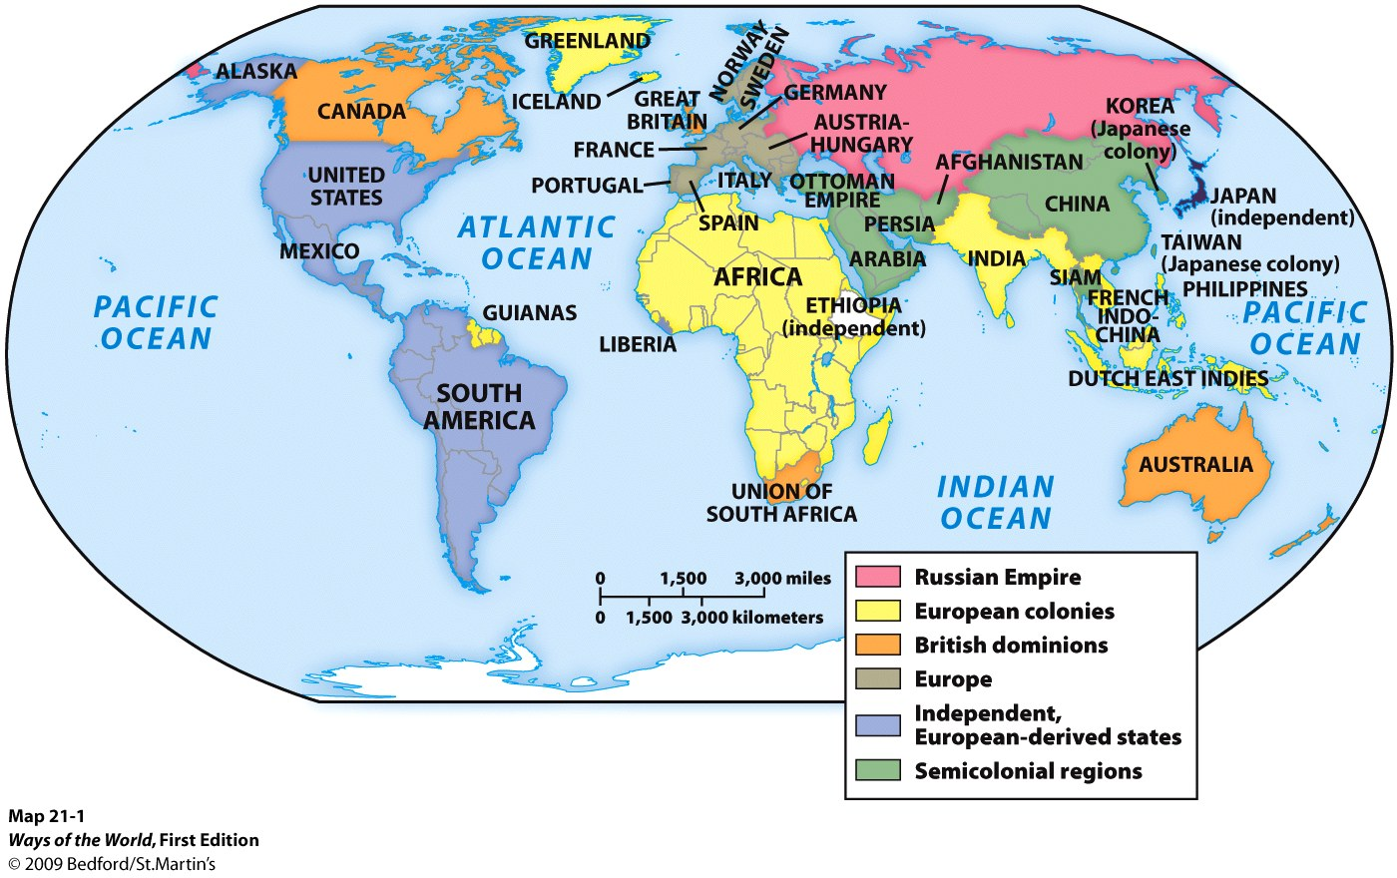
The First World War:
European Civilization in Crisis, 1914–1918
A. By 1900, Europeans, or people of European ancestry, controlled most other peoples of the world.

Slide 4
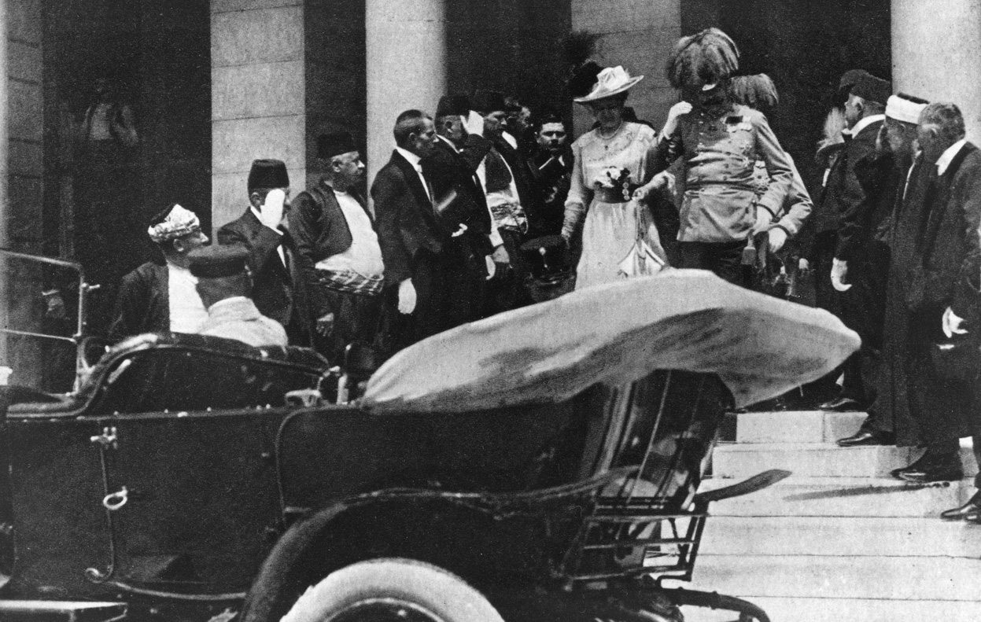
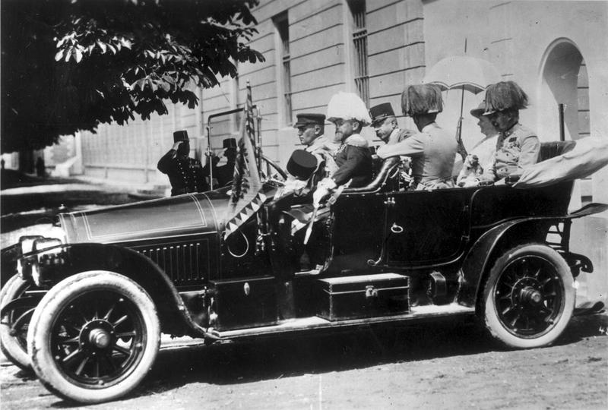
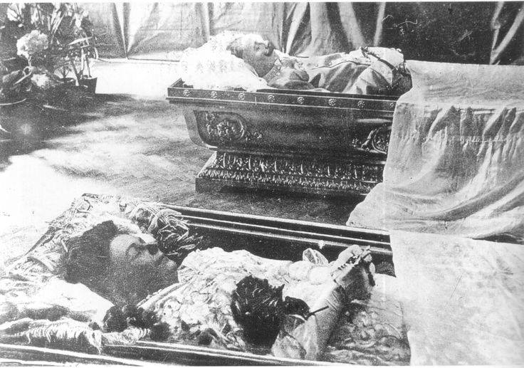
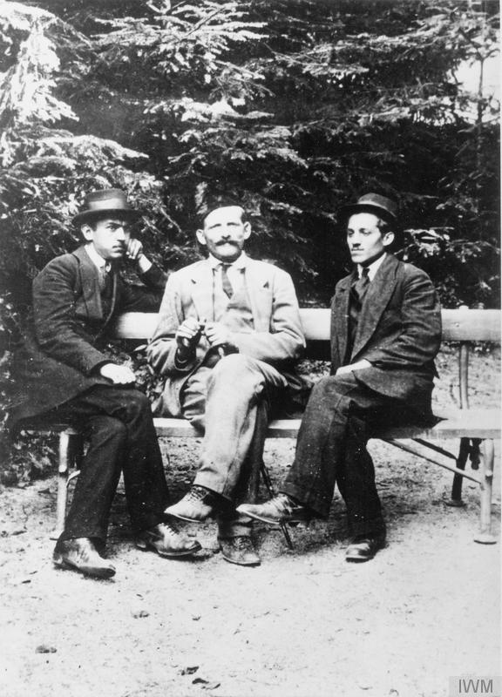
Notes:
Austria-Hungary Empire was large and consisted of many different ethnic groups. Trouble holding them together.
Any provocation the government was swift to take offense and swift to deal with it. Feared a larger revolution from within. It was the second-largest European nation next to Russia and boasted a multi-ethnic population made up of at least ten different nationalities. These included Austrian Germans, Hungarians, Czechs, Slovaks, Poles, Romanians, Italians, Croats and Bosnians among others.
The spark that started World War I was the assassination of Arch Duke Ferdinand and his wife Sophie. The assassination occurred on June 28, 1914 while Ferdinand was visiting the city of Sarajevo in the Austro-Hungarian province of Bosnia-Herzegovina.
Although Archduke Franz Ferdinand, the nephew of Austria's emperor and heir-apparent to the throne, was not very well liked by most, his assassination by a Serb nationalist was viewed as a great excuse to attack Austria-Hungary's troublesome neighbor, Serbia.

Slide 5
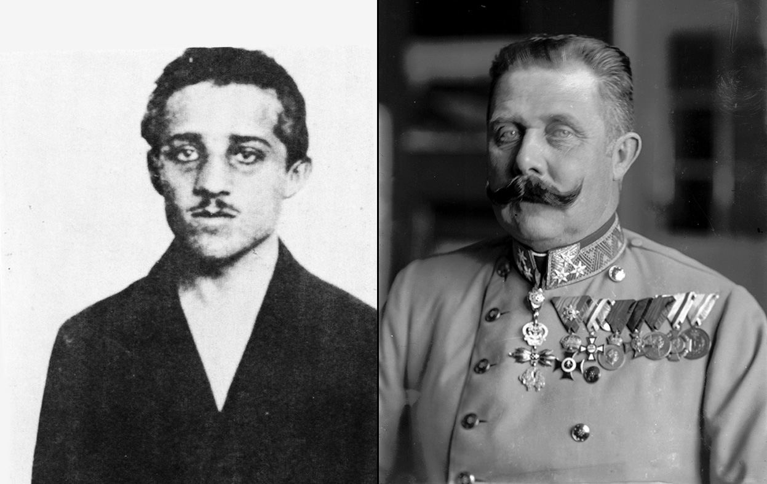
Notes:
However, instead of reacting quickly to the incident, Austria-Hungary made sure they had the backing of Germany, with whom they had a treaty, before they proceeded. This gave Serbia time to get the backing of Russia, with whom they had a treaty.
The calls for back-up didn't end there. Russia also had a treaty with France and Britain.
This meant that by the time Austria-Hungary officially declared war on Serbia on July 28, 1914, an entire month after the assassination, much of Europe had already become entangled in the dispute.

Slide 6
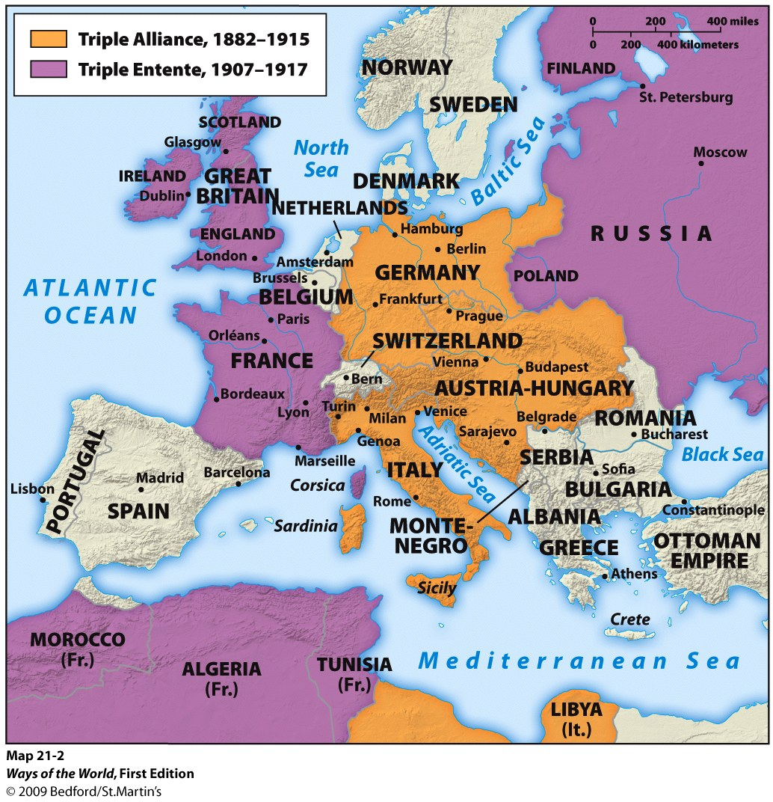
Notes:
Shortly after the assassination, Austria-Hungary issued a list of demands to Serbia, demanding they halt all anti-Austro-Hungarian activity, dissolve certain political groups, remove certain political officers, and arrest those within its borders who participated in the assassination, among other things -- with 48 hours to comply. Serbia, with the backing of their ally Russia, politely refused to fully comply, and mobilized their army. Soon after, Austria-Hungary, backed by their ally Germany, declared war on Serbia on July 28 1914. A network of treaties and alliances then kicked in, and within a month's time, Germany, Austria-Hungary, Russia, France, Britain, and Japan had all mobilized their armies and declared war. In this photo, taken in August of 1914, Prussian guard infantry in new field gray uniforms leave Berlin, Germany, heading for the front lines. Girls and women along the way greet and hand flowers to them. (AP Photo) #
However, instead of reacting quickly to the incident, Austria-Hungary made sure they had the backing of Germany, with whom they had a treaty, before they proceeded. This gave Serbia time to get the backing of Russia, with whom they had a treaty.
The calls for back-up didn't end there. Russia also had a treaty with France and Britain.
This meant that by the time Austria-Hungary officially declared war on Serbia on July 28, 1914, an entire month after the assassination, much of Europe had already become entangled in the dispute.
Russia wanted to be part of Europe but has always felt a little left out. So they wanted a cause, they decided to be the saviors of the Slavs. When Serbia came calling they were more than willing to back them

Slide 7
Notes:
World War I was not an American war. It does not register to Americans like the Civil War, the Revolutionary War or World War II.
In Europe World War I was obviously huge and still resonates to this day.
The Us enter fairly late but made a huge impact at the most crucial time.
Russia out in 1917/transfer all German troops to the West for a decisive offensive in 1918.
History of competition + Industrial capacity of the Industrial Revolution + new Technology

Slide 8
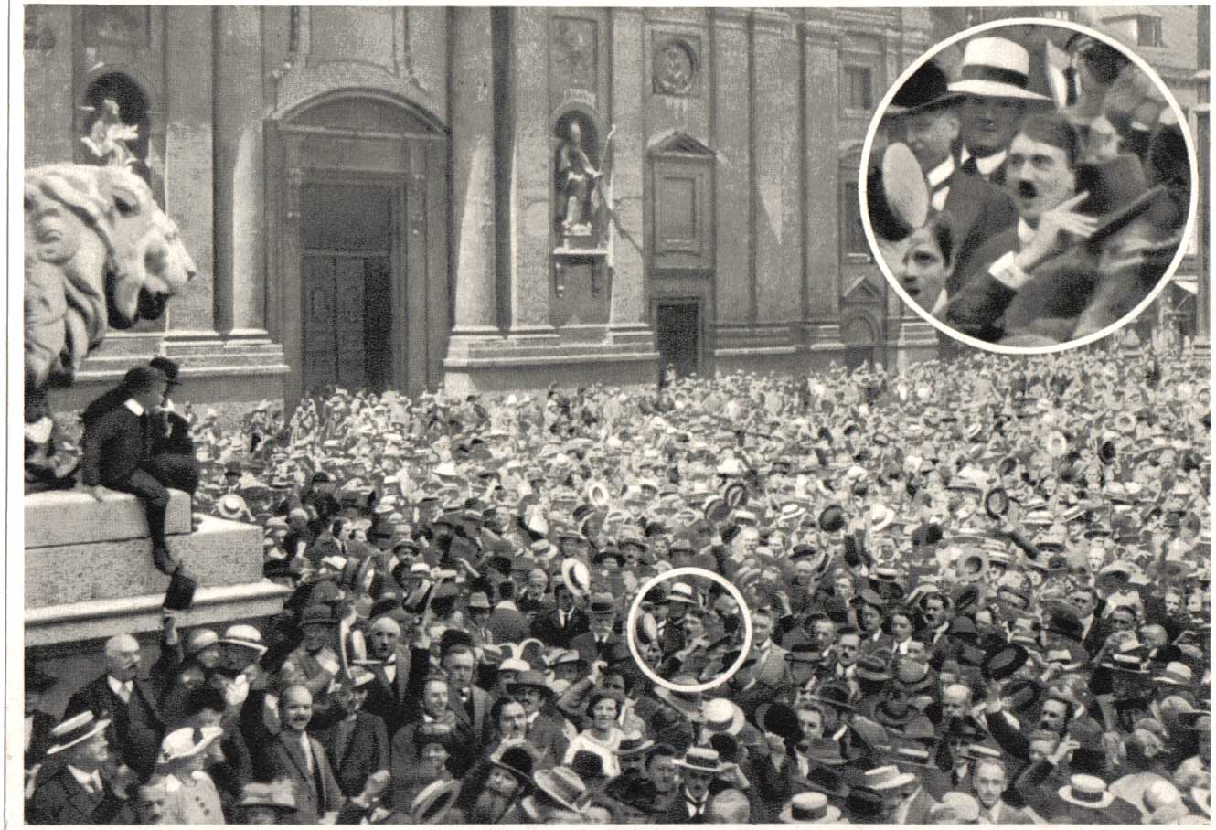

Slide 9
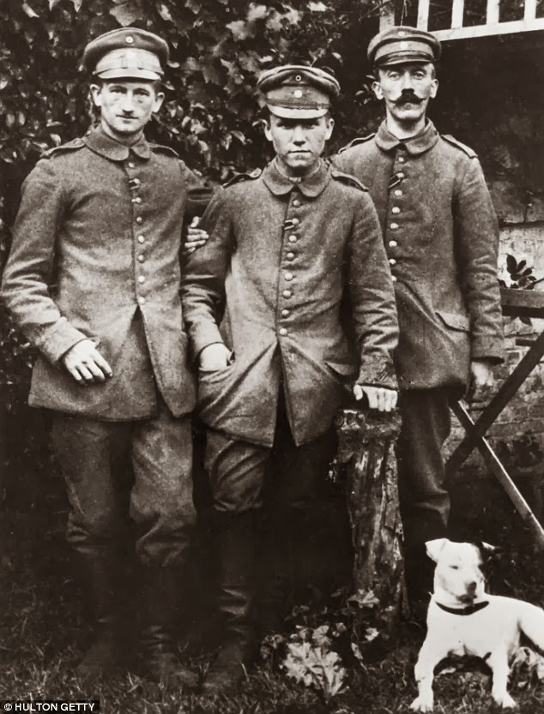

Slide 10
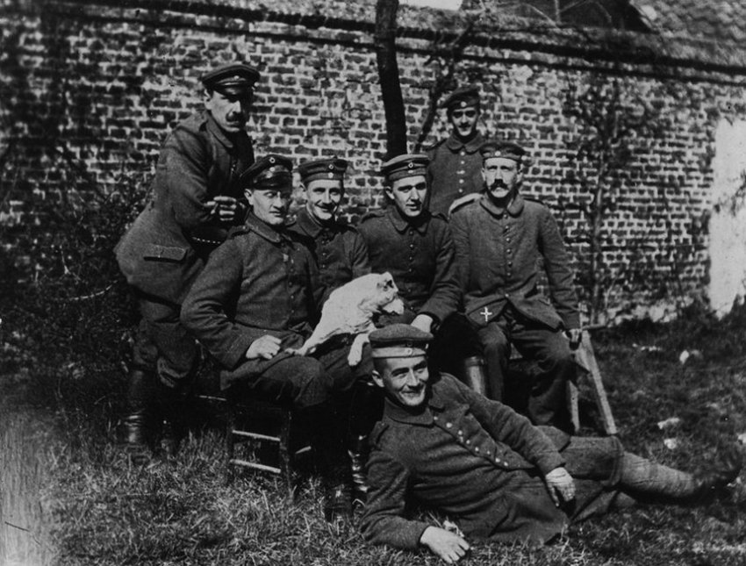

Slide 11
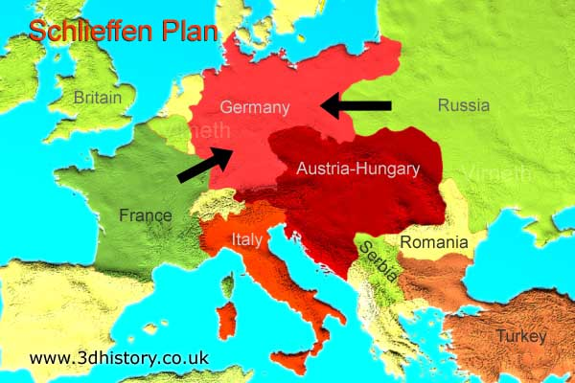

Slide 12
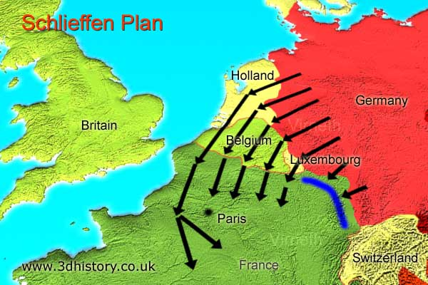

Slide 13
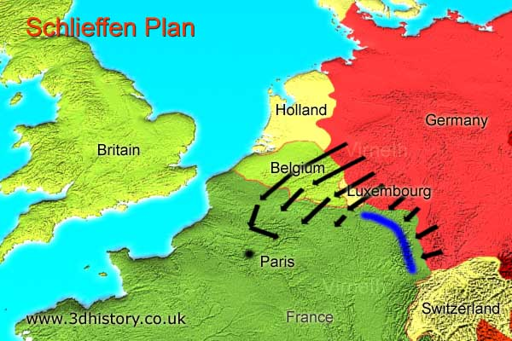
Notes:
French had been falling back for 10 days,
Attack plan 17
Paris Defense Minister ordered two corps to come back and defend Paris.
French attacked, Germans order the left turn to relieve the pressure from the attack.
Left the left flank exposed,
Battle of the Marne
The next 4 years would be Trench Warfare (Battle of Attrition)

Slide 14
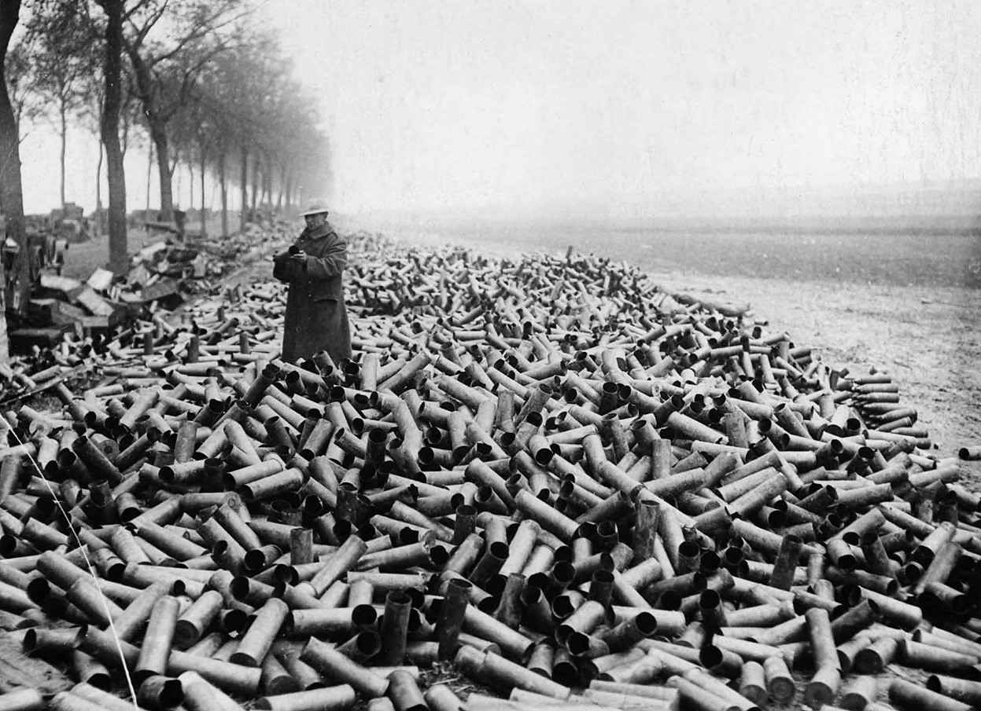
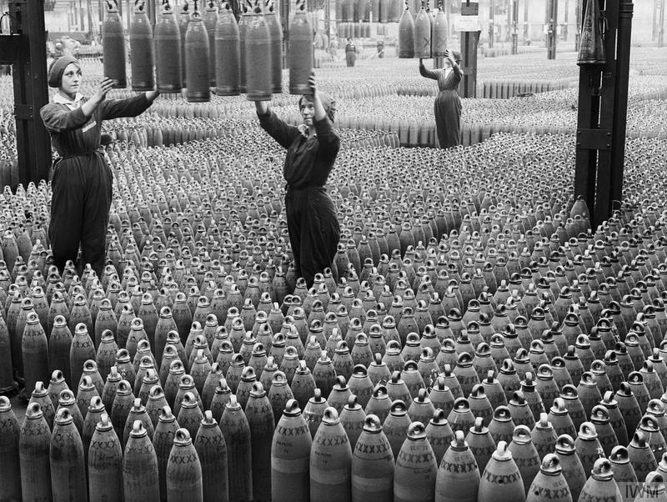

Slide 15
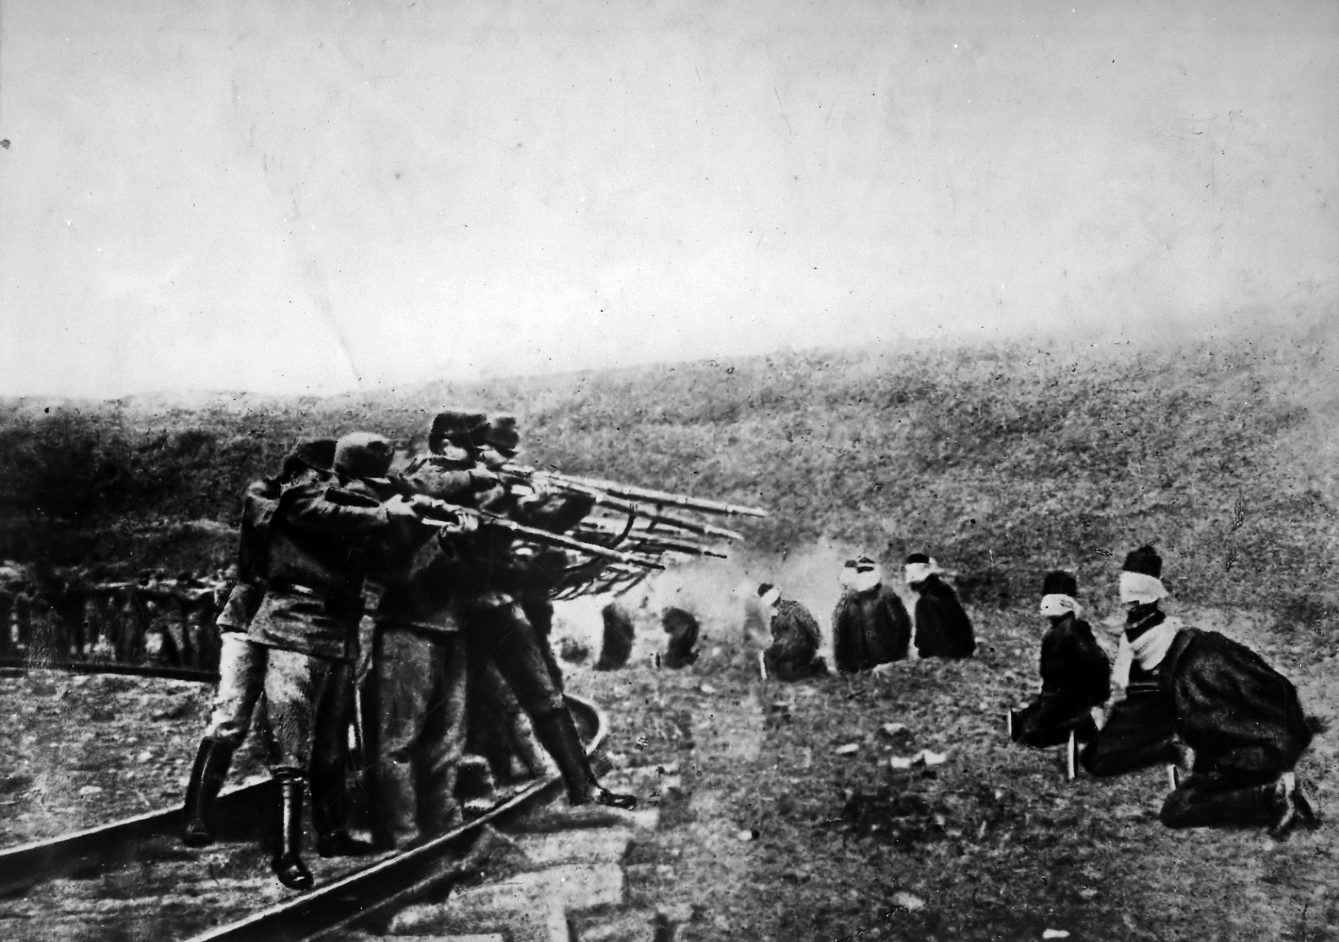

Slide 16
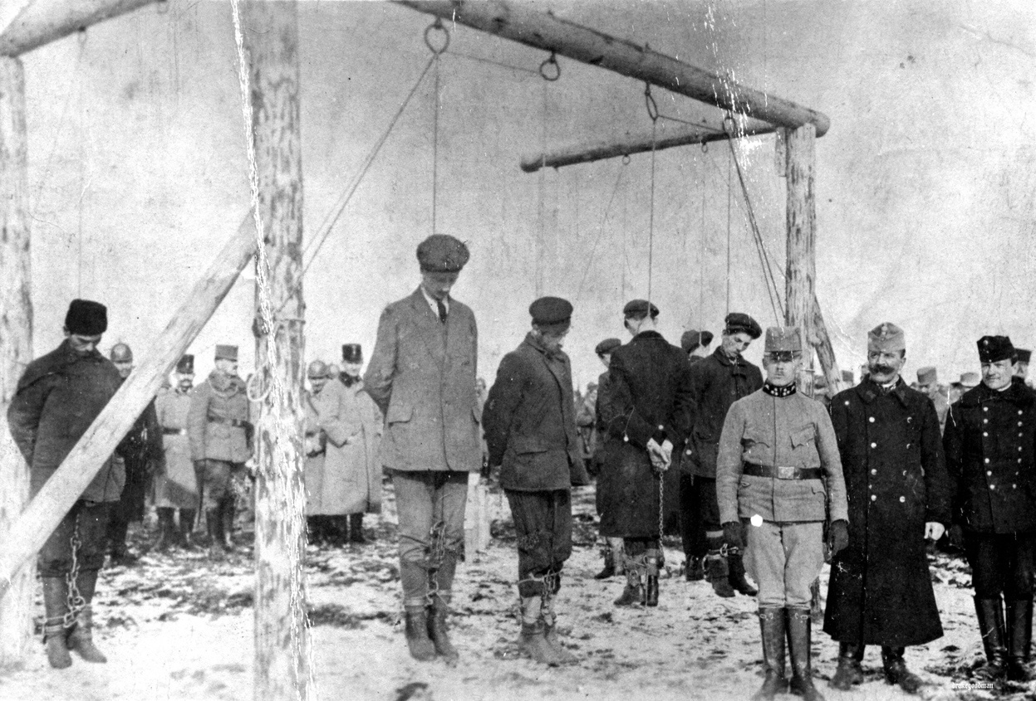
Notes:
Austro-Hungarian troops executing Serbian civilians, likely ca. 1915. Serbians suffered greatly during the war years, counting more than a million casualties by 1918, including losses in battle, mass executions, and the worst typhus epidemic in history

Slide 17
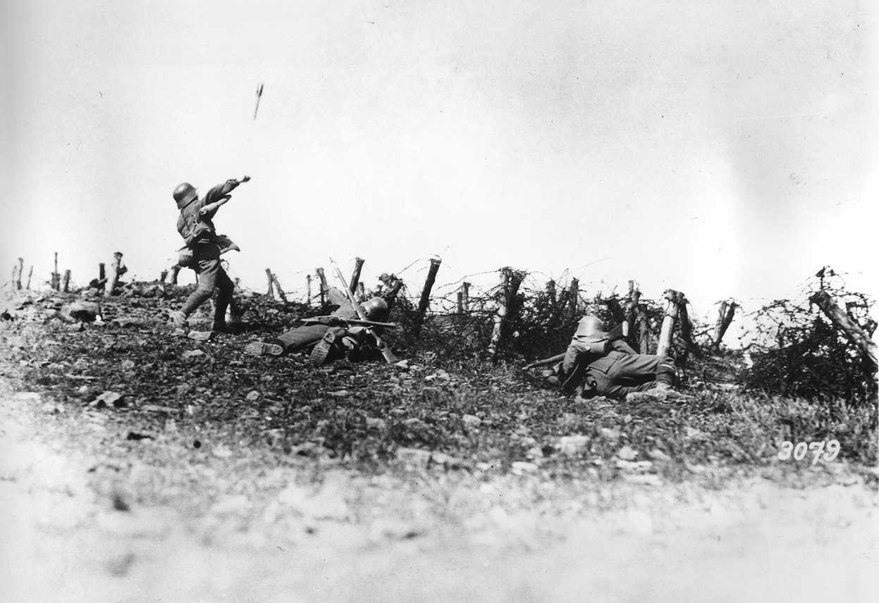

Slide 18
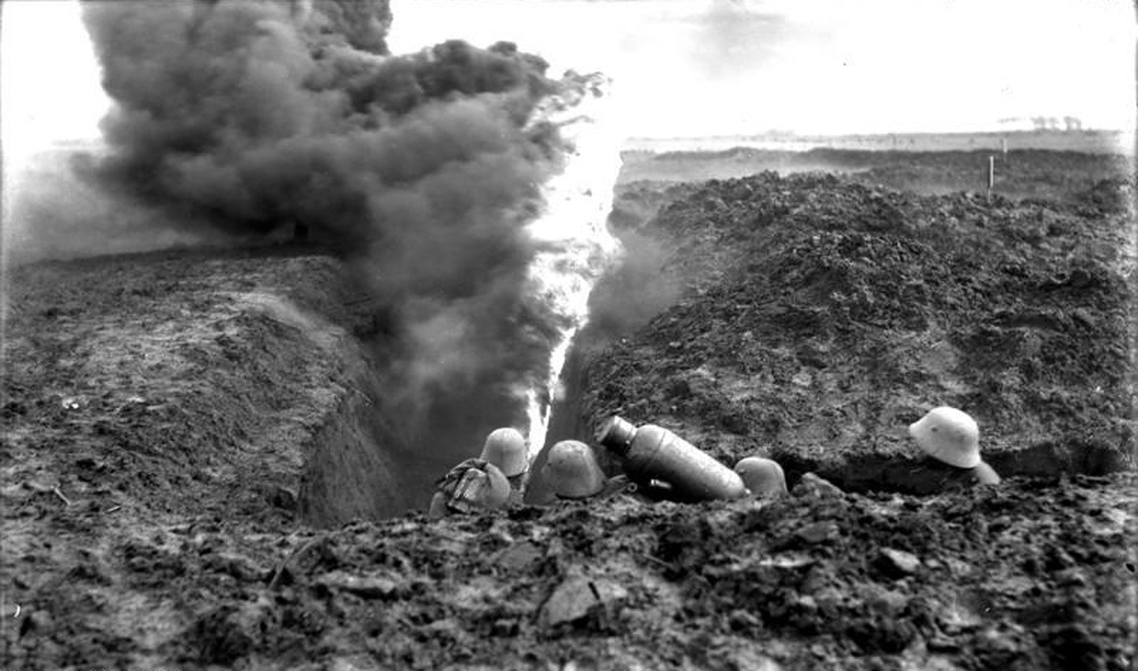

Slide 19
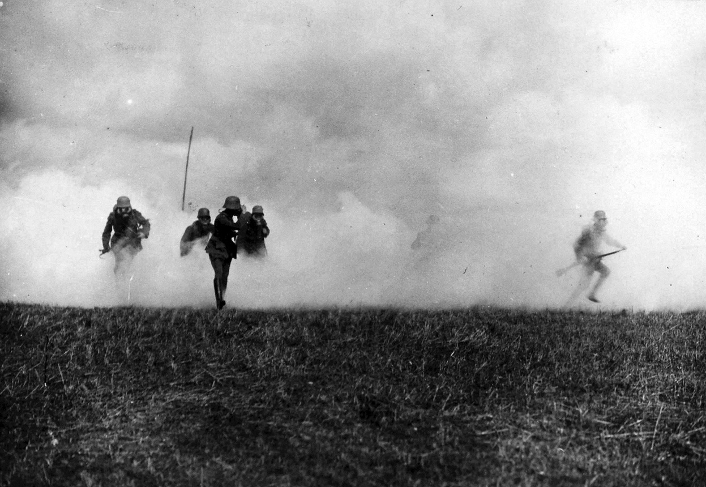

Slide 20
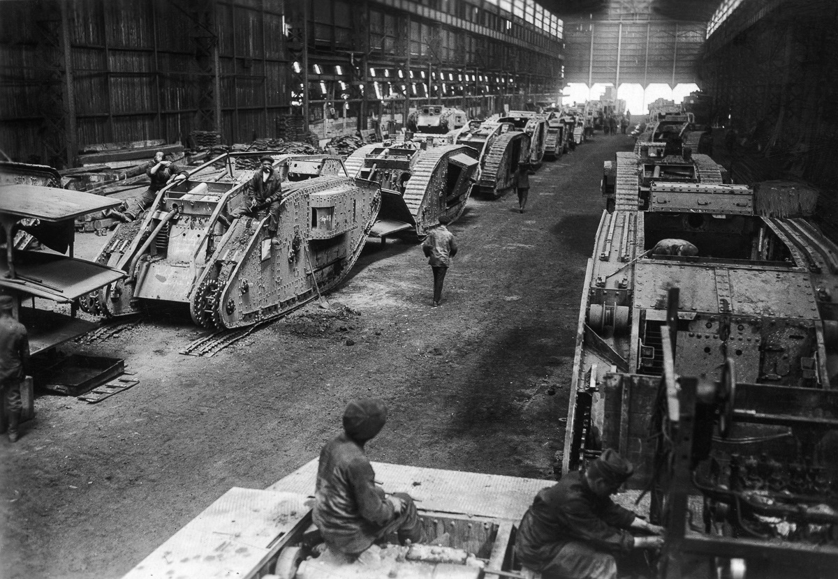
Notes:
Tanks

Slide 21
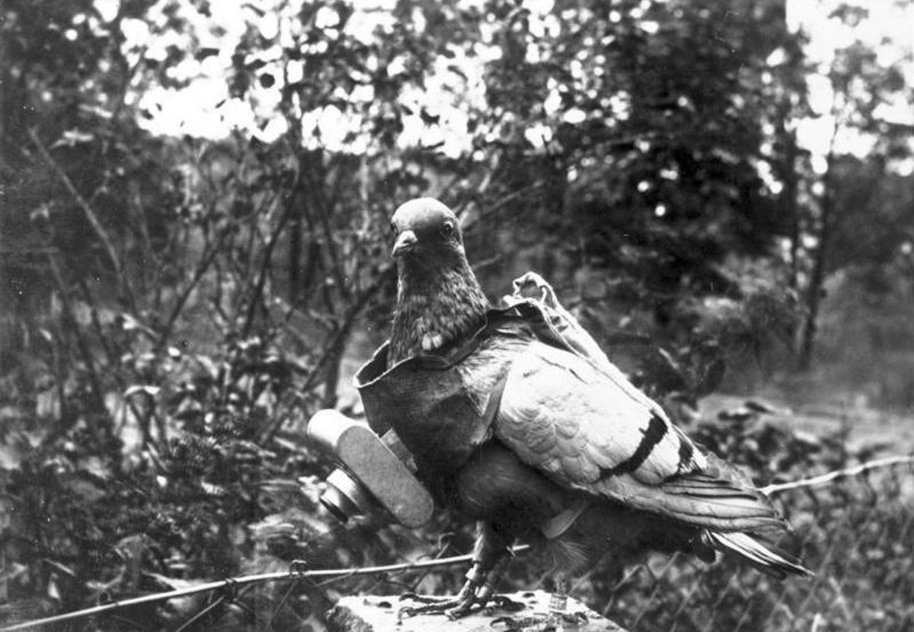
Notes:
Surveillance technology

Slide 22
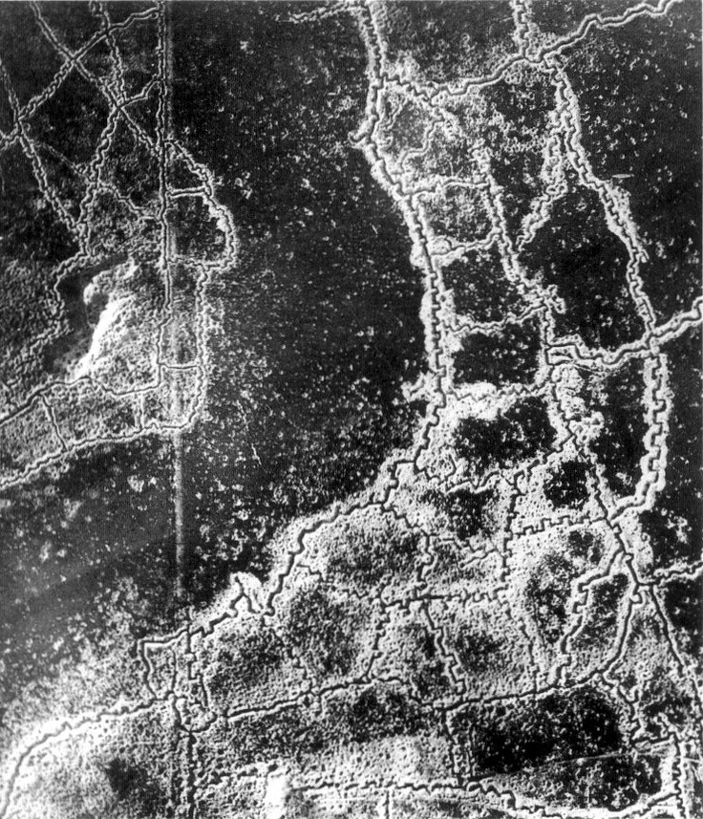

Slide 23
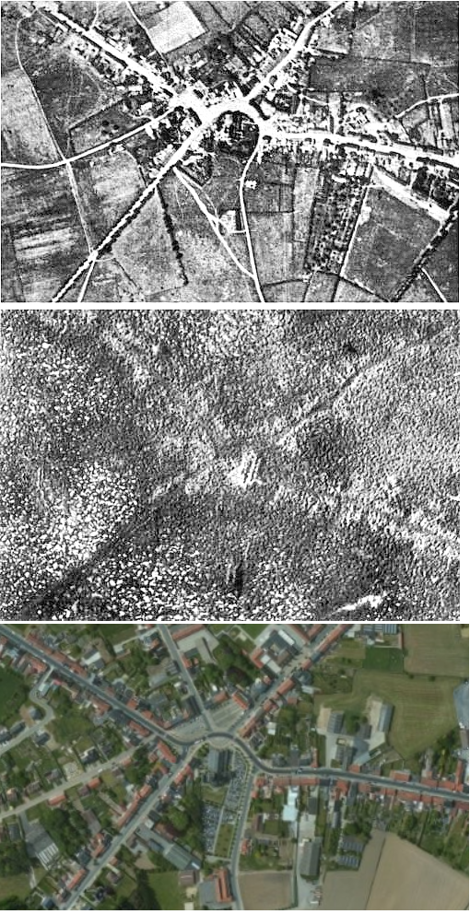

Slide 24
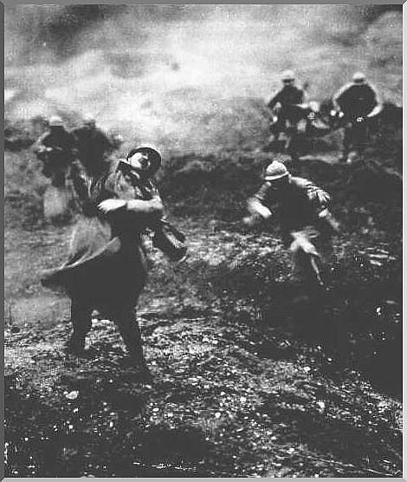

Slide 25
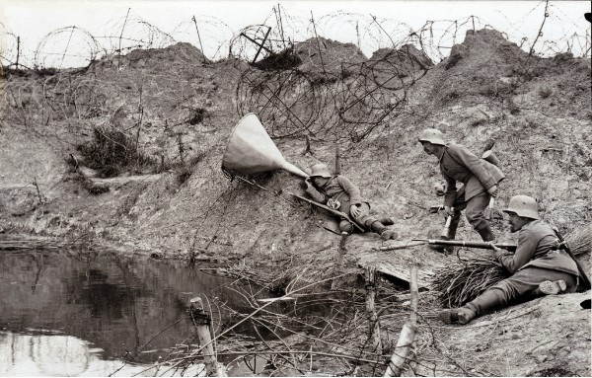
Notes:
Advanced hearing technology

Slide 26
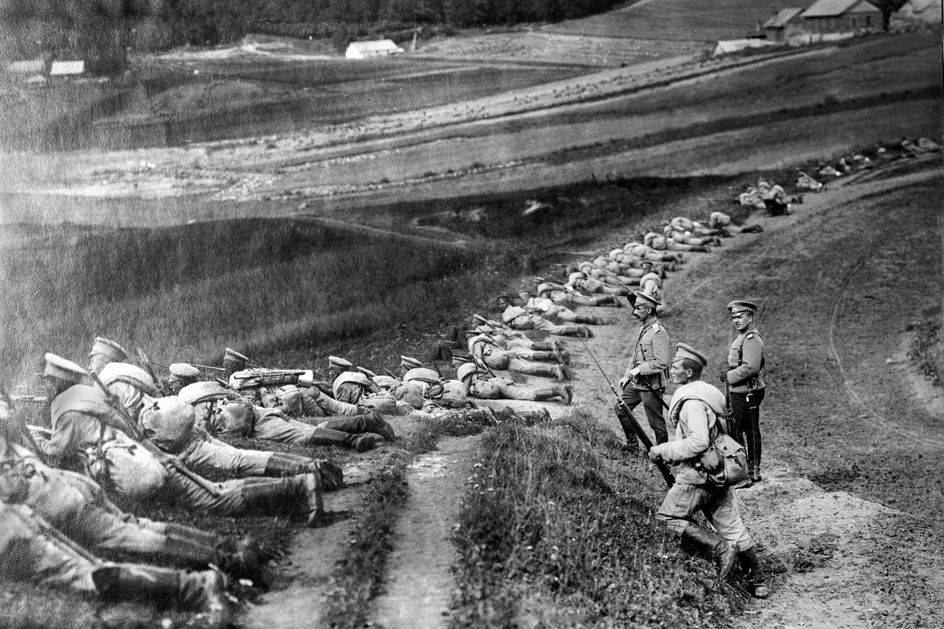
Notes:
Russian Troops

Slide 27
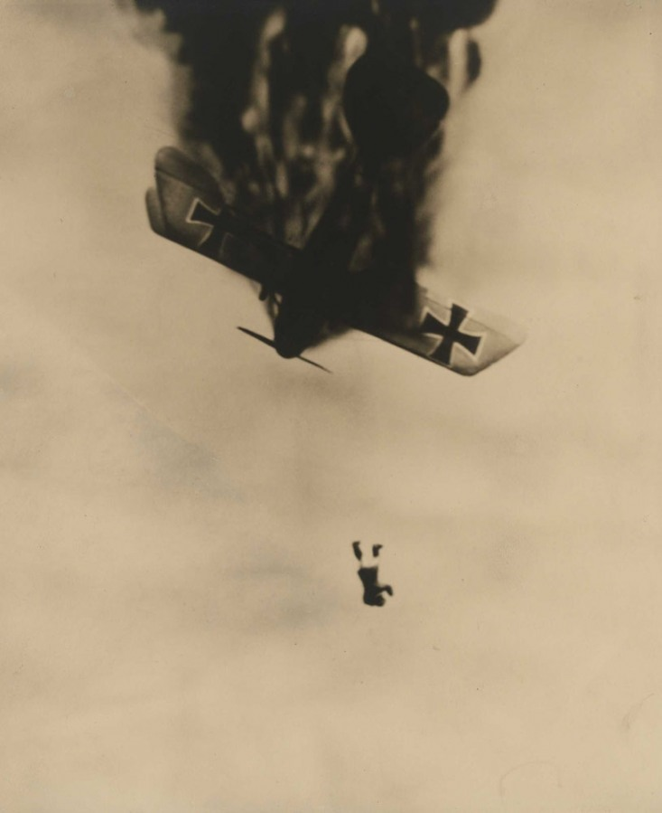
Notes:
Airplanes

Slide 28
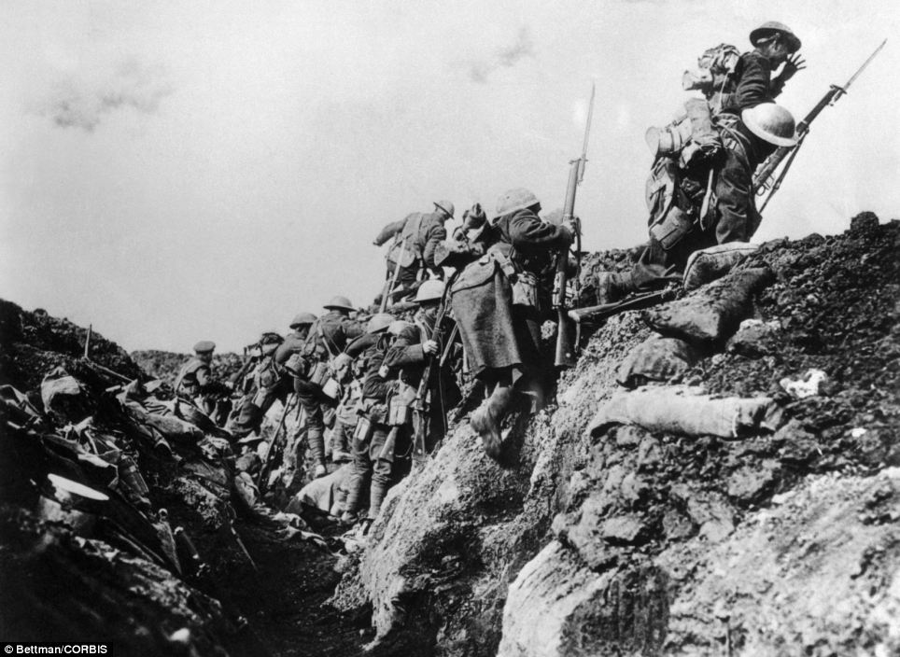
Notes:
Over the top

Slide 29
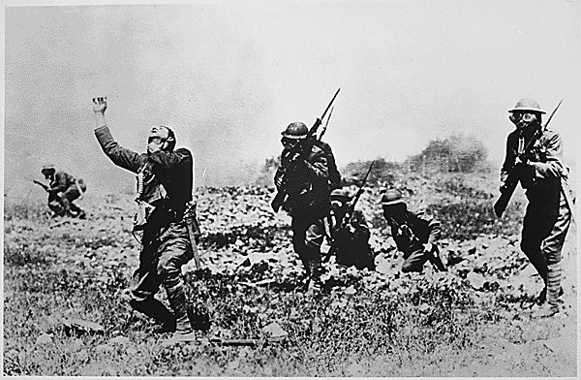

Slide 30
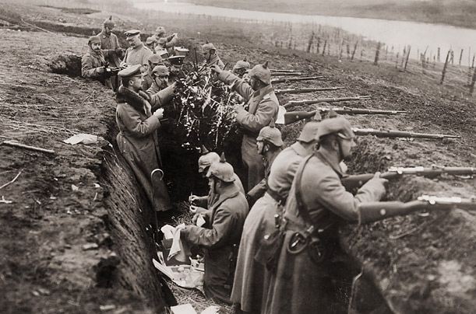
Notes:
Russian Troops

Slide 31
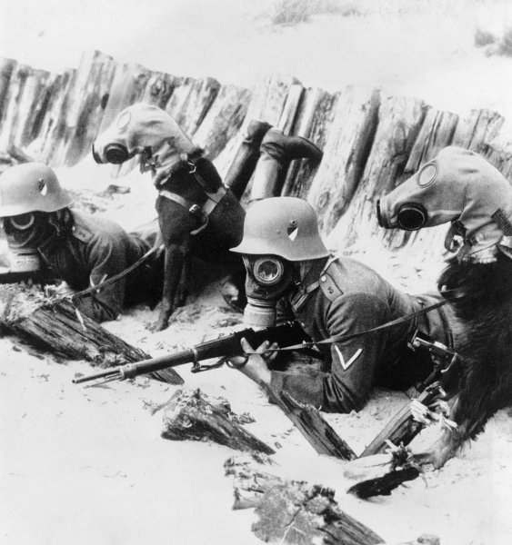
Notes:
Poison Gas

Slide 32
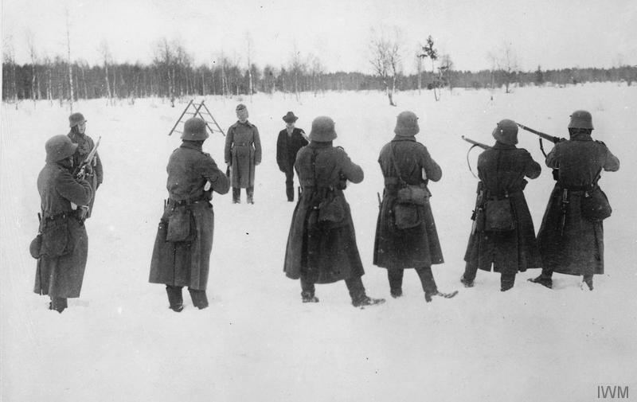

Slide 33
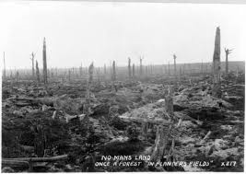
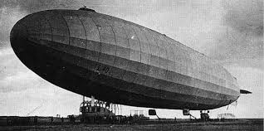
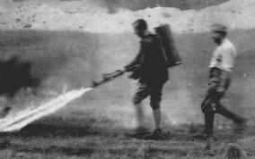
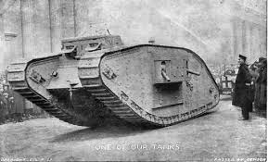
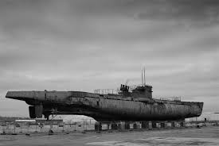
No Man’s Land…
Zeppelins
Tanks
Flame Throwers
U-Boats

Slide 34
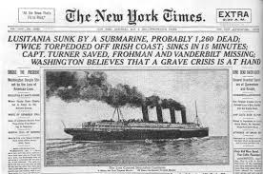
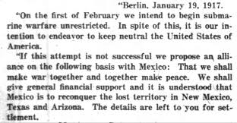
A Turning Point: The U.S. Enters the War
Unrestricted submarine (U-Boat) warfare
Lusitania
Zimmerman Note
Notes:
Unrestricted submarine (U-Boat) warfare
Lusitania
Zimmerman Note
Germans paid for and transported Vladimir Lenin to Russia to cause problems
Russia withdrew after the Communist Revolution in 1917
Successful Blockade of Germany

Slide 35
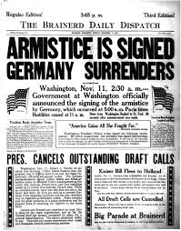
Notes:
11.11 at 11:00 PM

Slide 36
Losses in WWI
 | Deaths | Wounded
France | 1,300,000 | 4,000,000
Great Britain | 908,000 | 2,000,000
Russia | 1,7000,000 | 4,950,000
United States | 50,000 | 205,000
Germany | 1,800,000 | 4,250,000
Austria/Hungary | 922,000 | 3,600,000
Italy | 462,000 | 953,000
Direct Costs: $180 Billion Property Loss: $150 Billion

