Slide 1
Ways of the World: A Brief Global History First Edition
Robert W. Strayer
CHAPTER XXIII
Independence and Development
in the Global South
1914–Present

Slide 2
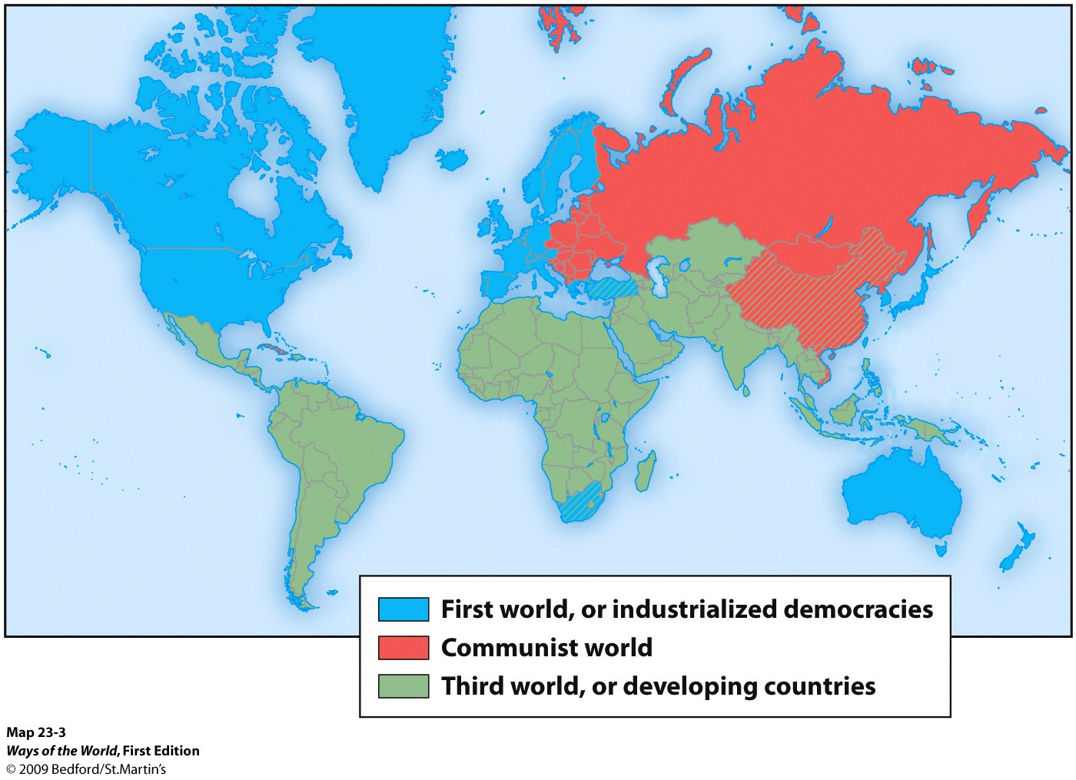
Toward Freedom:
Struggles for Independence

Slide 3
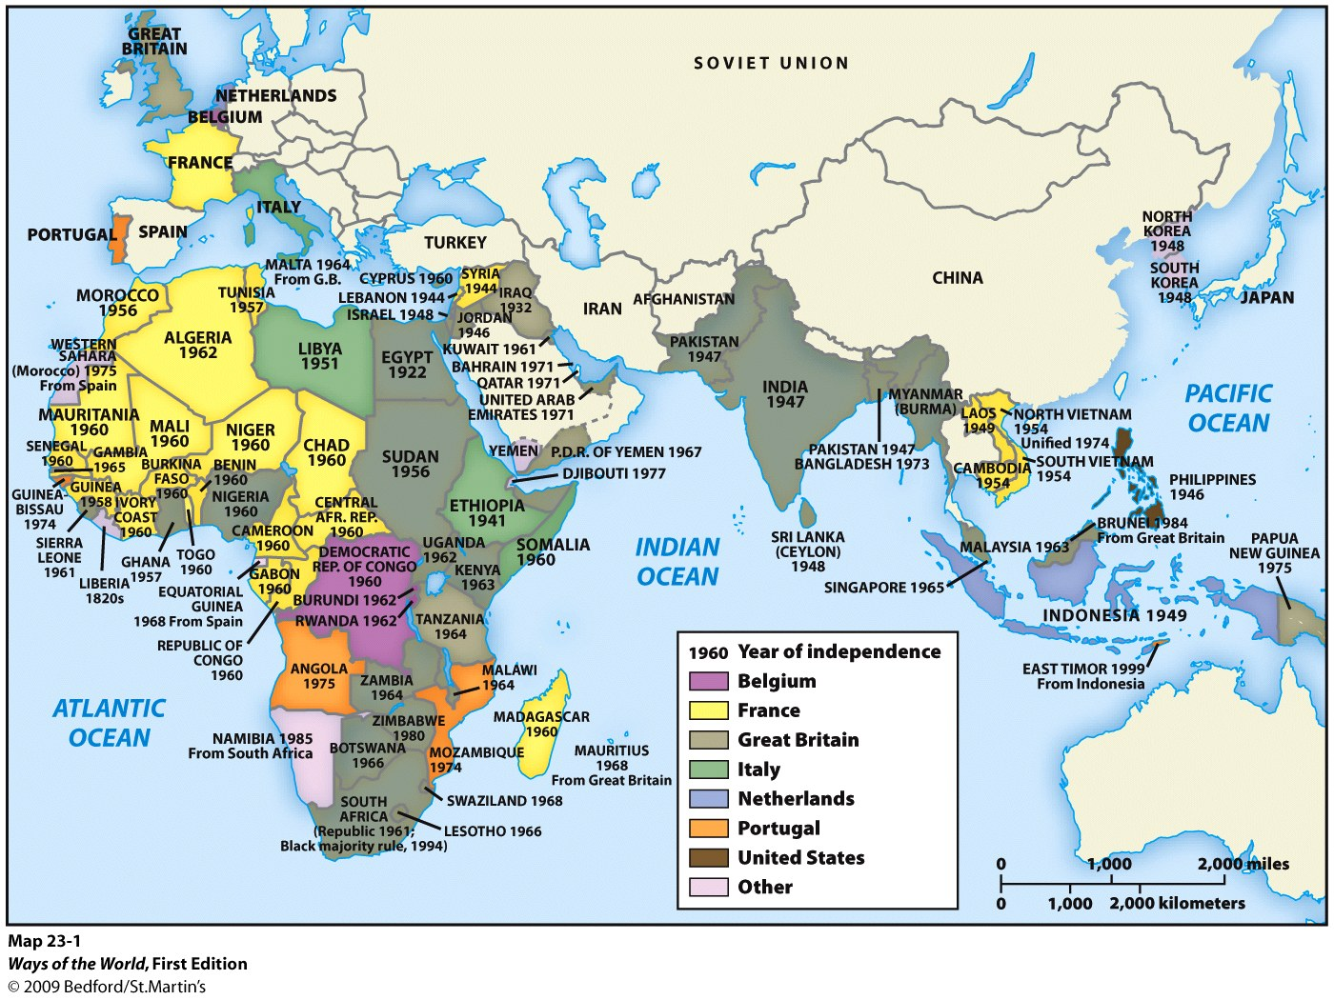
The End of Empire in World History
1. India, Pakistan, Burma, Indonesia, Syria, the Philippines, Iraq, Jordan, and Israel won independence in the late 1940s
2. African independence came between mid-1950s and mid-1970s

Slide 4
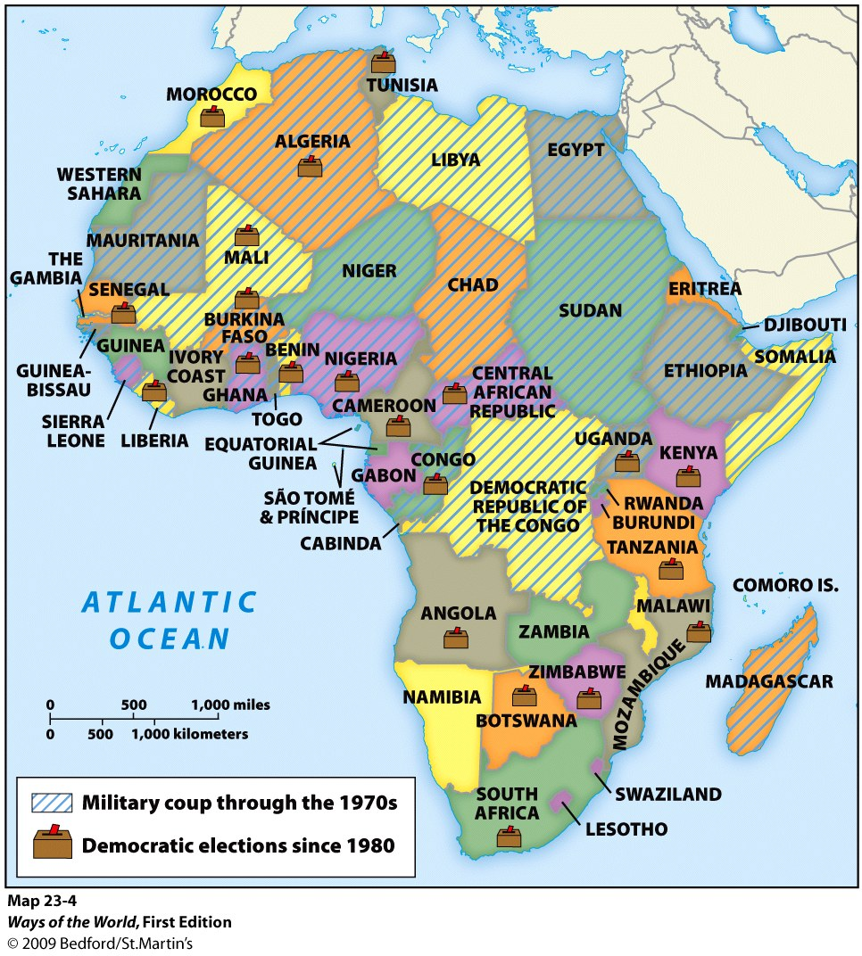

Slide 5
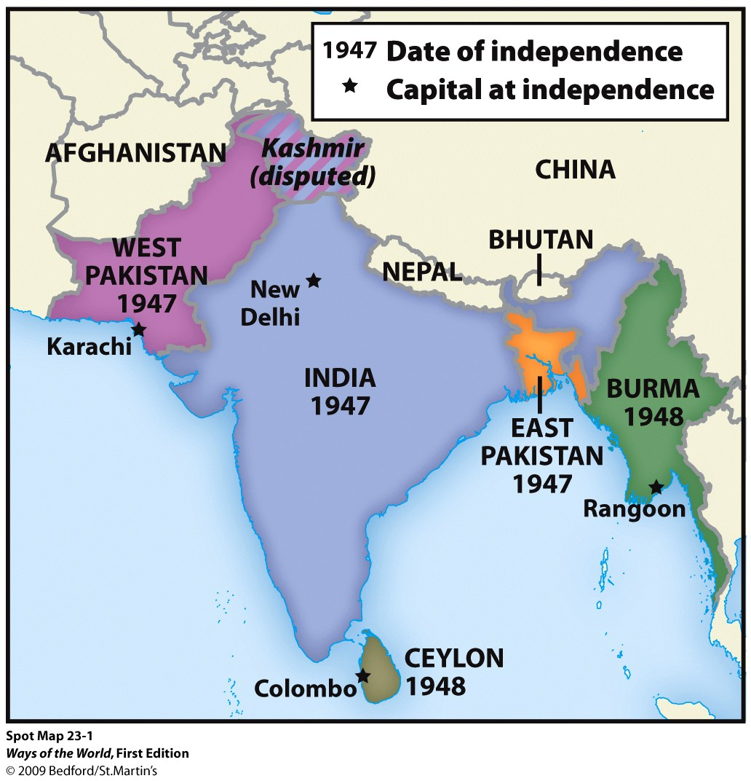

Slide 6
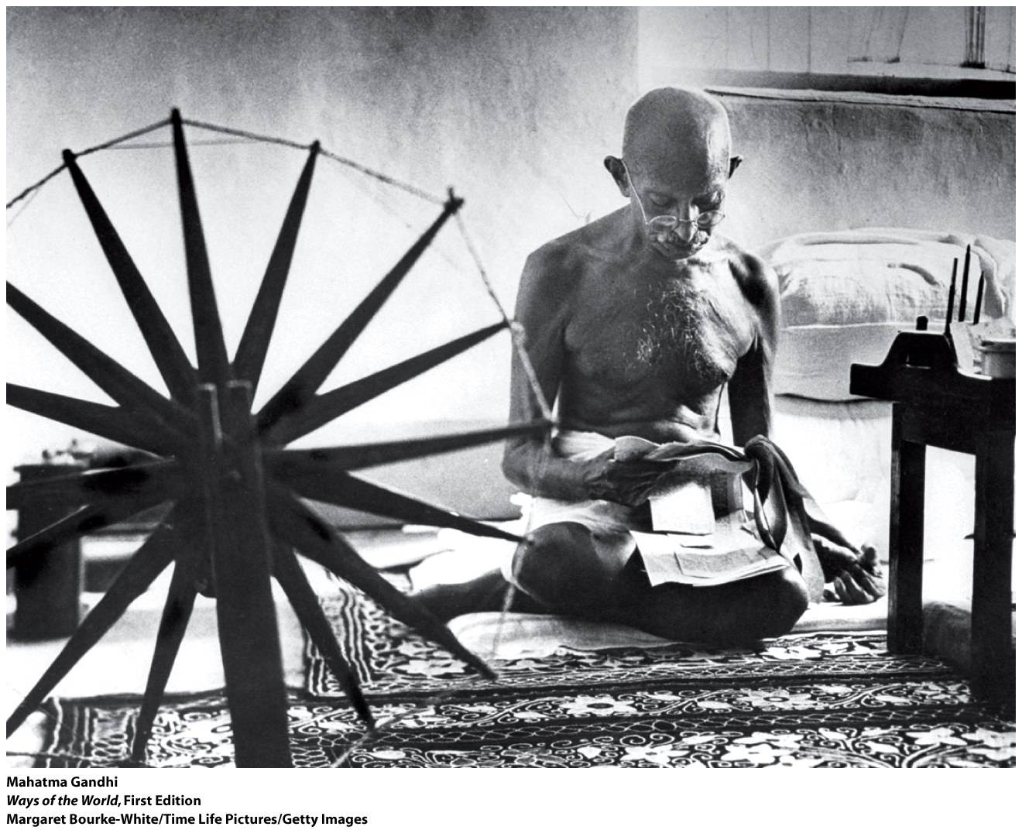
Comparing Freedom Struggles
Notes:
the role of Mohandas Gandhi (1869–1948)
a. had studied law in England but wasn’t a very successful lawyer
b. in 1893, took a job in South Africa , where he joined the fight against racial segregation
c. developed the political philosophy of satyagraha (truth force), a nonviolent approach to political action
d. back in India , Gandhi became a leader of the INC
e. attacked not just colonial rule but also mistreatment of India ’s untouchables and the evils of modernization
5. not everyone agreed with Gandhi
a. especially important was a growing Muslim/Hindu divide
b. 1906: creation of an All-India Muslim League
c. some Hindu politicians defined the nationalist struggle in religious terms
d. Muhammad Ali Jinnah, head of the Muslim League, argued that regions of India with a Muslim majority should be a separate state ( Pakistan , the land of the pure)
6. independence in 1947 created two countries
a. Pakistan (Muslim, divided into two wings 1,000 miles apart)
b. India (secular but mostly Hindu)
c. process was accompanied by massive violence; some 1 million died, 12 million refugees relocated
7. 1948: a Hindu extremist assassinated Gandhi

Slide 7
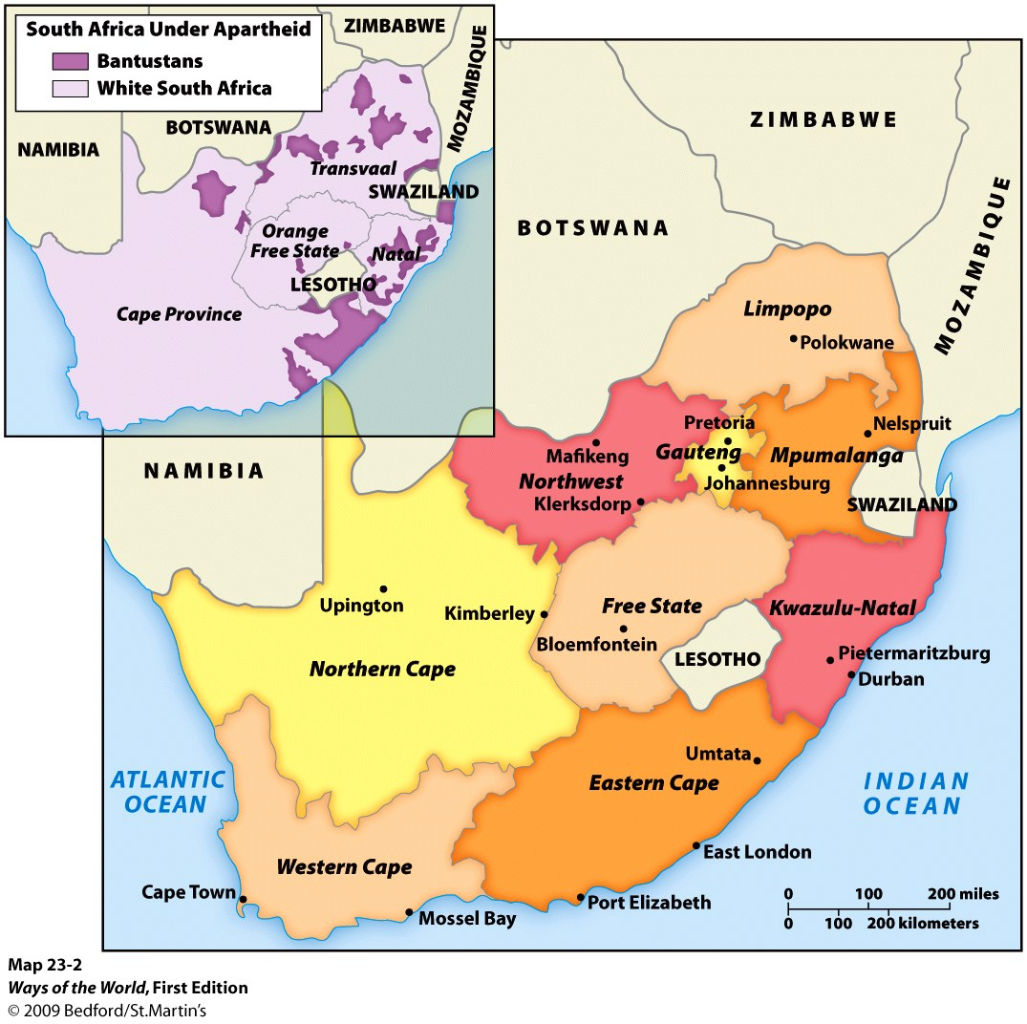
The End of Empire in World History
Fall of many empires in the twentieth century
- Austrian and Ottoman empires collapsed in the wake of World War I
- Russian Empire collapsed but was soon recreated as the USSR
- German and Japanese empires ended with World War II
- disintegration of the USSR (1991) was propelled by national self-determination (creation of 15 new states)
Notes:
1. South Africa won freedom from Great Britain in 1910
2. but its government was controlled by a white settler minority
3. white population was split between British descendants (had economic superiority) and Afrikaners (Boers) of Dutch descent (had political dominance)
a. Afrikaners had failed to win independence from the British in the Boer War (1899–1902)
b. both white groups felt threatened by any move toward black majority rule
4. by the early 1900s, South Africa had a mature industrial economy
a. by the 1960s, had major foreign investments and loans
b. black South Africans were extremely dependent on the white-controlled economy
5. the issue of race was overwhelmingly prominent
a. policy of apartheid tried to keep blacks and white completely separate, while retaining black labor power
b. enormous repressive powers enforced social segregation
6. African National Congress (ANC) founded in 1912
a. like India ’s INC, it consisted of elite Africans who wanted a voice in society
b. for 40 years, the ANC was peaceful and moderate
c. 1950s: moved to nonviolent civil disobedience
d. the government’s response was overwhelming repression
e. ANC was banned and its leadership imprisoned
underground nationalist leaders turned to sabotage and assassination
a. opposition came to focus on student groups
b. Soweto uprising (1976) was the start of spreading violence
c. organization of strikes
8. growing international pressure
a. exclusion from international sporting events
b. economic boycotts
c. withdrawal of private investment funds
9. negotiations began in the late 1980s
a. key apartheid policies were abandoned
b. Mandela was freed and the ANC legalized
10. 1994: national elections brought the ANC to power
a. apartheid was ended without major bloodshed
b. most important threat was a number of separatist and “Africans only” groups

Slide 8
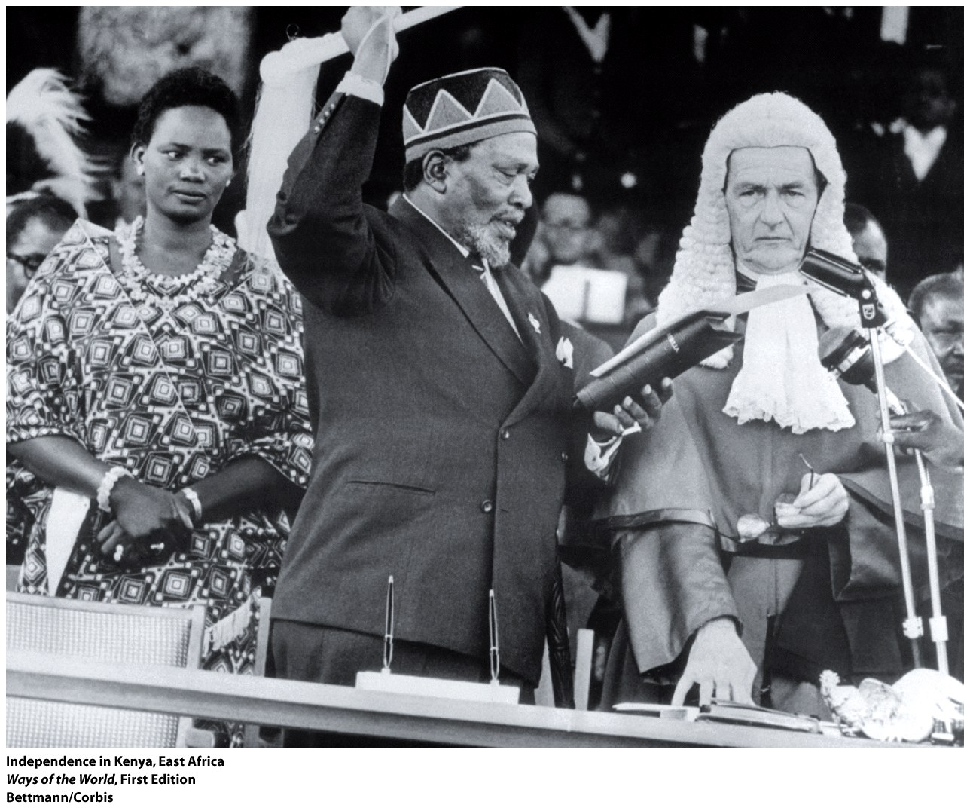
The Case of South Africa: Ending Apartheid
7. underground nationalist leaders turned to sabotage and assassination
a. opposition came to focus on student groups
b. Soweto uprising (1976) was the start of spreading violence
c. organization of strikes
8. growing international pressure
a. exclusion from international sporting events
b. economic boycotts
c. withdrawal of private investment funds
9. negotiations began in the late 1980s
a. key apartheid policies were abandoned
b. Mandela was freed and the ANC legalized
10. 1994: national elections brought the ANC to power
a. apartheid was ended without major bloodshed
b. most important threat was a number of separatist and “Africans only” groups

Slide 9
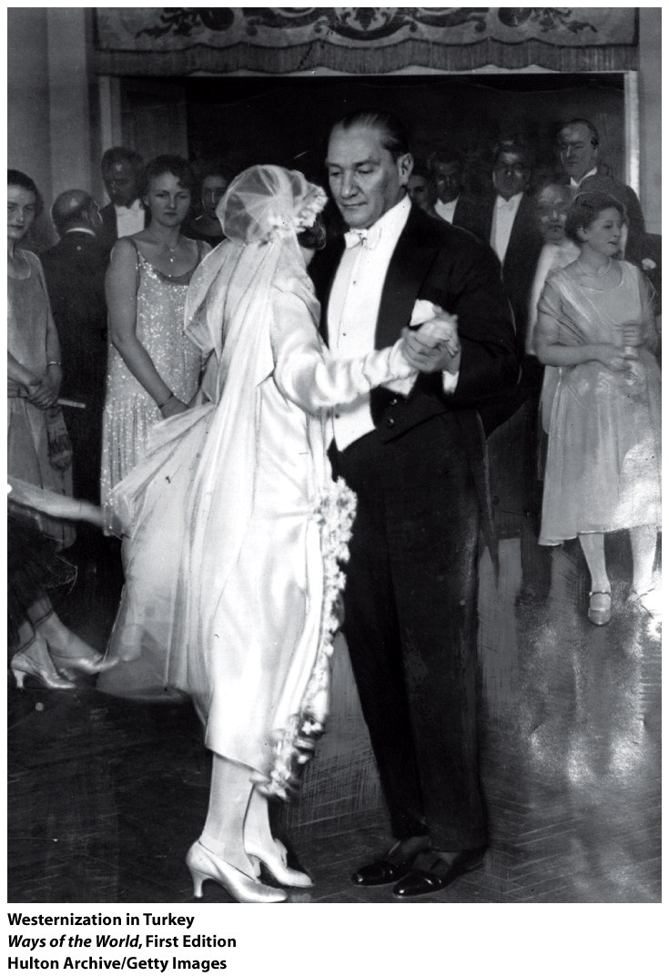
Experiments with Culture: The Role of Islam in Turkey and Iran
- The relationship between Western-style modernity and tradition has been an issue across the developing world
- The case of Islam: Turkey and Iran approached the issue of how Islam and modernity should relate to each other very differently

Slide 10
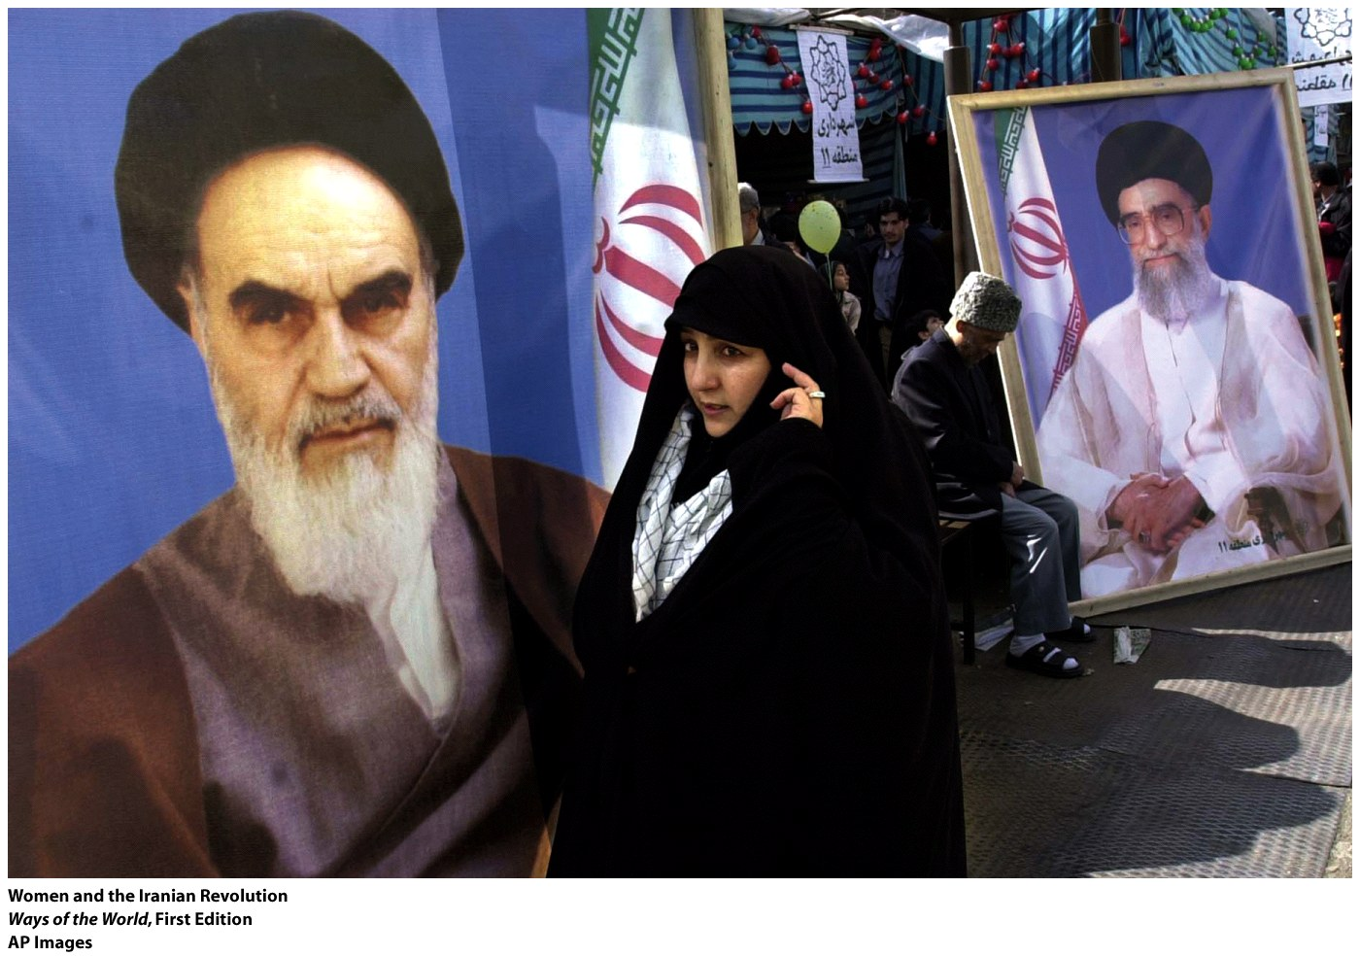
Experiments with Culture: The Role of Islam in Turkey and Iran
Iran : became the center of Islamic revival (1970s)
- growing opposition to Shah Mohammad Reza Pahlavi’s modernizing, secularizing, U.S.-supported government
- many of the shah’s reforms offended traditional Islamic practices
- the mosque became the main center of opposition to the government
- The shah was forced to abdicate in 1979, and the Ayatollah Khomeini assumed control of the state
- The Islamic revolution moved Iran towards Islamization of public life

